Slide 1
Lab 5 10/09/2020 Psychometrics and Measuring What Matters
stacked presentation with new slides added to the end

Slide 3
Measurement and measures
Objectives:
Understand what statistics is
Define types of measures and levels of measurement
Discuss main types of statistical analyses

Slide 4
What is Statistics
Statistics is how one approaches data
Collection
Quantitative (numerical)
Qualitative (text)
Organization
Analysis
Interpretation
Two types of statistics
Descriptive Statistics
Organizing, picturing, summarizing information from data
Inferential statistics
Using information from a sample to draw conclusions about the population

Slide 5
Statistics Evaluates
Study participants
Data= Variables of interest
People or objects included in the study
Population data
Census
Subpopulation
Sample data
Convenience Sample
Random Sample (Equal probability of being selected)
Stratified
Systematic
Cluster
Randomized Controlled Sample
Simulation Data
Characteristics of the participant to be measured or observed
Quantitative: numerical values
Age
Qualitative: descriptive qualities
Race, sex

Slide 6
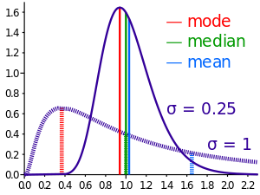
Levels of Measurement
Types of Variables
Key Measurement
Continuous (infinite count)
Interval (No zero or no starting point)
Temperature, Calendar dates
Ratio (True zero or starting point, ratios have meaning)
Time elapsed
Discrete (finite/limited count)
Ex: age in years, time in minutes
Categorical
Nominal (no order)
Ex: colors
Ordinal (ordered but difference in levels are meaningless)
Ex: Some high school, HS graduate, college graduate, professional degree
Binary
Dichotomous
Ex: No/Yes or 0/1 values
Mean
Average
Median
Half-way point
Mode
Most frequent response
Range
Difference between lowest and highest values

Slide 7
Types of Statistical Analyses
Descriptive Statistics
Totals (min/max)
Averages for continuous/discrete variables
Percentages for categorical/binary
Bivariate Statistics
Statistically compares two groups on totals, averages, or percentages
T-tests for continuous variables
Chi-square tests for categorical variables
Multivariate Statistics
Statistically compares totals, averages, or percentages while accounting for confounders and covariates

