Slide 1
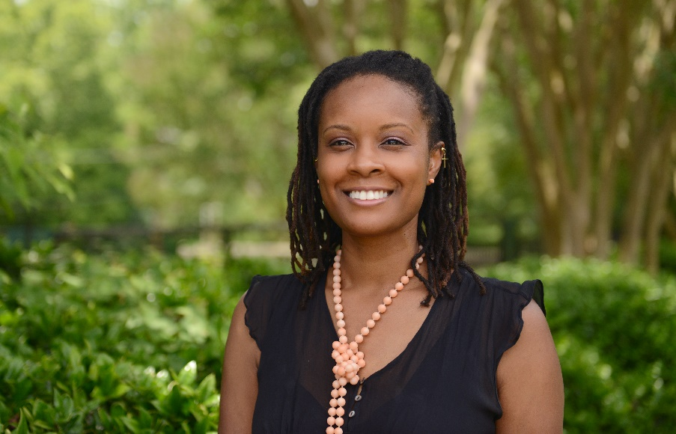
The HILL Lab
Sherika Hill, PhD
October 02, 2020
Lab 4

Slide 2
Lab 1 9/11/2020
stacked presentation with new slides added to the end

Slide 3
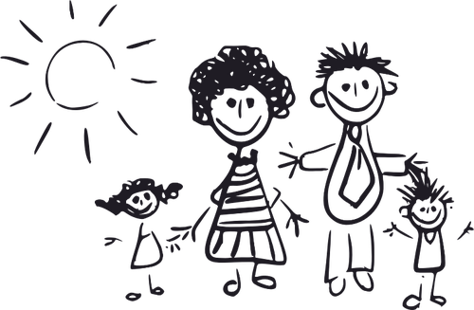
Guiding Principles
The hill lab
Collaborative
Community-based
Contextual at Family Level
Child-Focused Outcomes

Slide 4
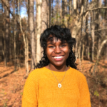
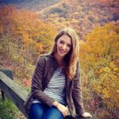
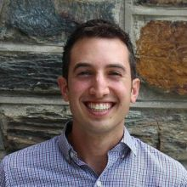

Slide 5
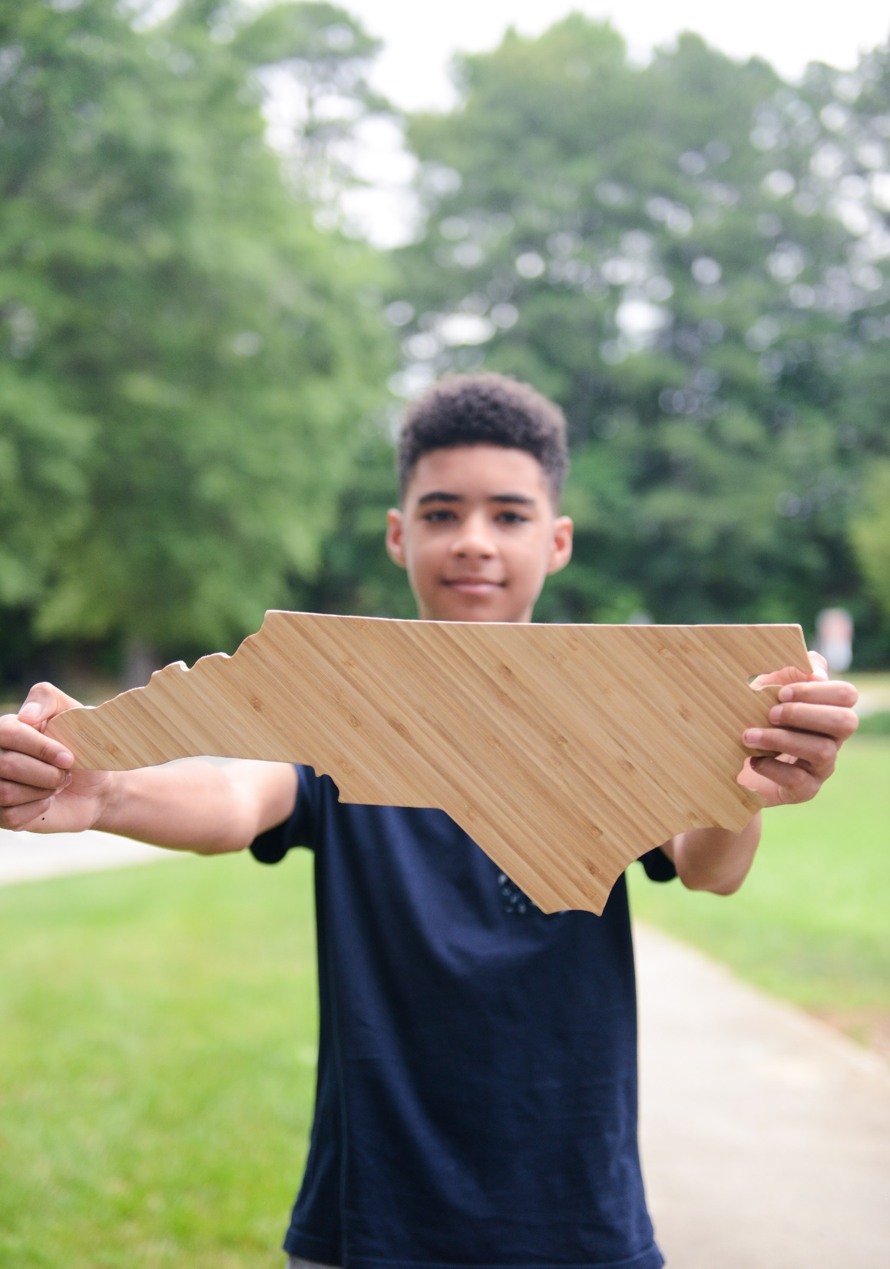
Carter Clinics Great Smoky Mountains Study National Center Child Traumatic Stress Family Connects
RURAL YOUTH MENTAL HEALTH

Slide 6
My Childhood Cancer Study Positive Youth Development Chronic Illness Study
Vulnerable Pediatric populations

Slide 7
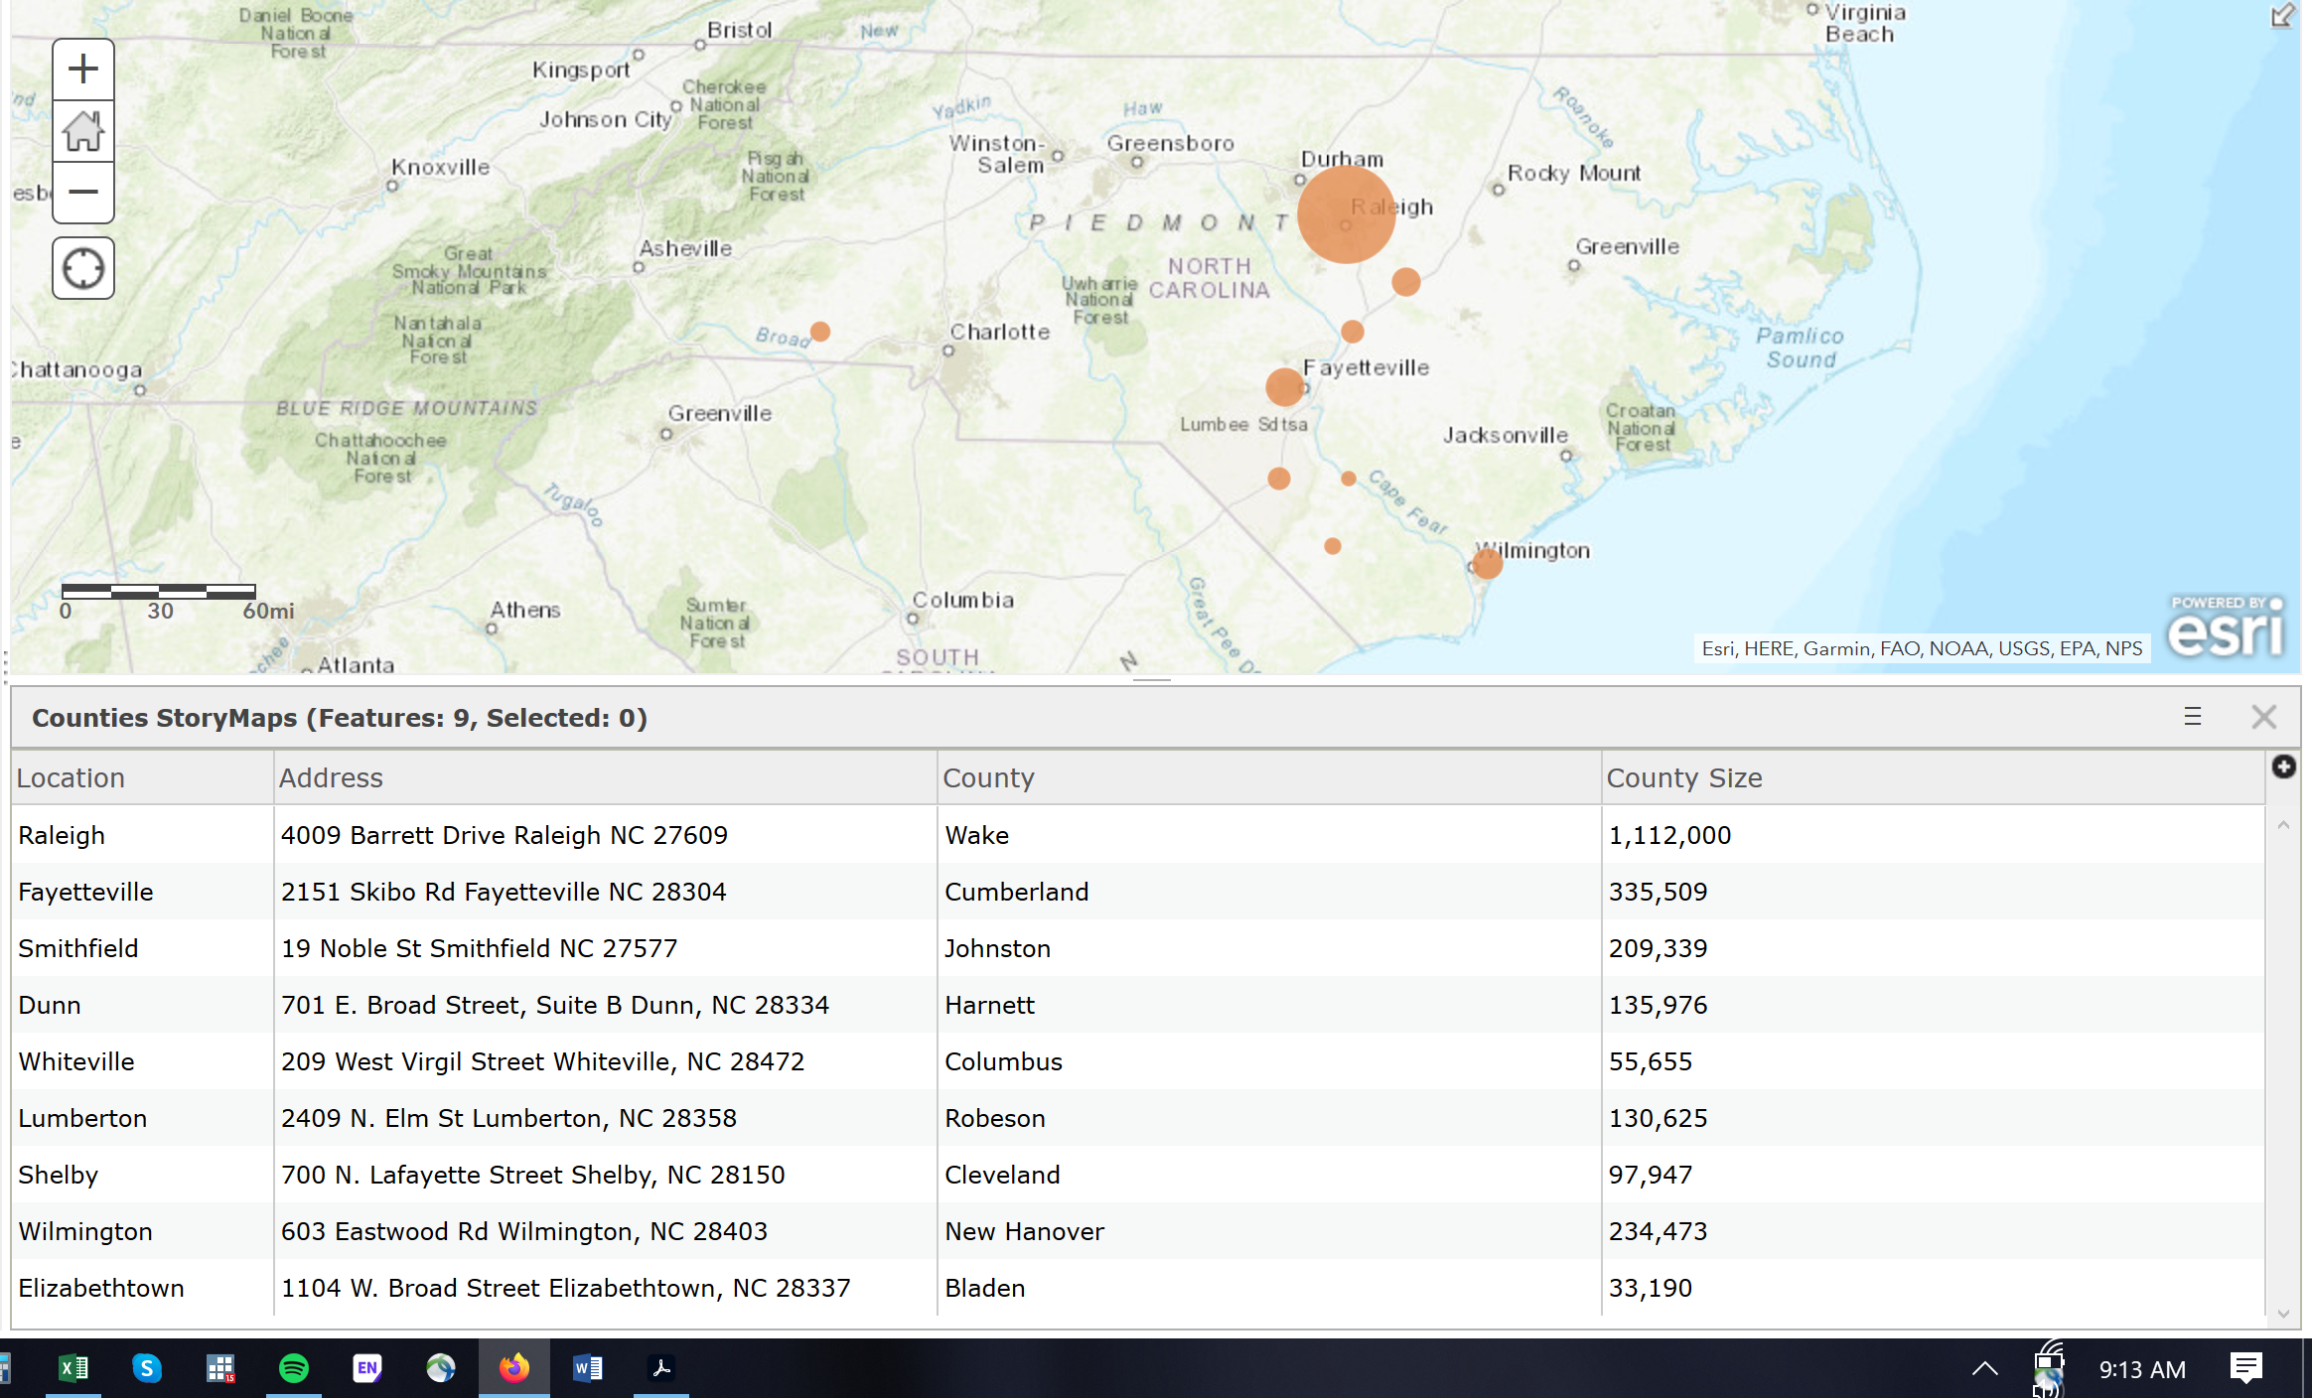
Carter Clinic, PA
SERVICES
Mental Health Disorders
1300 unique clients per month
2500 visits per month
Substance Use Disorder (Opioids) Treatment
3rd largest cohort in NC for buprenorphine (n=385)
Programming:
Family Therapy
Peer Support,
Pregnant SUD Mothers
Integrated Primary Care
12-bed Residential Treatment for Teens (Level 4)
12 Males
IDD Residential Care
Adults, 6 Occupants
Children, 6 Occupants
CLIENTS
20% Youth under 18yrs
80% Adults
92% parents
70% severe mental Illness
80% (n=600) Opioid SUD with 5yr history
STAFF
12 Psychiatrists
20 Licensed Clinicians
13 Administrative Staff
45 Trained Peer Supporters
Notes:
Carter Clinics has a 12 year history of serving Central and Southeastern North Carolina with 10 office locations that offer clinical, lab, and administrative services. For clinical care, Dunn (population 9,718), Smithfield (pop: 12,965), and Wilson (pop: 49,348) feed into our Raleigh location (pop: 465K). Elizabethtown (pop: 3,583) and Lumberton (pop: 20,795) feed into our Fayetteville location (pop: 210K). Whiteville (pop:5,396) feeds into the Wilmington location (pop: 119K). Lastly, Shelby (pop: 20,323) is a stand alone clinic with the nearest metropolitan area being Charlotte (859K), where there isn't a Carter Clinic.
Medicaid payors include Trillium, Alliance, Cardinal, East Pointe, Sandhills, and Partners/Vaya. For private insurers, Carter Clinic accepts Blue Cross Blue Shield, Cigna, United Behavioral Health, and TriCare.

Slide 8
Interdisciplinary Approach
The hill lab: Carter clinics
Clinical Epidemiology
NC TRACS
NCTSN
Trauma Screening
Referral Network
Community Advisory Boards
Biomedical Research
NICHD
Implementation Science
RWJF
Community Advisory Boards & CoCreation
Triple P
Family Connects
Public Policy Research
Managed Care Organizations
Medicaid Integrated Care
Families First Act

Slide 9
NC Community Mental Health Needs and Resources
Notes:
Next steps:
Overlay Clinic Characteristics with
(1) County Community Health Assessments to determine demographics and health needs
(2) NCCare360.org to identify local resources for Housing, Employment, Food Assistance, Interpersonal Violence, Transportation, No Wrong Door and Income Support. NCCARE360 continues to add and verify resources daily and will continue to expand as the program completes implementation throughout the state. Current view shows 14 state-level resources for mental/behavioral health referrals (20 sites total including Asheville in the western mountainous region of the state). To date, at least 30% of counties (29/100) have been included or implemented.

Slide 11
John Henryism
Allostatic Load
Resilience Frameworks & High-stress Coping
Biases
Differences
Disparities Research
Minority Health Research
Systems Research

Slide 12
Lab 4 10/02/2020
stacked presentation with new slides added to the end

Slide 13
Framing the Developmental Research Questions
LAB 3 Lesson Objectives
Learn Key Epidemiologic Frameworks
Discuss How to Build Conceptual Models
Describe Relationship of Trauma/ACES Constructs and Rural Youth Mental Health
Resources:
Theory Construction (2010); James Jaccard and Jacob Jacoby
Health Behavior & Health Education (2002); Karen Glanz, Barbara Rimer, Frances Lewis
Frameworks:
A. Ecological Models of Development; Bronfenbrenner
B. Developmental Science; Robert Cairns, Glen Elder, Jane Costello
C. The Epigenome and Developmental Origins of Human Health and Disease; Cheryl Rosenfield

Slide 14
Key Terms
Developmental
Life-course perspective that takes into account abnormalities/outliers for a given developmental stage
The development of a specific endpoint
Epidemiology
Public health research for the prevention of disease (epidemics) and promotion of health in the population at large
Clinical research to evaluate proper diagnosis and response to treatment of disease among clinic populations
Quantify disease distributions and frequencies
Characterize patterns and trajectories from onset to resolution
Identify disease determinants and control (interventions)

Slide 15
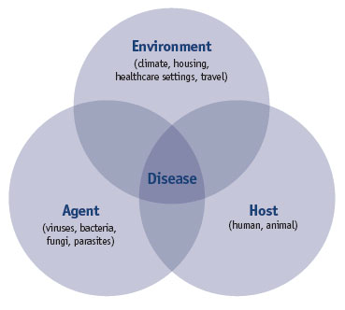
FRAMEWORK: Epidemiologic Triad of Disease
Context:
Natural
Built
Social
Susceptibility:
Biology
Genetic pre-disposition
Epigenetics
Exposure/
Contagion:
Relational
pro/anti-social behavior, attitude, pressure

Slide 16
FRAMEWORK: Social Determinants of Health & Disease Levels/Systems of Influence
Individual level
Micro level
Microsystem
Interpersonal level
Mesosystem
Family level
Exosystem
Macro level
Environmental/Organizational Level
(Neighborhood, Community, School, Industry, Culture)
Macrosystem
Policy level

Slide 17
FRAMEWORK: Developmental Science; Cairns

Slide 18
CONCEPTUAL MODELS
Mediator
Predictor
Outcome
Moderator

Slide 19
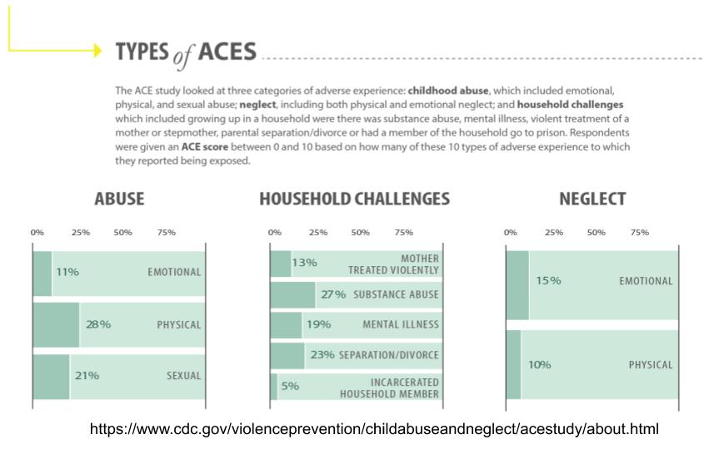
CONSTRUCTS
Adverse experiences

Slide 20
ACES & MALTREATMENT

Slide 23
Carter Clinic Innovations for Trauma Care
PREVENTION
for Rural Community
Offer Trauma-informed Integrated Primary Care
INTERVENTIONS
Impaired Caregiver & Child
Implement Trauma Screening
EBT/P ADAPTATIONS for special populations
Native American Indians (Lumley Indians, Eastern region; Cherokee, Western region)
RURAL MH SYSTEMS CHANGE
Community Resources
Train Carter Clinic Clinicians on EBTs and Trauma-informed Care
Triage at-risk Families to EB Therapy/Programming
Provide outreach to School-based MH Services
Parenting Skills Training
Family Connects (Home Visiting)
Family-based Therapy
Trauma-informed, Resilience-lens Individualized Therapy
Align resourcing with recently passed NC legislation
Military Families
Robeson County (East Coast Drug Corridor & Human Trafficking)
Inpatient Clients (IDD, Teen Boys)
Pregnant mothers support group
Scale from 3 clinics to all 10 locations
Partner with local schools
Brief interventions for primary care (CFTSI?)
Potential school-based interventions: Sparcs, CBITS
TF-CBT – older kids including the level 4 boy’s home
Establish expansive Rural Referral Network
(CARE, CPP, PCIT)- little kids
Collect Biological Samples and School Records for future research proposals

Slide 24
Gantt Chart
Fall 2020 TASKS

