Slide 1
Epistemic Dispositions in Socioscientific Issues-Based Systems Modeling
Jamie N. Elsner¹, Eric A. Kirk¹, Li Ke², Troy D. Sadler¹
¹ University of North Carolina at Chapel Hill, NC, USA
² University of Nevada, Reno, NV, USA

Slide 2
Socioscientific Issues (SSIs)
Complex problems of society with ethical dilemmas¹
Ex: climate change, food deserts, antibiotic resistance, viral pandemics
Reasoned about using scientific concepts and evidence
No simple solution → Students must think about the issue from multiple dimensions
Modeling is a scientific practice that can support understanding of SSIs
2

Slide 3
Goals for Science Curriculum
We need to tools to help students learn how to perform science practices but also learn how science is generated and ultimately accepted^{2,3}
Via social discourses and community knowledge building
Modeling is one of the NGSS science practices that can support this goal
Helps students explain science concepts and make predictions
Diagrams, drawings, simulations, other representations
Systems modeling can help students think about how sub-components in a system are related
Cross-cutting concept that unites disciplines
3

Slide 4
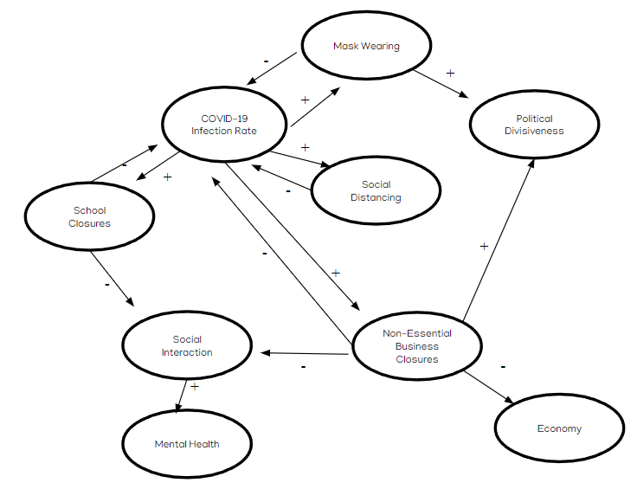
Systems Modeling of SSIs
Assessing how factors are related is difficult for students⁴
Especially indirect relationships and factors that have multiple causes⁵
4

Slide 5
Epistemic Practices
They way students propose, communicate, evaluate, and legitimize knowledge claims⁸
Collaborative process that occurs through social interactions
Improves the quality of students’ arguments and explanations^{6,7}
Modeling is an epistemic practice
5

Slide 6
Framework
Epistemic Dimension⁸ | Examples of Epistemic Operations⁹
Proposing Knowledge | Proposing explanations, proposing causal relationships, inferring the scope of a decision
Communicating Knowledge | Persuading other group members
Evaluating Knowledge | Contrasting claims with evidence, acknowledging the absence of data
Legitimizing Knowledge | Building consensus, recognizing the value of other positions
⁸Kelly and Licona (2018)
⁹Casas-Quirogas and Crujeiras-Pérez’s (2020)
6

Slide 7
Research Questions
1) Which epistemic dimensions do students demonstrate during SSI-based systems modeling?
2) Which epistemic operations do students perform during SSI-based systems modeling?
3) What interactional operations do students engage in during SSI systems modeling?
7

Slide 8
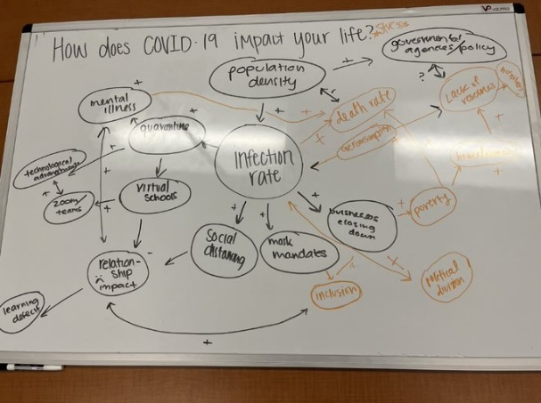
Participants
6 students: Avery, Olivia, Leah, Audrey, Daniela and Brianna
4 high school seniors and 2 college undergraduates
2 bilingual in Spanish and English
Students worked in pairs
8

Slide 9
Data Analysis
Informed by two frameworks: Kelly and Licona (2018) and Casas-Quirogas and Crujeiras-Pérez’s (2020)
Determine the distinct epistemic operations students perform during systems modeling
Open-coded transcripts from modeling sessions
Ultimately developed a full codebook (See conference paper)
9

Slide 10
R1: What epistemic dimensions did students demonstrate?
Proposing knowledge, evaluating knowledge, and legitimizing knowledge
Did not see evidence of communicating knowledge
Students in our study were engaging in argumentation
10

Slide 11
R2: Proposing Knowledge Operations
Epistemic Operation
Student Example
Proposing a factor
“Maybe we could put like education.” (Leah)
Proposing an explanation
[Globalization factor added to model]
“…because we're doing air travel and trading with other
countries.” (Leah)
Proposing a correlation
“Well, I guess you could also think about the economy, like when
people weren't working, unemployment rates were higher.”
(Leah)
Proposing a societal implication
[Students discuss pros and cons of the financial impact of COVID]
“I feel like it [budgeting] could be a good and bad thing, because
for some people who were helped by the emergency grants, they
had a little bit more room.” (Brianna)
“And they probably saved it.” (Daniela)
“Yeah, but then there’s people who were unemployed, and even
the grants weren’t enough to hold them.” (Brianna).
11

Slide 12
R2: Evaluating Knowledge Operations
Epistemic Operation | Student Example
Evaluating claim | “I was just thinking there's a big like learning deficit [factor added to model] for like kids.” (Olivia) “True, because of virtual school, because of the lack of relationships with their teachers.” (Avery)
Acknowledging limited understanding | [Avery and Olivia discuss mental health concerns] “I don't know yet. Just write it down and then we can think about it.” (Avery)
12

Slide 13
R2: Legitimizing Knowledge Operations
Epistemic Operation | Student Example
Building Consensus | [Avery proposes that hospitals had a lack of resources] “Actually, you could connect those then.” (Olivia) “Okay, yeah.” (Avery) [Avery connects “lack of resources” factor to “hospitals” factor]
Recognizing the value of other positions | [Brianna discusses how unemployment grants helped her mom financially during the pandemic] “I know you meant the unemployment with your mom was like more [money] than what we were getting before. I know they gave out a lot of, um, emergency grants that really helped, like that was the most [money] you really had in a minute.” (Daniela)
13

Slide 14
R3: Interactional Operations
 | Excerpt | Interactional Operation
Daniela | And so you want another one to be like mortality rates? | Seeking advice
Brianna | Uh, yeah, could you write that? | Assigning task
Daniela | Okay, I don't know where to write in this. | Verbalizing task
Brianna | Just pull it out. | Verbalizing task
Daniela | Yeah. Mortality, okay, what do you want to say about that? | Coordinating language
Brianna | Um, I know that I did have family members who passed away in other countries and you're not able to travel.
Daniela | Oh, that could be another one, traveling, and then do you want me to put mortality rates under traveling? | Seeking advice
14

Slide 15
Summary
Systems modeling is a tool to support students in recognizing the complexity of a SSI. Students:
Linked different components of a system
Considered how science related to society
Assessed the truthfulness of knowledge claims
Students reflected on their own experiences and validated the experiences of others
We identified the distinct epistemic operations that supported students’ sensemaking around complex SSIs
15

Slide 16
Implications
Established a taxonomy of talk that is the first step towards identifying patterns and characteristics of high-quality modeling conversations
Students engaged in back-and-forth process of knowledge construction → appropriate science practice⁸
Supported epistemic agency – students were positioned to collaboratively construct knowledge⁹
16

Slide 17
References
Zeidler, D. L., Herman, B. C., & Sadler, T. D. (2019). New directions in socioscientific issues research. Disciplinary and Interdisciplinary Science Education Research, 1(1), 1-9
Aleixandre, M. P. J., & Crujeiras, B. (2017). Epistemic practices and scientific practices in science education. In Science education (pp. 69-80). Brill.
Duschl, R. (2008). Science education in three-part harmony: Balancing conceptual, epistemic, and social learning goals. Review of research in education, 32(1), 268-291.
Yoon, S. A., Goh, S. E., & Park, M. (2018). Teaching and learning about complex systems in K–12 science education: A review of empirical studies 1995–2015. Review of Educational Research, 88(2), 285-325.
Hmelo-Silver, C. E., Marathe, S., & Liu, L. (2007). Fish swim, rocks sit, and lungs breathe: Expert-novice understanding of complex systems. The Journal of the Learning Sciences, 16(3), 307-331.
Nussbaum, E. M., Sinatra, G. M., & Poliquin, A. (2008). Role of epistemic beliefs and scientific argumentation in science learning. International Journal of Science Education, 30(15), 1977-1999.
Ryu, S., & Sandoval, W. A. (2012). Improvements to elementary children's epistemic understanding from sustained argumentation. Science Education, 96(3), 488-526.
Dijk, E. M. V. (2011). Portraying real science in science communication. Science Education, 95(6), 1086-1100.
González‐Howard, M., & McNeill, K. L. (2020). Acting with epistemic agency: Characterizing student critique during argumentation discussions. Science Education, 104(6), 953-982.
17

Slide 18
Acknowledgements
Name: Jamie Elsner
Email: jelsner@unc.edu
Paper & slides can be found at:
https://tarheels.live/seel/publications/conference-presentations/
This material is based upon work supported by the National Science Foundation under Grant DRL-2023088. Any opinions, findings, and conclusions or recommendations expressed in this material are those of the author(s) and do not necessarily reflect the views of the National Science Foundation."

