Slide 1
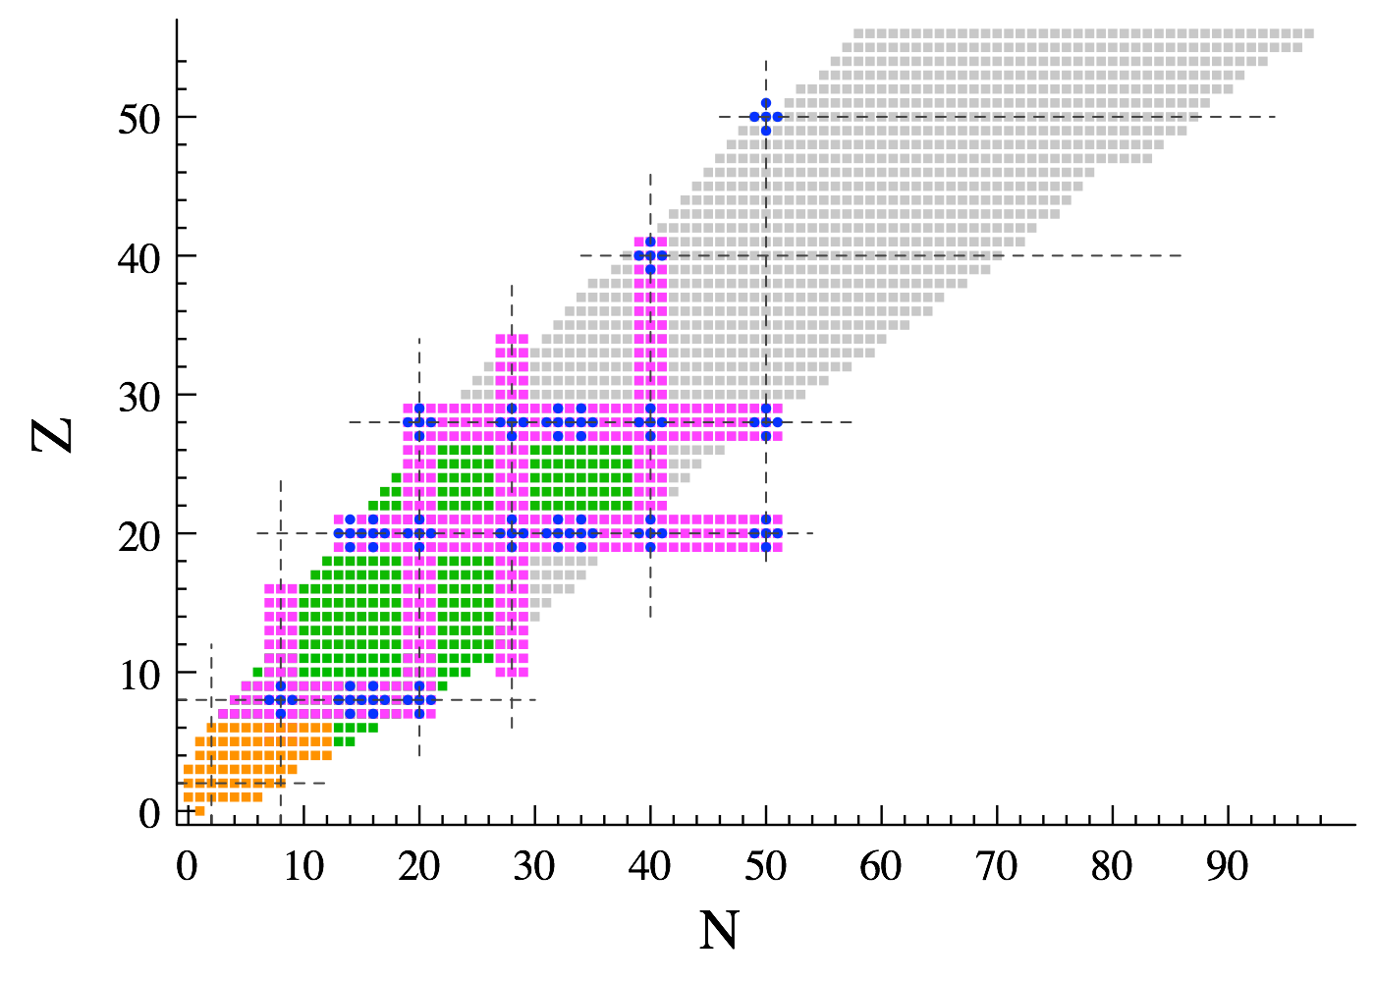



Dynamical and static correlations in ab initio calculations of nuclei
Breaking&restoring symmetries (+ pre-processing H) in expansion methods
Thomas DUGUET
DPhN, CEA-Saclay, France
IKS, KU Leuven, Belgium
Ab initio methods
International Conference on Recent Progress in Many-Body Theories XXI
September 12-16 2022, University of North Carolina, Chapel Hill

Slide 2
Keywords and caveats
Keywords
➲ « Universal » expansion methods with polynomial scaling
➲ Open-shell nuclei and strong « static » correlations
➲ Finite systems and emergent symmetry breaking
➲ Low-scaling multi-reference method
➲ Hamiltonian pre-processing via similarity renormalization group transformations
Not dealt with today
➲ Rank-reduction of many-body, e.g. 3-nucleon interaction, operators
➲ Use of many-body emulators to provide statistical uncertainties of Hamiltonian parameters
➲ Evaluation of systematic Hamiltonian and many-body uncertainties
➲ Numerical scaling reductions (e.g. tensor factorization, importance truncation, natural basis…)

Slide 3
Selected references
Symmetry-breaking single-reference expansion methods
GSCGF [V. Somà, T. Duguet, C. Barbieri, PRC 84 (2011) 064317]
[V. Somà, A. Cipollone, C. Barbieri, P. Navratil, T. Duguet, PRC 89 (2014) 061301]
[C. Barbieri, T. Duguet, V. Somà, PRC 105 (2022) 044330]
BMBPT [A. Tichai, P. Arthuis, T. Duguet, H. Hergert, V. Somà, R. Roth]
[P. Arthuis, T. Duguet, A. Tichai, R.-D. Lasseri, J.-P. Ebran, CPC 240 (2019) 202]
BCC [A. Signoracci, T. Duguet, G. Hagen, G. R. Jansen, PRC 91 (2015) 064320]
[T. M. Henderson, G. E. Scuseria, J. Dukelsky, A. Signoracci, T. Duguet, PRC89 (2014) 054305]
[A. Tichai, P. Demol, T. Duguet, in preparation (2022)]
Symmetry-breaking and restored single-reference expansion methods
PBMBPT [T. Duguet, JPG 42 (2015) 025107]
PBCC [T. Duguet, A. Signoracci, JPG 44 (2016) 015103]
[Y. Qiu, T. M. Henderson, J. Zhao, and G. E. Scuseria, JCP 147 (2017) 064111]
[Y. Qiu, T. M. Henderson, T. Duguet, G. E. Scuseria, PRC 99 (2019) 044301]
[G. Hagen, S. J. Novario, Z. H. Sun, T. Papenbrock, G. R. Jansen, J. G. Lietz, T. Duguet, A. Tichai, PRC 105 (2022) 064311]
Symmetry-conserving multi-reference expansion method
PGCM-PT [M. Frosini, T. Duguet, J.-P. Ebran, V. Somà, EPJA 58 (2022) 62]
[M. Frosini, T. Duguet, J.-P. Ebran, B. Bally, T. Mongelli, T. R. Rodriguez, R. Roth, V. Somà, EPJA 58 (2022) 63]
[M. Frosini, T. Duguet, J.-P. Ebran, B. Bally, H. Hergert, T. R. Rodriguez, R. Roth, J. M. Yao, V. Somà, EPJA 58 (2022) 64]

Slide 4







Collaborators on ab initio many-body methods/calculations
J.-P. Ebran
M. Frosini
A. Porro
A. Roux
A. Scalesi
V. Somà
G. Stellin
H. Hergert
P. Demol
A. Willems
P. Navratil
A.Tichai
P. Arthuis
R. Roth
C. Barbieri
G. Hagen
T. Papenbrock

Slide 5
Contents
⦿ Introduction
⦿ Expansion many-body methods
⦿ Pre-processing of the Hamiltonian
⦿ Conclusions

Slide 6
Contents
⦿ Introduction
○ Categories of nuclei and basic consequence from the theoretical standpoint
⦿ Expansion many-body methods
⦿ Pre-processing of the Hamiltonian
⦿ Conclusions

Slide 7
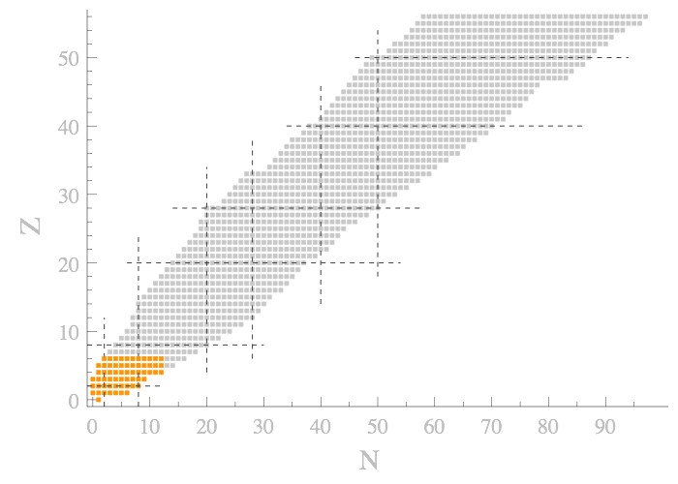
Categories of nuclei vs correlations vs expansion method
50
Nuclear shells from SC ([H,J²]=0) Hartree-Fock
¹³²Sn
¹⁰⁰Sn
28
j=l+s → 2j+1 degeneracy
20
⁵⁶Ni
⁶⁸Ni
⁷⁸Ni
« Magic » numbers
=
Closed major shells
Protons
Neutrons
8
⁴⁰Ca
2
⁴⁸Ca
50
¹⁶O
²⁸O
⁴He
Doubly « Magic » nucleus = « double noble gas »
20
28
2
8
1 set for protons
1 set for neutrons
Counting even-even nuclei belonging to each category
Closed-shell = weak « dynamical » correlations
Open-shell = weak « dynamical » correlations + strong « static » correlations
99.2%

Slide 8
Categories of nuclei vs correlations vs expansion method
50
Nuclear shells from SC ([H,J²]=0) Hartree-Fock
¹³²Sn
¹⁰⁰Sn
28
j=l+s → 2j+1 degeneracy
20
⁵⁶Ni
⁶⁸Ni
⁷⁸Ni
« Magic » numbers
=
Closed major shells
Protons
Neutrons
8
⁴⁰Ca
2
⁴⁸Ca
50
¹⁶O
²⁸O
⁴He
Doubly « Magic » nucleus = « double noble gas »
20
28
2
8
1 set for protons
1 set for neutrons
More pertinent categorization
Mostly
open-shell
even-even
ground-states
91.3%
Via particle-attached methods

Slide 9
Categories of nuclei vs correlations vs expansion method
50
Nuclear shells from SC ([H,J²]=0) Hartree-Fock
¹³²Sn
¹⁰⁰Sn
28
j=l+s → 2j+1 degeneracy
20
⁵⁶Ni
⁶⁸Ni
⁷⁸Ni
« Magic » numbers
=
Closed major shells
Protons
Neutrons
8
⁴⁰Ca
2
⁴⁸Ca
50
¹⁶O
²⁸O
⁴He
Doubly « Magic » nucleus = « double noble gas »
20
28
2
8
1 set for protons
1 set for neutrons
Any « universal » (expansion) method must deal with static and dynamical correlations
Consistently (no double counting)
Efficiently (at reasonal polynomial cost)

Slide 10
Contents
⦿ Introduction
⦿ Expansion many-body methods
○ Rationale and key questions
⦿ Pre-processing of the Hamiltonian
⦿ Conclusions

Slide 11
Expansion many-body methods: general rationale
Hamiltonian
Good neutron/proton number N/Z
Symmetries (U(1), SU(2)…)
Good angular momentum (J²,J_{z})
Secular equation
Solution to static correlations lies here
Partitioning
Key questions
Unperturbed state
  -what nature for which systems?
                -what about symmetries?
                -how « simple »/low-cost can it remain?
Nature of the expansion
-perturbative? non-perturbative?
-formulation depends on unperturbed state?
« Easy »
to solve
Unperturbed state
Expansion series
Impacts algebraic&numerical complexity there
Fully correlated state

Slide 12
Contents
⦿ Introduction
⦿ Expansion many-body methods
○ Closed-shell nuclei: single-reference symmetry-conserving methods
⦿ Pre-processing of the Hamiltonian
⦿ Conclusions

Slide 13
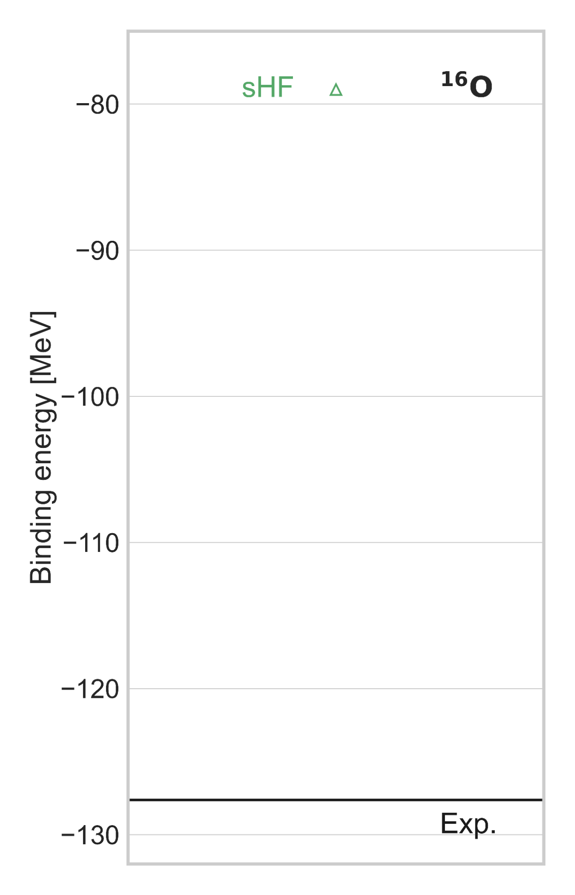
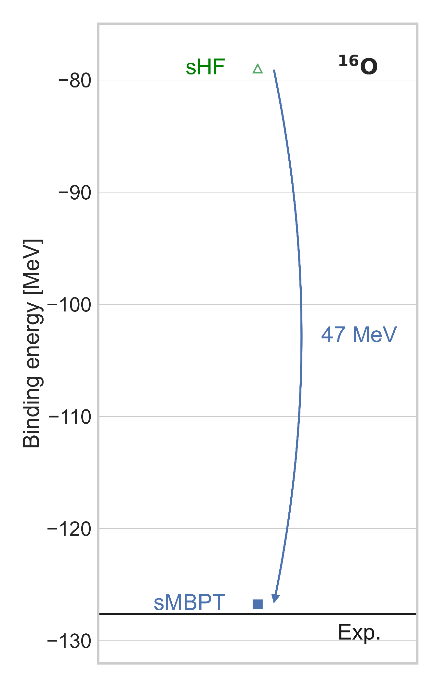

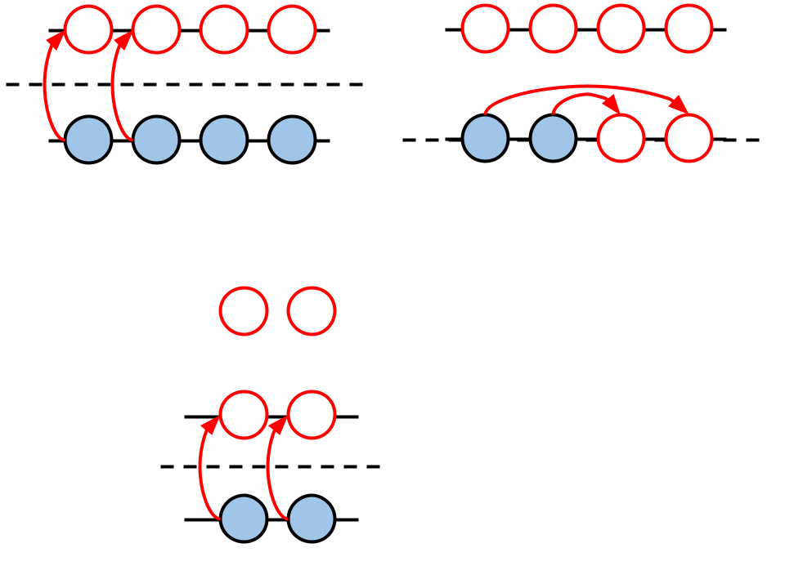


Closed-shell systems
Z=8,N=8
Closed-shell
No
correlations
Spherical
Hartree Fock
Non-degenerate
unperturbed
Slater determinant
Controlled
np-nh
expansion
Dynamical
correlations
sMBPT, sCC, sDSCGF…
Partition
Expand
Ex:
Standard rationale in quantum chemistry, nuclear physics…

Slide 14

Open-shell systems - 1
What to do?
-can one keep the simplicity of a single-reference method?
-if so, is there a price to play?
Open-shell
Symmetry-conserving single-reference expansion
►state misses crucial IR static correlations
No
correlations
Spherical
Hartree Fock
Degenerate
unperturbed
Slater determinant
Dynamical
correlations
Uncontrolled
np-nh
expansion
Ex:

Slide 15
Contents
⦿ Introduction
⦿ Expansion many-body methods
○ Closed and open-shell nuclei: single-reference symmetry-breaking methods
⦿ Pre-processing of the Hamiltonian
⦿ Conclusions

Slide 16
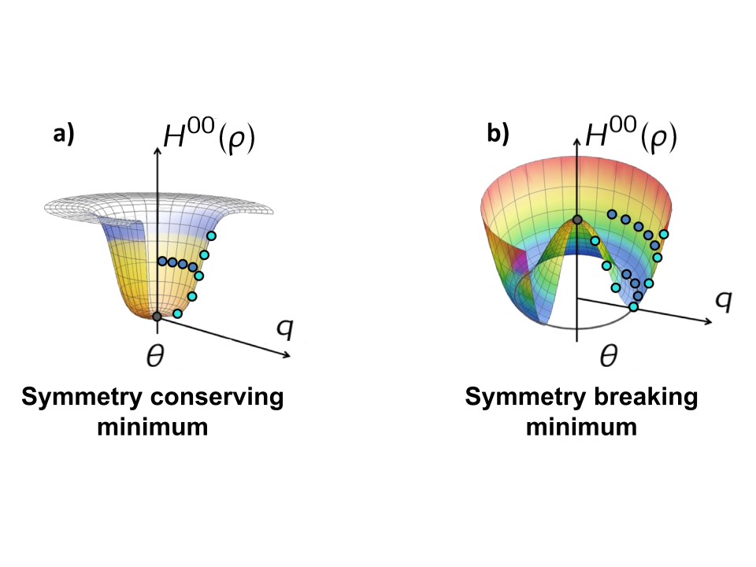
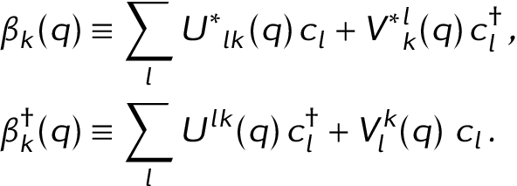

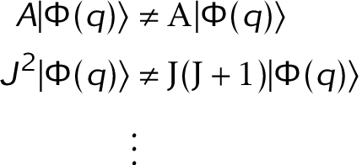
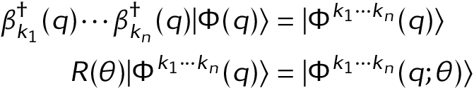
Open-shell systems - 2
order parameter
Example for SU(2)
Closed-shell = particular case
Open-shell
(with J=0)
Static IR
correlations
Deformed
Hartree Fock
Bogoliubov
Zero static correlations
Bogoliubov transformation
Bogoliubov Vacuum
Product state as Slater determinant
Dynamical
correlations
Symmetry breaking
Sum over different j
Elementary excitations
Generalize np-nh excitations

Slide 17
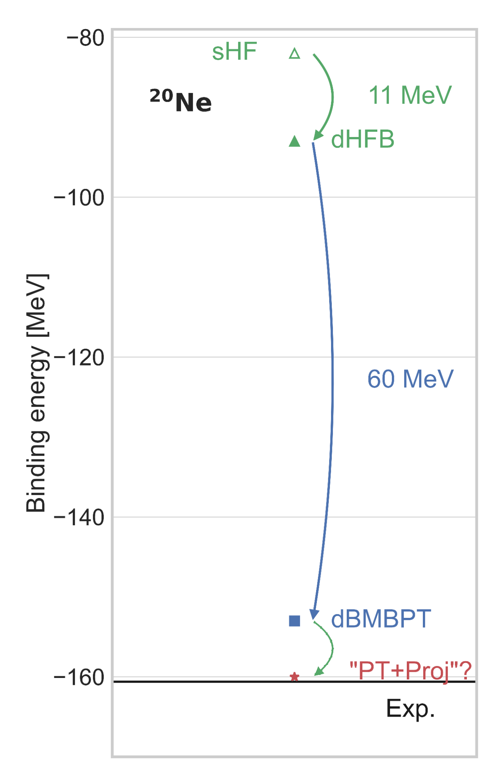
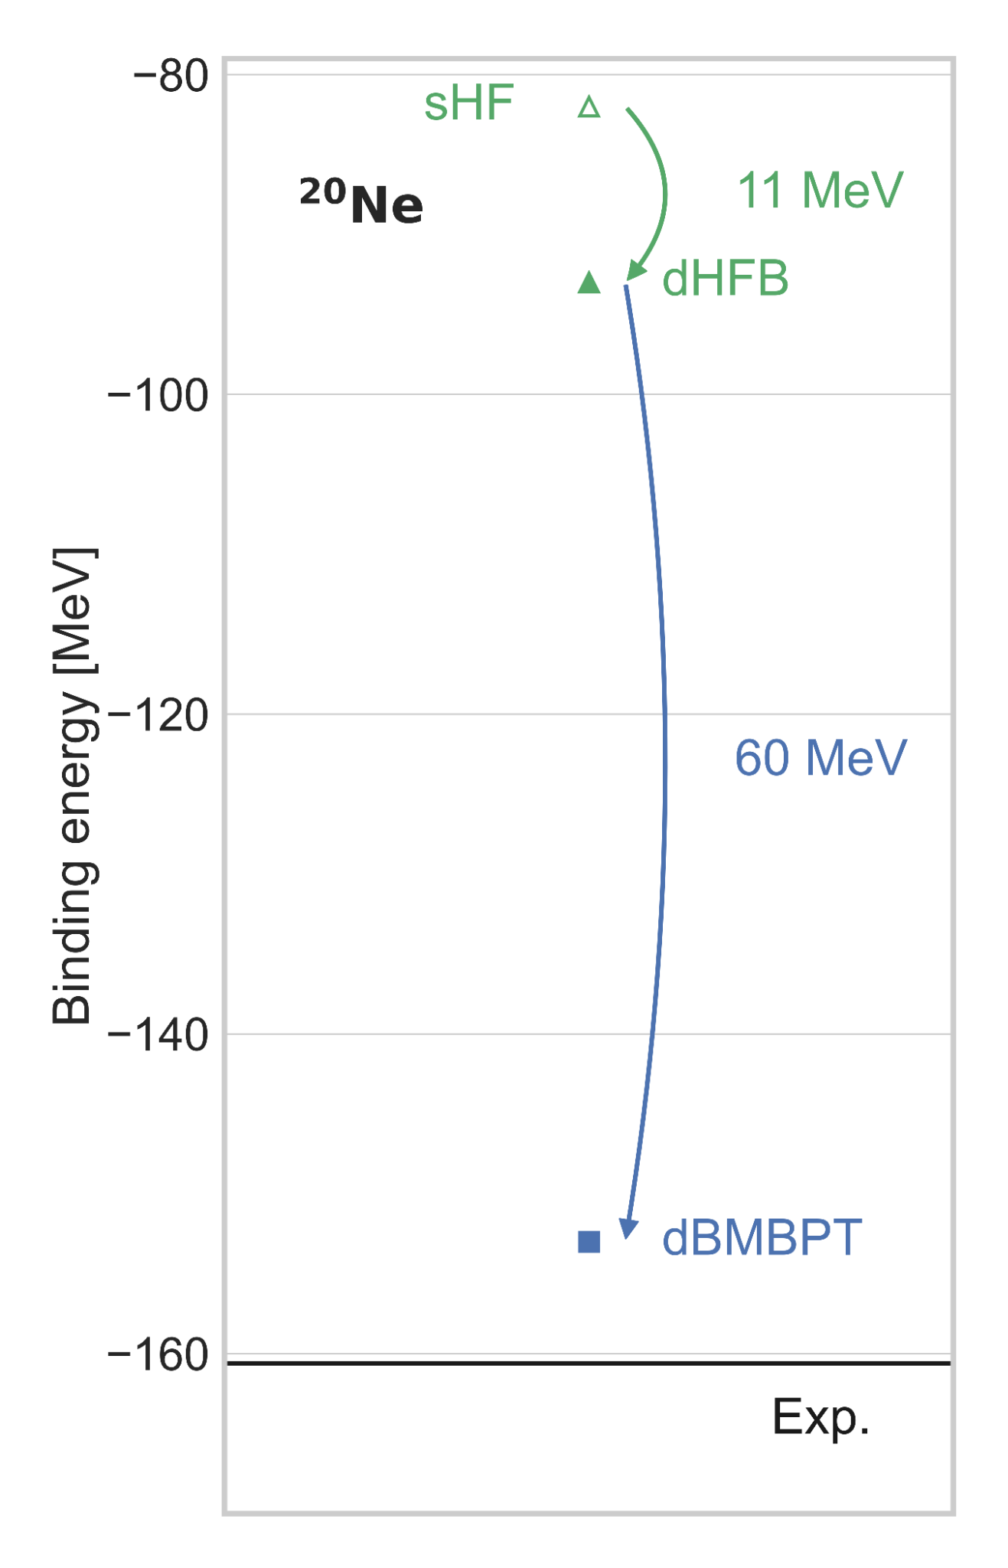
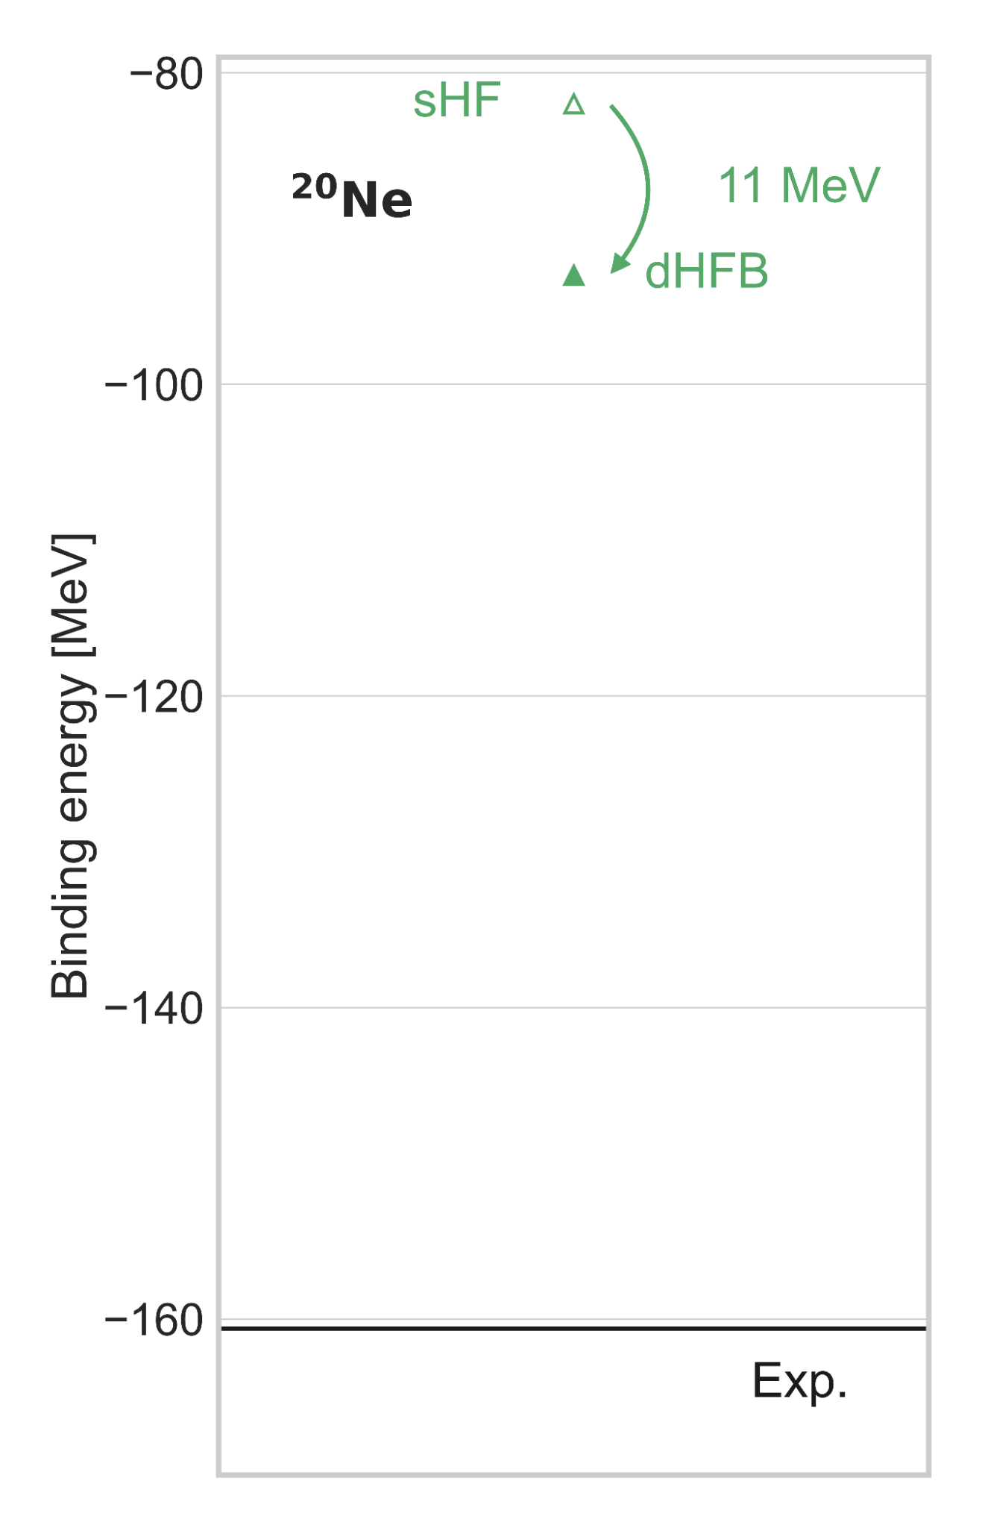
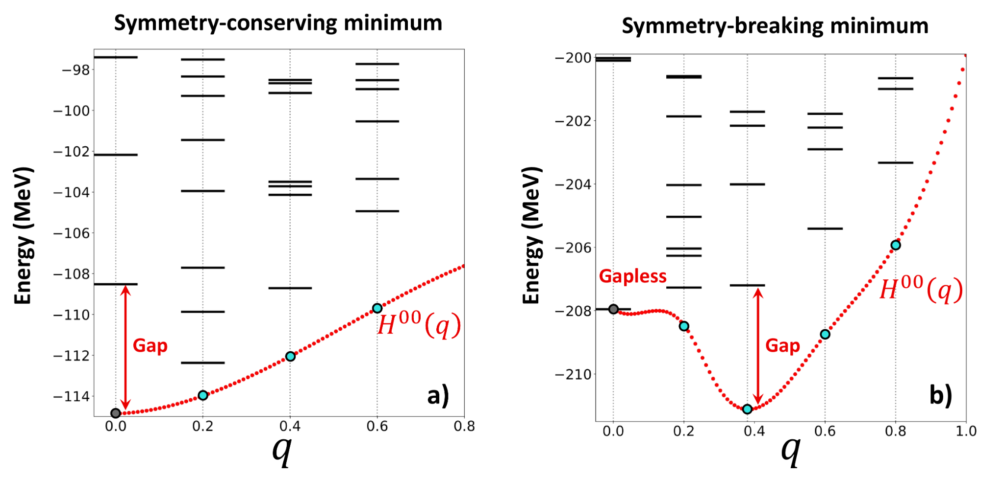
Open-shell systems - 2
order parameter
Z=10,N=10
Open-shell
Static correlations indeed included in
Dynamical correlations safely brought on top
Static IR
correlations
Deformed
Hartree Fock
Bogoliubov
Missing ingredient?
Symmetry breaking only emergent but not real
Controlled
qp
expansion
Non-degenerate
unperturbed
Bogoliubov state
Dynamical
correlations
dBMBPT, dBCC, dGSCGF…
Talk by M. Urban on Wednesday (BMBPT)
Talk by C. Barbieri on Monday (sGSCGF)
Break - partition
Expand
Ex:
Talk by G. Hagen on Wednesday (dCC)
Poster by P. Demol (sBCC)

Slide 18
Contents
⦿ Introduction
⦿ Expansion many-body methods
○ Closed and open-shell nuclei: single-reference symmetry breaking&restoring methods
⦿ Pre-processing of the Hamiltonian
⦿ Conclusions

Slide 19
Open-shell systems - 3
order parameter
Open-shell
Manifold of rotated Bogoliubov vacua
Static IR
correlations
Deformed
Hartree Fock
Bogoliubov
Projector on symmetry quantum numbers (J²,A…)
Insert into expanded energy:
►keep same partitioning and expansion of Ω
►P superfluous/impactful if Ω exact/truncated
Further capture static correlations
Dynamical
correlations
Generalized qp
expansion
Talk by G. Hagen on wednesday (PCC)
Successful novel approach
Natural access to rotational excitations
Projection however approximated
Handling symmetry prior to partition?
PBMBPT, PBCC
Break - partition
Expand - Project

Slide 20
Contents
⦿ Introduction
⦿ Expansion many-body methods
○ Multi-reference (low-scaling) symmetry conserving method
⦿ Pre-processing of the Hamiltonian
⦿ Conclusions

Slide 21


Open-shell systems - 4
Open-shell
Caveat
High dimensionality DZ
Hybrid scaling
Bottleneck for large N&Z
Static IR
correlations
Multi-configuration
sHF
Dynamical
correlations
Generalized
np-nh
expansion
Final requirements for unperturbed state
Handles degeneracy
Preserves symmetry
Low dimensionality
MCPT

Slide 22
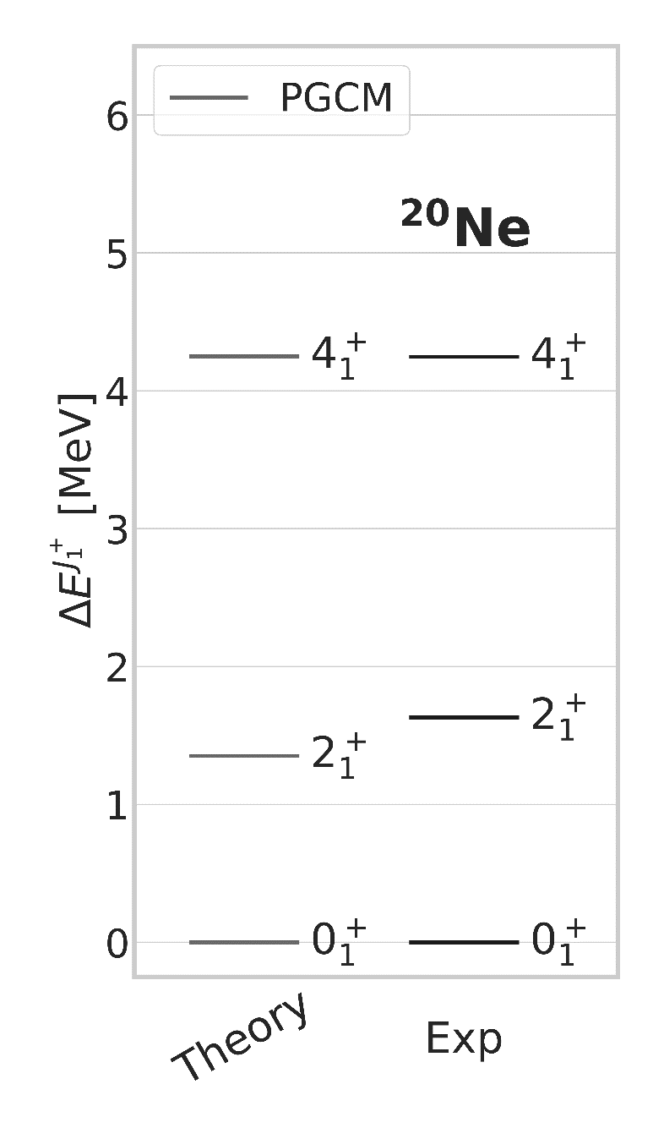
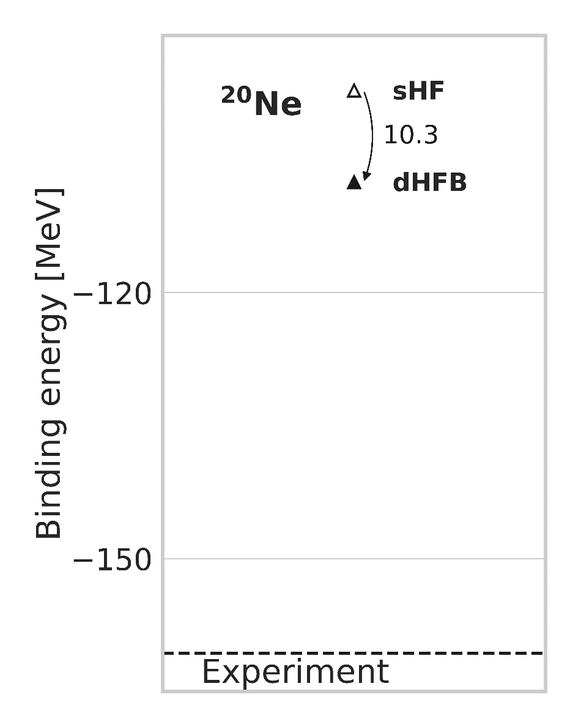
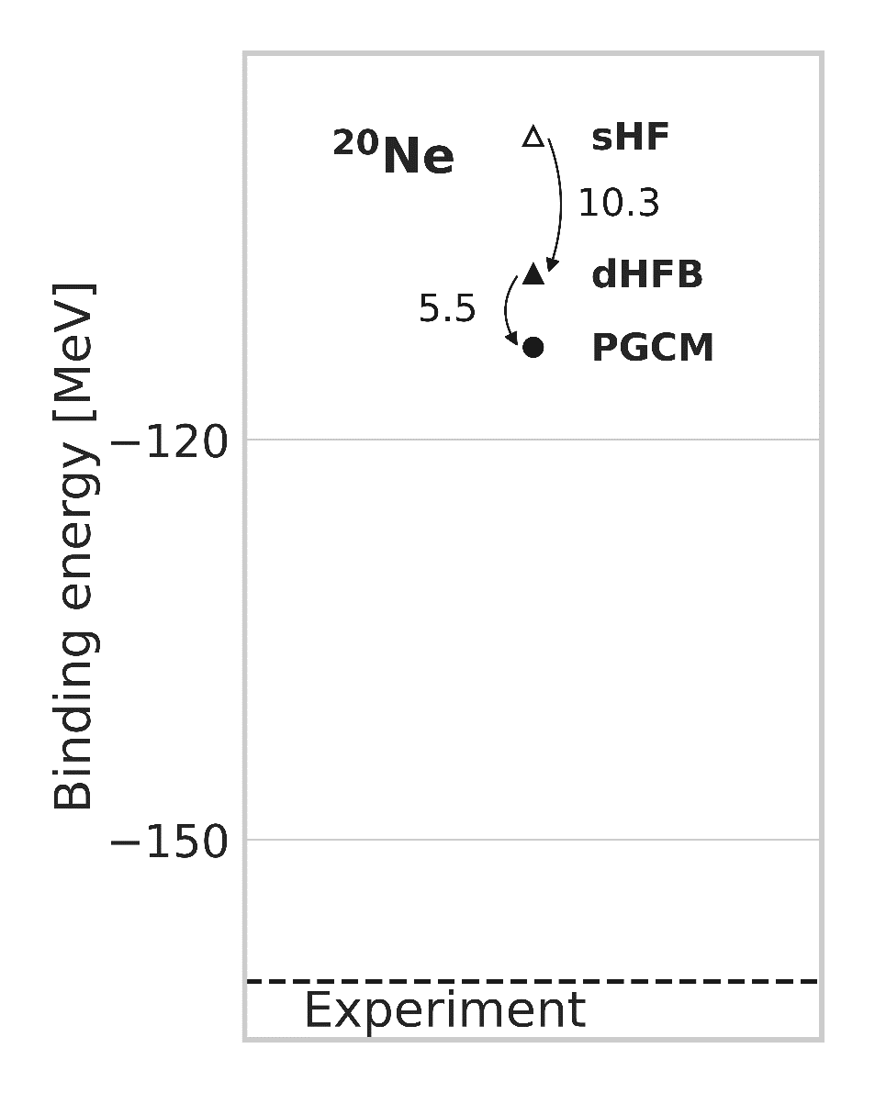
Open-shell systems - 4
order parameter
Z=10,N=10
Open-shell
Set of HFB states with different values of q
►generated via contrained HFB (cHFB) calculations
Static IR
correlations
PGCM
Projected generator coordinate method
Low dimensional mixing of non-orthogonal cHFB states
►Symmetry restored = fluctuation of angle θ of order parameter
►Further includes quantum fluctuations of norm q of order parameter
Perform low-dimensional diagonalization in non-orthogonal basis
►further include static ground-state correlations
►access both vibrational (q) and rotational (θ) excitations
Dynamical
correlations

Slide 23
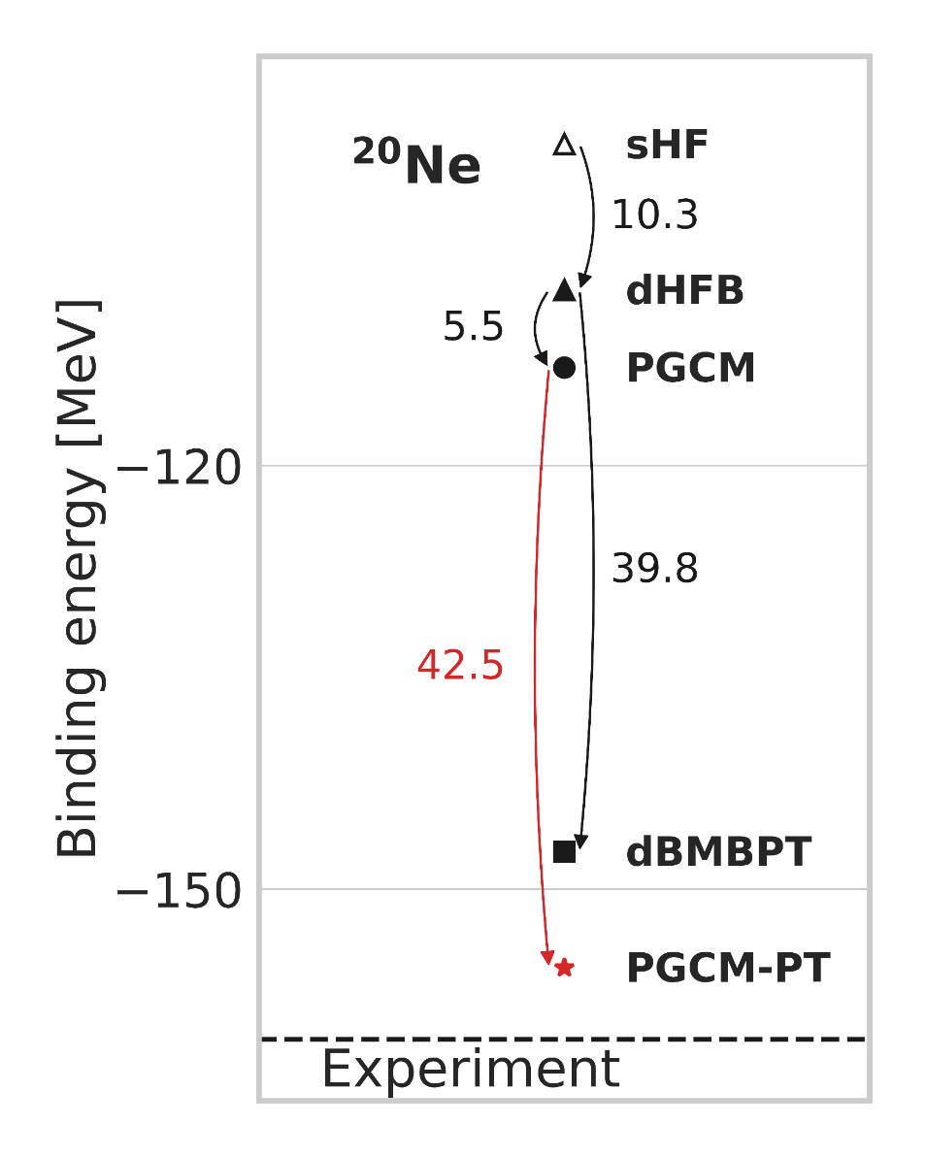
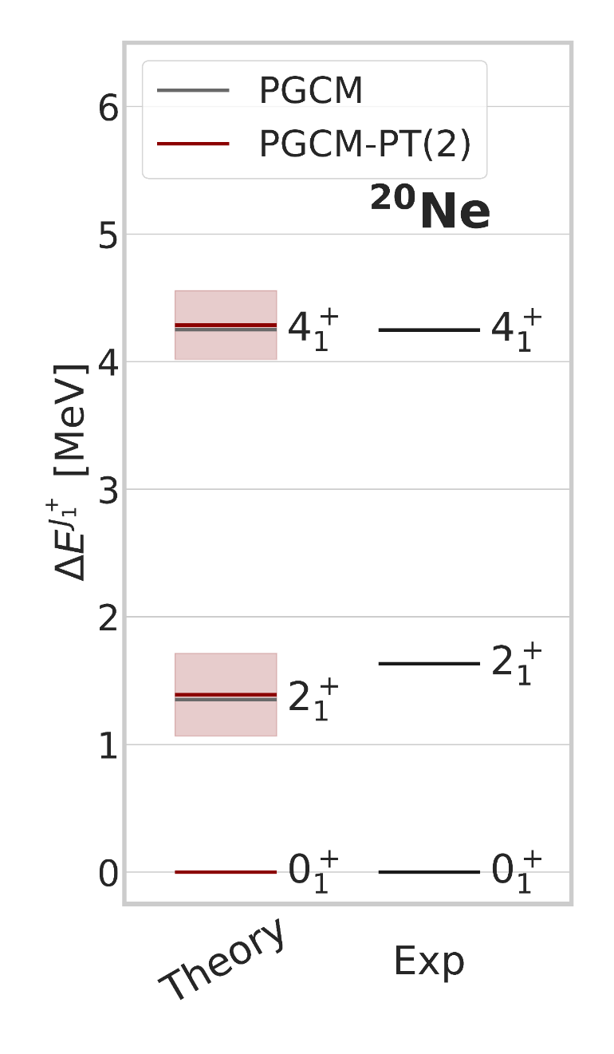
Open-shell systems - 4
Absolute energies: 1-2% accuracy
-improves over dBMBPT(2)
Spectra: 20% accuracy
-Negligible PT corrections
-Enrich PGCM state?
Open-shell
Static IR
correlations
PGCM
Generalized
multi vacua qp
expansion
PGCM Perturbation Theory
Only weak remaining dynamical correlations to include
Multi copies of Fock space = large linear system to solve
►handling redundancies, intruders, large dimension
State-specific expansion for each PGCM state
► access ground-state and spectroscopy
Dynamical
correlations
PGCM-PT
Break - project - partition
Expand
[M. Frosini et al., EPJA 58 (2022) 62; 63; 64]

Slide 24
Contents
⦿ Introduction
⦿ Expansion many-body methods
⦿ Pre-processing of the Hamiltonian
⦿ Conclusions

Slide 25
Open-shell systems - 5
Non-perturbative pre-processing of H via MR-IMSRG w/t PGCM state
Initial condition
Normal ordered w/t PGCM state
►Kutzelnigg-Mukherjee NO/WT
Flow equation
Truncated at 2-body operators MR-IMSR(2)
►Induced many-body operators ~capture via NO
►Unitarity violation as flow parameter s grows
Generator parameterizes the unitary transformation
►Chosen to decouple PGCM state from « Q space »
►Reshuffle dynamical correlations into H(s)
Static IR
correlations
PGCM
Combine MR-IMSRG pre-processing with PGCM-PT
►everything done before now depends on s via H(s)
►how well PGCM state effectively decoupled?
►dynamical correlations taken away from PGCM-PT?
Generalized
multi vacua qp
expansion
Dynamical
correlations
PGCM-PT
[H. Hergert et al., PR 621 (2016) 165]
[M. Frosini et al., EPJA 58 (2022) 62; 63; 64]

Slide 26
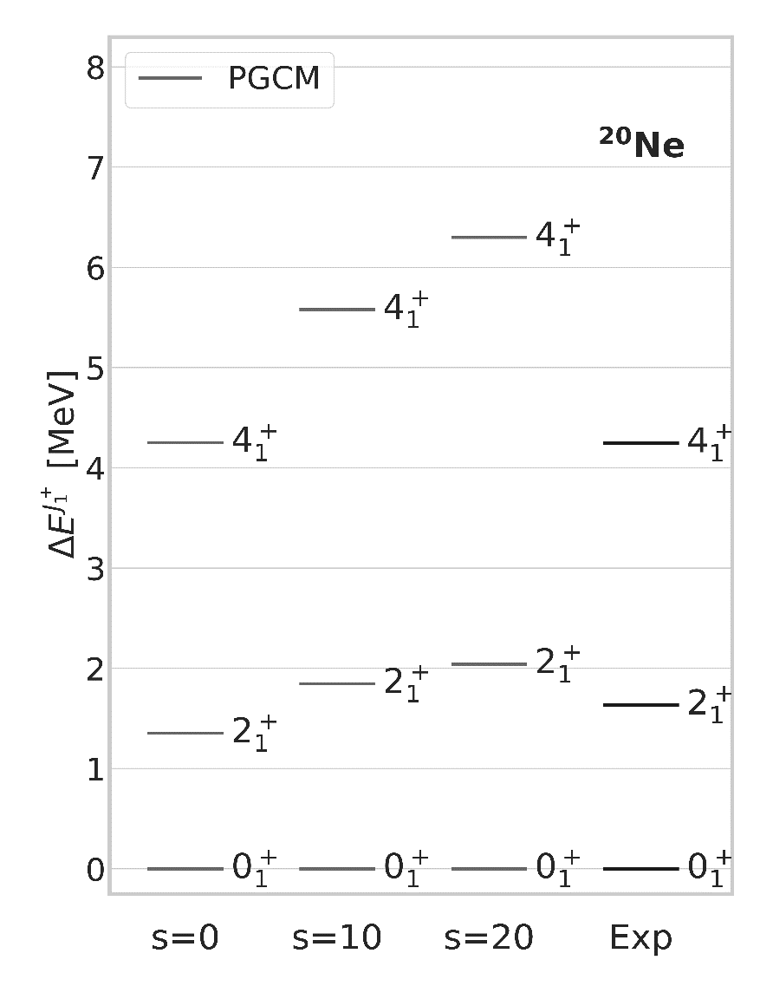
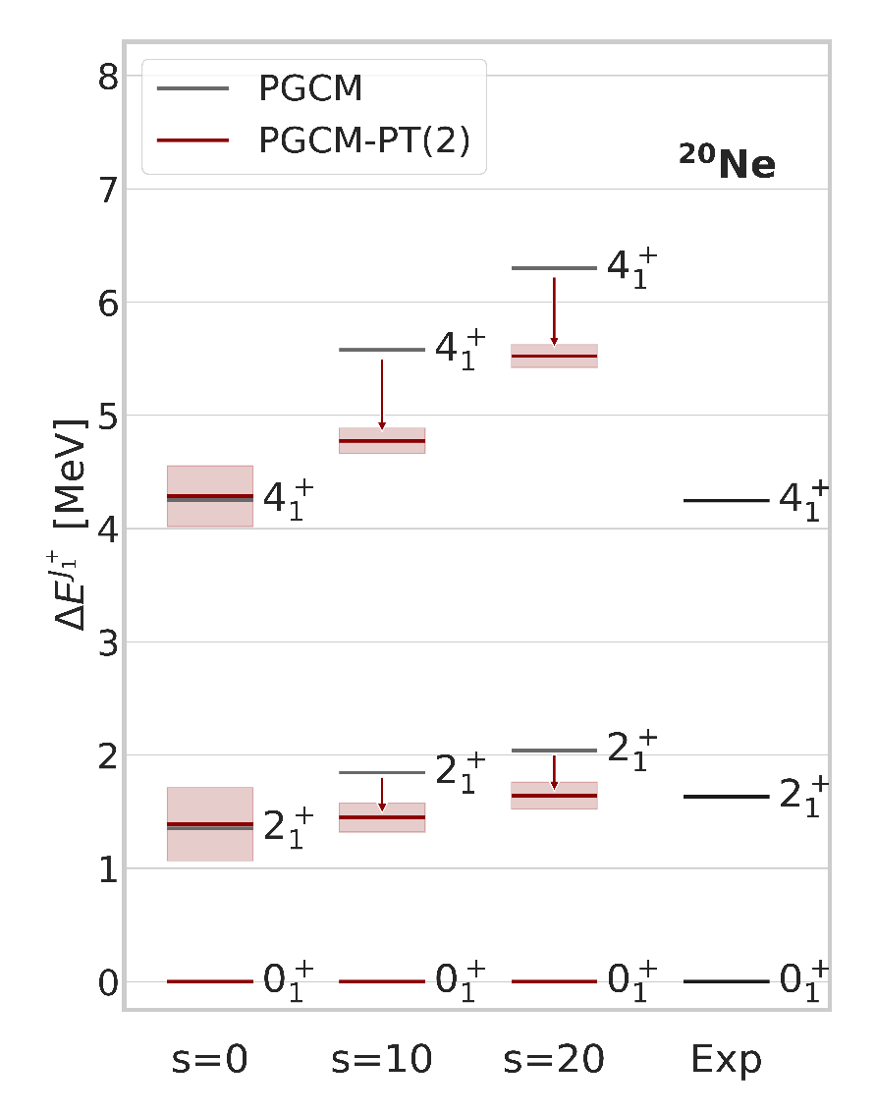
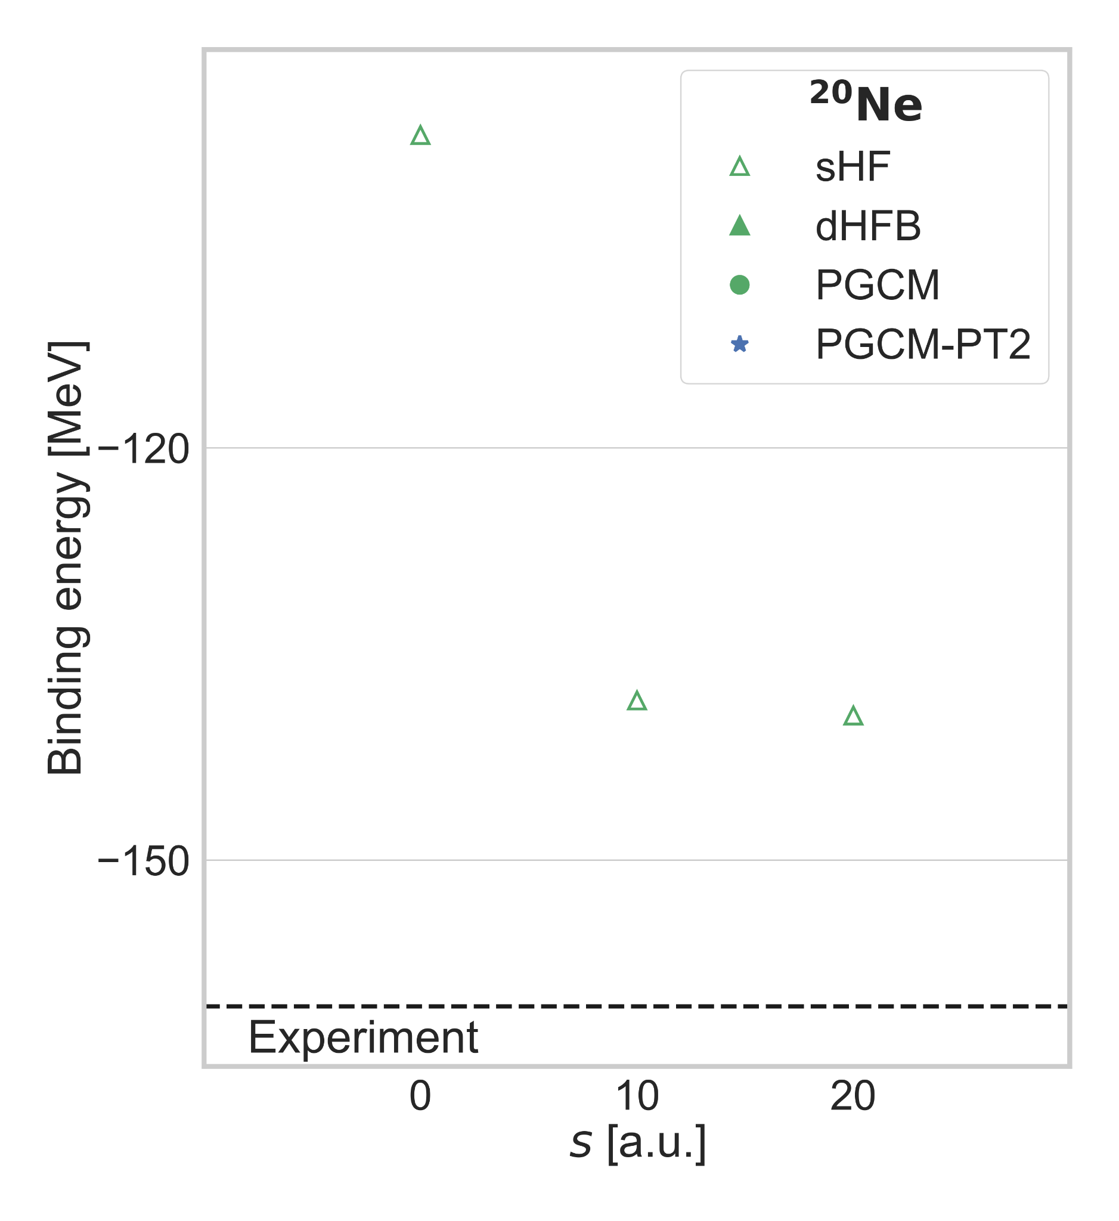
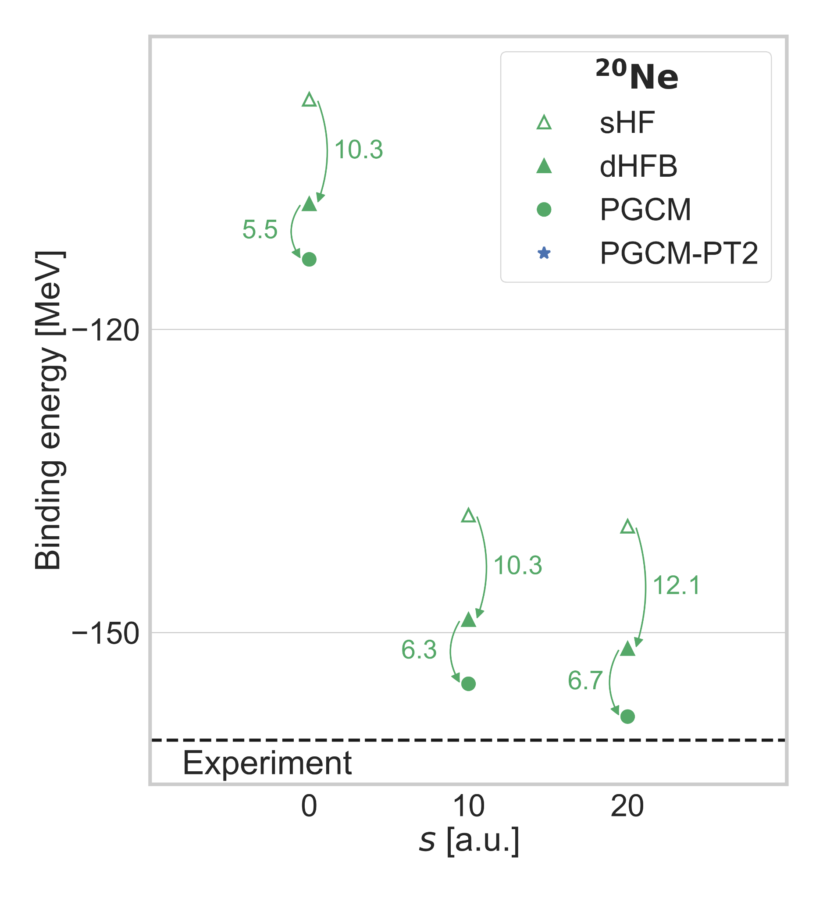
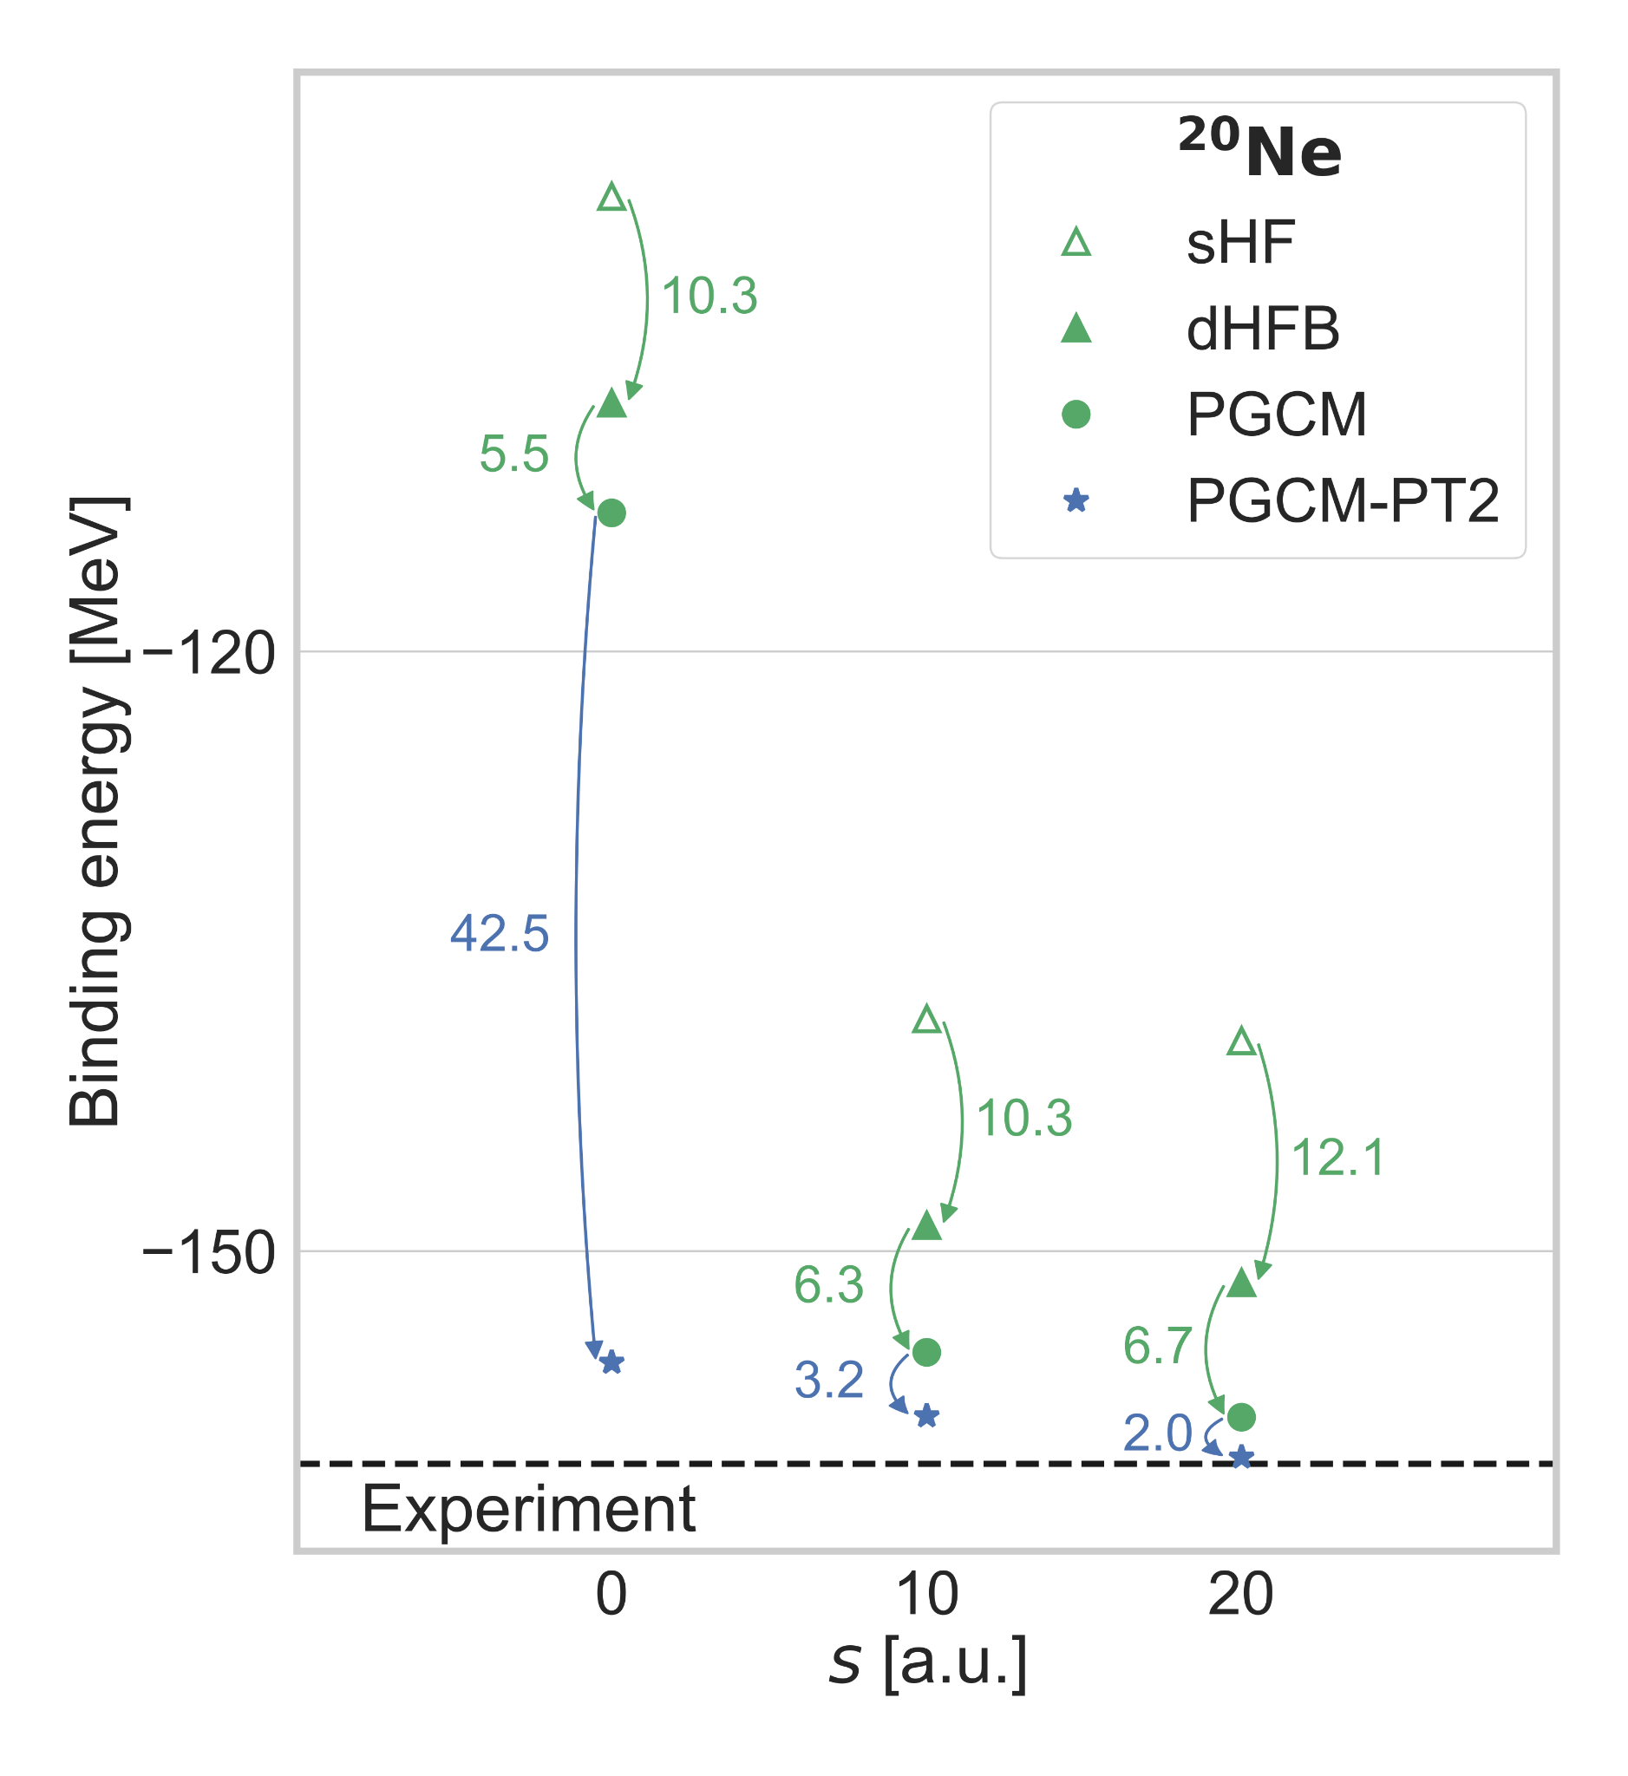
Open-shell systems - 5
Pre-processing of H via MR-IMSRG transformation w/t PGCM state
Static IR
correlations
PGCM
Generalized
multi vacua qp
expansion
MR-IMSRG pre-processing PT
►Lowers drastically sHF reference point (~45MeV)
►Slightly enhances static correlations (15->18MeV)
►Severaly lowers dynamical PT correlations (42->2MeV)
►Remaining dynamical however non negligible (~1.5%)
►Spreads out PGCM spectrum
►PT effect on spectra consistently increased
Dynamical
correlations
PGCM-PT
[M. Frosini et al., EPJA 58 (2022) 62; 63; 64]

Slide 27
Contents
⦿ Introduction
⦿ Expansion many-body methods
⦿ Pre-processing of the Hamiltonian
⦿ Conclusions

Slide 28
Conclusions 1
►Formulation and implementation of an extended portefolio of generalized expansion many-body methods
-Larger and larger span towards doubly open-shell, i.e. all, nuclei
-Unperturbed state can efficiently handle strong static correlations
via symmetry breaking (+ restoration + coll. fluctuations)
with low polynomial scaling (n⁴)
-High accuracy still requires high-order perturbative/non-perturbative truncations on top
►Advantages from MR-IMSRG non-perturbative pre-processing of H
►Latest efforts towards low-lying rotational and vibrational excitations
►Further extensions to consistently describe collective and non-collective excitations at the same time
Note: having several methods based on same rational but different expansion schemes is crucial
►cross-validation and respective limitations
►systematic uncertainty evaluation
►physical understanding&interpretation

Slide 29
Conclusions 2
New « universal » PGCM-PT many-body method
MR unperturbed PGCM state
-Low cost
-Efficiently captures strong static correlations
-Allows access to (collective) excitations
State-specific MR perturbative expansion
Proof-of-principle calculations
  Numerics ok: pre-conditioning, complex shifts
  Absolute energies = 1-2 % accuracy
  Spectra = 20 % accuracy
MR-IMSRG non-perturbative preprocessing of H
-Makes H more perturbative
-Largely resums dynamical correlations
-Remaining PT converged in smaller basis?
Three levers for an accurate / versatile / optimal / consistent nuclear structure description
Preprocessing of Hamiltonian via e.g. MR-IMSRG: further improve decoupling?
PGCM to capture static correlations at low computational cost: further enrich to improve a) and c)?
PGCM-PT(2) to bring remaining dynamical correlations: converged in smaller basis thanks to a)?
Optimal compromise still to be investigated

