Slide 1
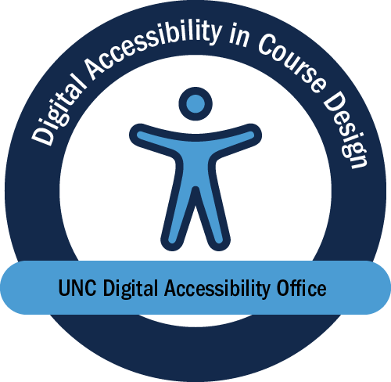
Digital Accessibility in Course Design
Jamie Storyward
Notes:
My name is Jamie Storyward and my final project for the MEITE program is the Digital Accessibility in Course Design training. I created this training in coordination with UNC’s Digital Accessibility Office. I converted the content from a recorded webinar to interactive, self-paced training with a directed capstone.

Slide 2
Overview
UNC Instructional faculty and staff
Prepare instructors to evaluate and improve the accessibility of their digital course materials
This Photo by Unknown Author is licensed under CC BY-NC-ND
Notes:
Its goal is to prepare UNC instructors to evaluate and improve the accessibility of their digital course materials.
Put another way, the goal is to prevent the UNC community from needing to puzzle their way through experiences like this. This slide shows insufficient text size and color contrast. It also fails to use built-in content organization tools like Headers and bullets. Lastly, it includes a decorative image and auto-playing media that the user cannot control.

Slide 3
Course Overview
Digital accessibility in course design
Prepare UNC instructional faculty and staff to evaluate and improve the accessibility of their digital course materials.
Create inclusive, accessible educational experiences.
Notes:
Learners: instructional faculty and staff at UNC Chapel Hill
Objectives:
Support your students and all learners by creating inclusive, accessible educational experiences.
Understand the legal, ethical, and social imperatives to create and promote accessible digital course content.
Produce digital content that is perceivable, operable, and usable to all learners, including those who use assistive technology.
Create easy-to-understand digital course content that is clearly communicated and logically organized.
Develop strategies to keep your course content up-to-date and easily accessible as technology changes.
Make use of the available tools and resources at UNC and beyond to aid you in creating and maintaining accessible digital course materials.

Slide 4
Incorporation of External Tools
Digital accessibility in course design
Content in Articulate Rise encourages use of other tools
Color contrast analyzer
Adobe Acrobat
Automated Accessibility Checker
Screen reader
Others
Transferrable skills
Notes:
Scaffolding: guided practice

Slide 5
Personal Application
Digital accessibility in course design
Instructors conduct an independent assessment of a course
Checklist customized to course
DAO available to assist
Notes:
Independent practice

Slide 6
Try it for yourself!
Digital accessibility in course design
https://uncch.instructure.com/courses/156

