Slide 1
The Power of AI on language learning app
A case study of ELSA Speak
Thuc Anh Pham
anhplt@unc.edu
ltanhpham@gmail.com

Slide 2
From CALL to MALL
2000s
Desktop Dominace + Web-based Platforms
Early 2010s
Mobile Revolution + Gamification
Mid 2010s
Personalization+ Focus on Conversational Practice
Late 2010s
AI-Powered Chatbot and Pandemic Surge
2021 onwards
Advanced AI Integration

Slide 3
ENGLISH LEARNING SPEECH ASSISTANT
AI-powered English Speaking Coach

Slide 4
TOWS matrix | Strength: Extensive AI-based lesson database for paid users
Opportunity: Content Adaptation for Gen Z's preference | Deepen content by incorporating popular media into lessons

Slide 5
TOWS matrix | Strength: Extensive AI-based lesson database for paid users
Opportunity: Content Adaptation for Gen Z's preference | Deepen content by incorporating popular media into lessons
Threat: High Threats of Substitute Products | Provide free trial when user share promote the app

Slide 6
TOWS matrix | Strength: Extensive AI-based lesson database for paid users | Weakness: Complicated UI leading to confusion
Opportunity: Content Adaptation for Gen Z's preference | Deepen content by incorporating popular media into lessons | Clarify pages by adding description and help button
Threat: High Threats of Substitute Products | Provide free trial when user share promote the app | Clarify pages by adding description and help button

Slide 7
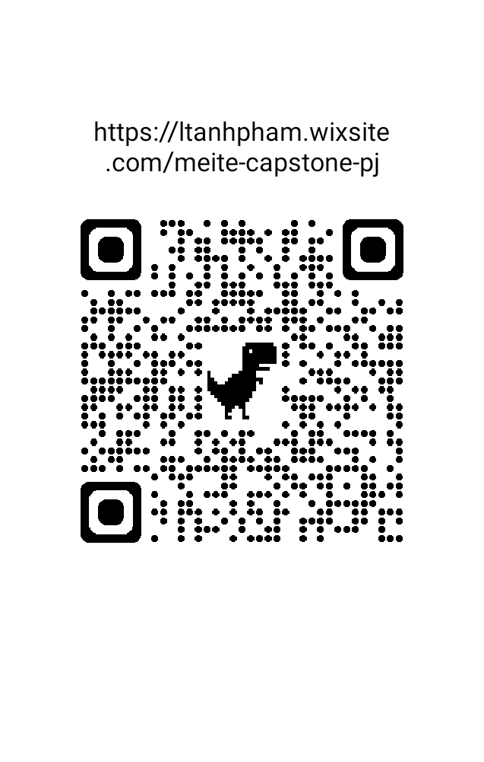
Thank you!
Thuc Anh Pham
MEITE '24
anhplt@unc.edu
ltanhpham@gmail.com
https://ltanhpham.wixsite.com/portfolio

