Slide 1
Lindsay Hann
MEITE Innovation Showcase 2024

Slide 2
Industry Overview
Education Technology Evaluation's contributions to the education ecosystem:

Slide 3
Key Player
A UK-based company offering services to both educators and edtech companies.
Edtech evaluation marketplace
Specialized evaluations
Edtech analytics tool
Honorable Mentions:
LearnPlatform by Instructure
ISTE
McREL International

Slide 4
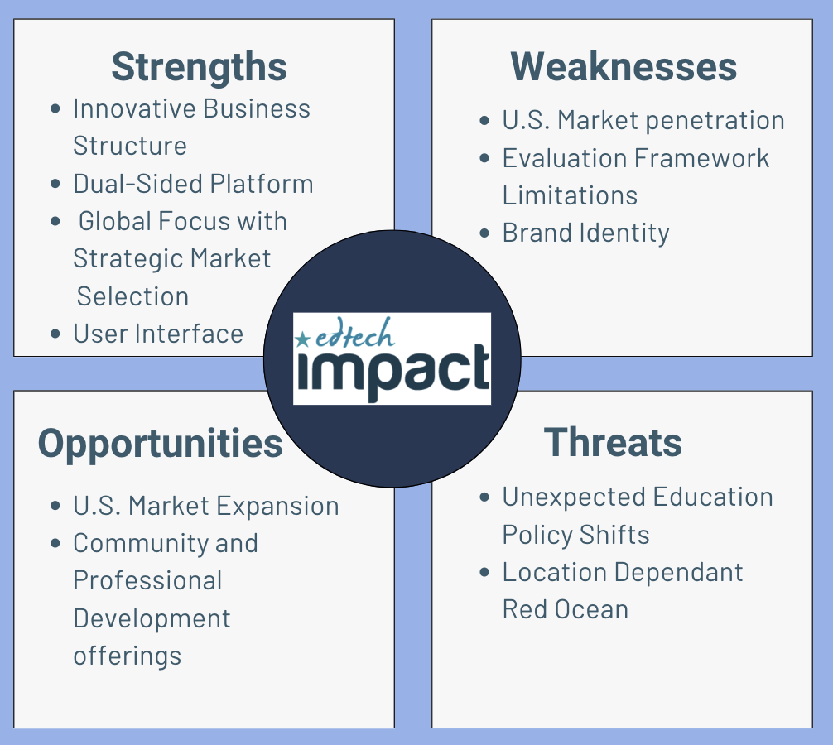
SWOT

Slide 5
Predictions and Next Moves
Intergration of AI to enhance evaluation processes, not replace them
Edtech evaluation companies may face increasingly stringent regulations and policies
Switch in processes to evaluate as creating rather than creating then evaluating.
Edtech Impact U.S. Market Expansion Plan
Create an evaluation framework based on the ESSA Standards
Partner with a higher education institution to create an office of innovative education research and evaluation
Conduct community outreach to gain local U.S. users in the market place

Slide 6
Thank you!
Check out my full thesis here:
Lindsay Hann
Innovative Specialist
Lrhann@unc.edu
lindsayrosehann.com

