Slide 1



AI-Powered Professional Development:
Unveiling LinkedIn Learning’s Innovations
MEITE
2024
By: Elle Gallagher

Slide 2

Professional Development
  Rise of computer usage
  Technical skill development
  Data globalization
  MOOCs
  COVID: Online learning
  AI-powered chatbots
  Dynamic content
Early 2000s
2010s
2020s
Present
  Customized recommendations & feedback
  Mobile learning
  Gamification
  Personalized learning
  Videos & simulations
  Micro-credentials/
certificates

Slide 3


Predictions
2030
Technology
  Personalization
  Detailed data analytics
Investments
  Chatbots
Societal Acceptance
  Positive results & regulations
New Skills
  Automating repetitive tasks

Slide 4

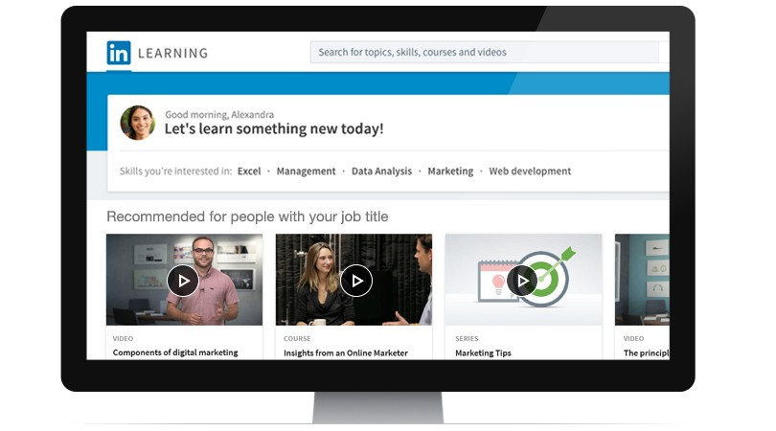
Strengths
  Connection to LinkedIn
  Data analytics from Microsoft & LinkedIn
  Extensive course library
Weaknesses
  Subscription cost
  Lack of emerging technologies
  Internet access required

Slide 5
Recommendations
AI
  Content creation
    Scripts
    Presentation decks
    Assessments
Enhanced personalization
  Course recommendations
  Identification of skill gaps
  Suggest courses
Tiered pricing model

