Slide 1

Adaptive Learning
Platforms
Revolutionizing Education Through Data-driven Personalization
Katie Cooper
Innovation Specialist
MEITE Showcase 2023-2024

Slide 2
What
Adaptive learning platforms are educational systems that use technology to tailor instruction and learning experiences to the individual needs and abilities of each student, optimizing their learning outcomes.
Why
These platforms aim to address diverse student learning needs and paces, enhancing engagement, retention, and performance through personalized, efficient, and effective instruction.
How
Adaptive
Learning
Overview
Adaptive learning platforms use artificial intelligence to continuously assess each student's progress and knowledge gaps. They then adjust the content, pace, and delivery method of instruction in real-time to provide personalized learning experiences that maximize each student's potential.

Slide 3








Features
Customized Pathways
Artifical Intellegence
Real-Time Feedback
Gamification Elements
Learner Analytics
Benefits
Differentiation
Data-Driven Insights
Increased Motivation
Helps teachers tailor teaching strategies to individual student needs, addressing diverse learning styles and paces.
Provides detailed reports on student performance, helping teachers identify trends and target interventions effectively.
Customizes learning paths to student interests and proficiency levels, boosting engagement and motivation with gamified elements.

Slide 4




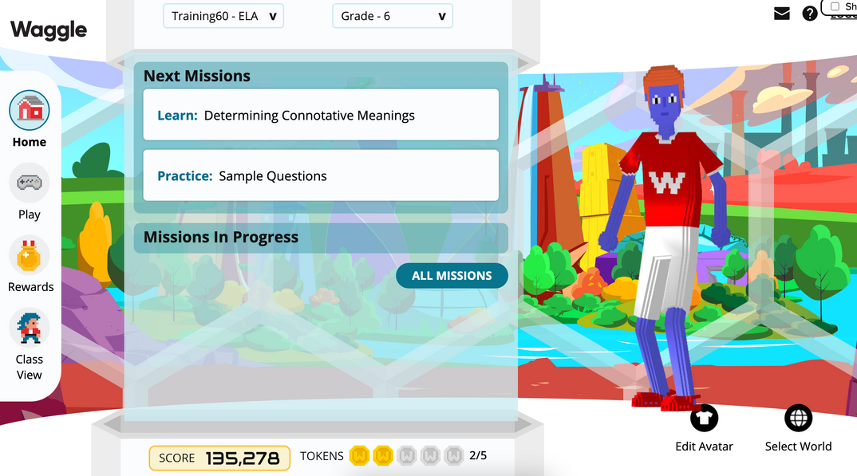
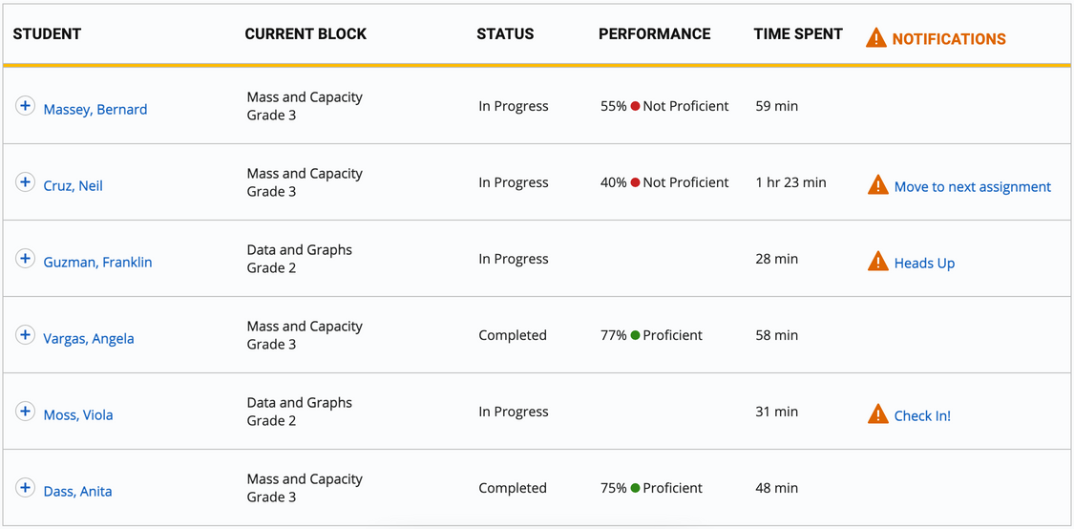
New Logo as of July 18th, 2024
Key Player
Among innovative adaptive learning platforms is Waggle, an adaptive learning math and ELA platform designed to provide personalized educational experiences for K-12 students.
Student View with Gamified Elements
Teacher View with Personalized Reports

Slide 5
Predictions for the Future
1
2
3
These programs will continue to evolve with the possibility of becoming more immersive and higher evidence-based programs.
Future platforms will be designed to cater to various abilities, ensuring inclusivity for students with different needs.
Enhanced AI and data analytics will enable more precise and dynamic adaptation of learning content.

Slide 6


Thank you!
Scan Here to Read My Full Thesis
Contact Me!
Kpcoope@gmail.com

