Slide 1




MEITE 2024
Innovation Showcase
Presented by Chiao-Jen Chang

Slide 2

Navigating the Future of Language Learning:
A Critical Analysis of AI Integration and Ethical Considerations
AI is changing language learning by providing personalized and engaging experiences. This research will explore AI in language instruction, its potential and limitations. With a focus on current language applications, compare the performance of artificial intelligence to human instruction, and discuss ethical issues like data protection and educational equity. By evaluating the impact of AI, we hope to provide a fair perspective on its potential and challenges in language learning.

Slide 3
Industry Growth and Future Projections
Growth Rate:
  The online language learning market was valued at USD 14.5 billion globally in 2022, and during the forecast period, a CAGR of 14.1% is anticipated.
Future Projections:
  Mobile Learning: Voice recognition, instant feedback, and gamified learning.
  AI Integration: AI-driven platforms will provide personalized and adaptive learning , with real-time feedback and comprehensive practice.
  VR Field Trips: VR will allow learners visit the foreign countries virtually, to have the opportunity to experience the culture, enhancing cultural immersion and language practice.
  AR Integration: AR can provide more interactive experiences with the real-time translations and exercises.

Slide 4
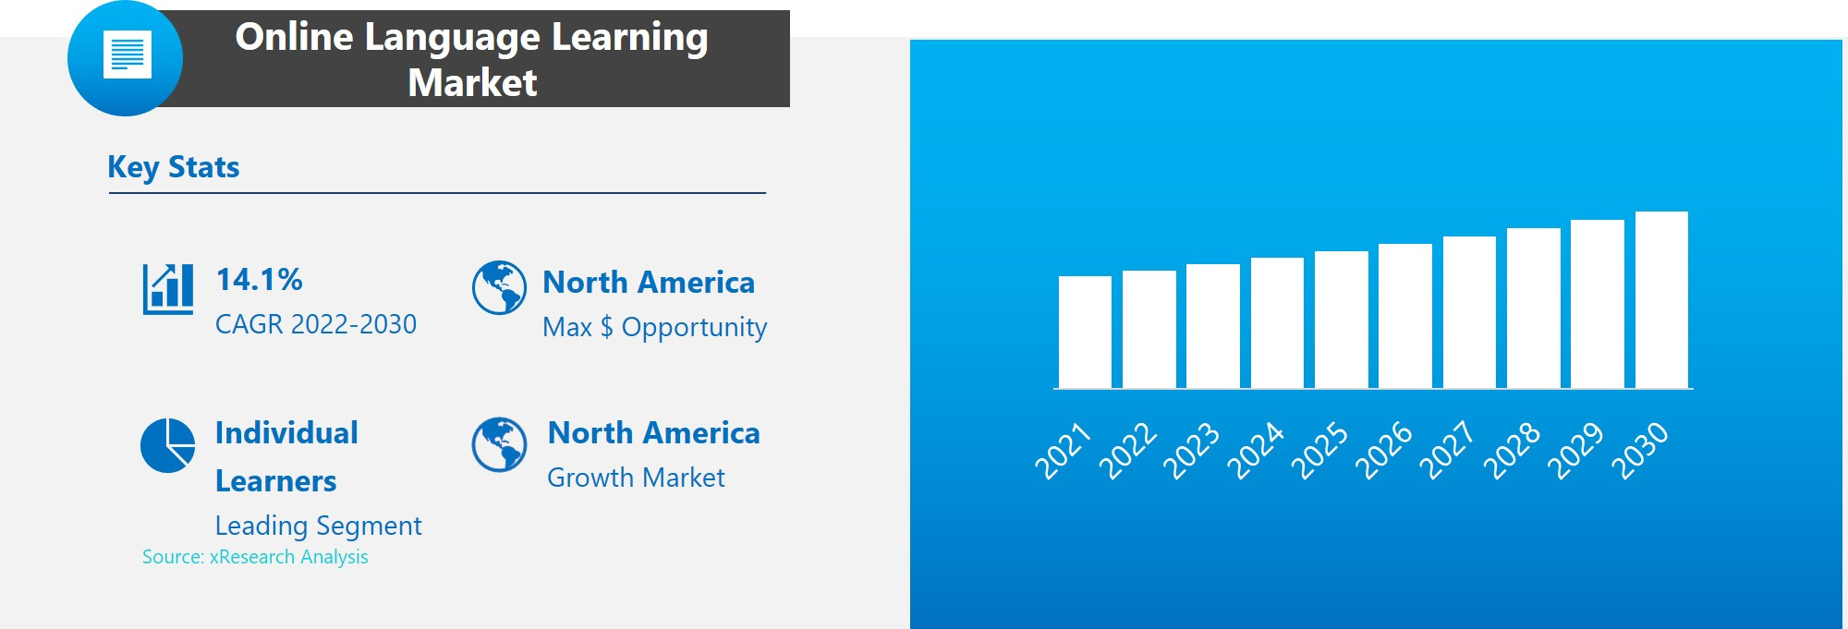
(Recourse by xResearch Analysis)

Slide 5

Introduction of Duolingo:
  Background:
  Founded in 2011 by Luis von Ahn and Severin Hacker.
  Duolingo is a leading online language learning platform with over 500 million registered users worldwide.
  Mission:
  To make education free and accessible to everyone.
  Products and Services:
  Offers language learning courses in over 30 languages.
  Features include gamified lessons, AI-driven exercises, and a community of learners.

Slide 6

S
W
STRENGTHS
  Gamified learning keeps users motivated
  Available on multiple platforms
  Wide range of language options
WEAKNESSES
  May not fully develop speaking and listening skills
  One-size-fits-all approach
O
T
OPPORTUNITIES
THREATS
  New features like Stories and podcasts
  Development of more specialized courses
  Expansion into corporate training
  Growing number of competitors
  Concerns over data security
  Challenges in sustaining revenue

Slide 7
Industry Predictions for 2024:
  AI Integration: More personalized, adaptive learning.
  VR and AR: Enhanced immersive and interactive learning.
  Gamification: Increased engagement and motivation.
  Corporate Training: Growth in corporate language programs.
Predictions for Duolingo:
  Enhanced AI Features: More personalized feedback and conversational practice.
  VR and AR Adoption: Immersive and interactive learning experiences.
  Expanded Course Offerings: Offer more advanced and more specialized courses.
  Corporate Partnerships: Increased corporate training collaborations.
  New Revenue Streams: Diversified monetization strategies.

Slide 8
Key Discussion Points and Recommendations
Enhance Personalization:
  Develop more personalized learning paths to cater to individual needs, especially for intermediate and advanced learners.
Expand Interactive Features:
  Integrate more speaking and listening exercises to improve conversational skills.
Diversify Revenue Streams:
  Explore additional monetization strategies, such as partnerships with educational institutions and corporate training programs.

Slide 9
Recourses
  https://pressbooks.nebraska.edu/iblog/chapter/the-future-of-language-education-trends-and-predictions-for-2024/
  https://blog.osum.com/duolingo-swot-analysis/
  https://www.linkedin.com/pulse/online-language-learning-market-size-estimated-grow-cagr-i02kf/
  https://www.prnewswire.com/news-releases/online-language-learning-market-size-is-to-grow-usd-37400-million-by-2030-at-a-cagr-of-18-1--valuates-reports-302043204.html
  https://www.xresearch.biz/shop/online-language-learning-market

Slide 10
Thank
You
Presented by Chiao-Jen Chang

