Slide 1
Ingoude Company

Slide 2
01
03
02
Integrated Curriculum
Events and Competitions
Experiential Learning
Our courses combine design thinking, modern technology, and social studies content.
We host events throughout the program to maintain energy and foster creativity.
Students will apply skills to design solutions to real problems.

Slide 3
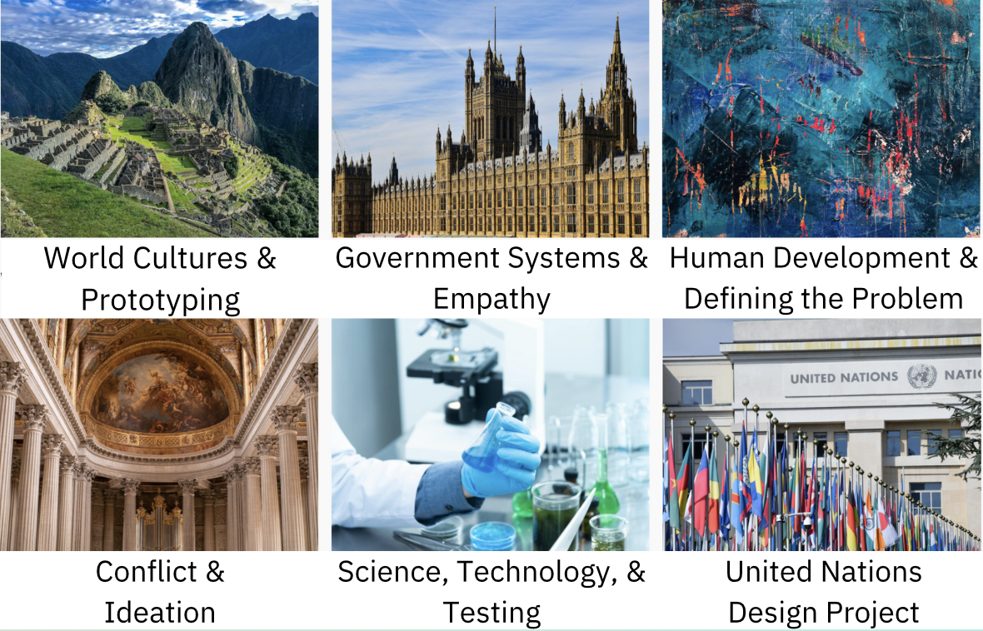
Support for Educators
Course frameworks and ready-to-use lesson plans
1
Training on design thinking and coaching
2
Logistics, partnerships, and community
3
World History units

Slide 4
Grounded in Theory
Further efforts are needed to create instructional materials and strategies...[to] support teacher practice in ways that help students develop transferable knowledge and skills.
Susan Goldman and James Pellegrino (2015)

Slide 5
$140,000
Step 1
Curriculum development
Step 2
Partnerships
Step 3
Digital Platform

