Slide 1
ATHLETE CONNECT
Livi Lawton
26 July 2024
484-252-3442
livi@live.unc.edu

Slide 2
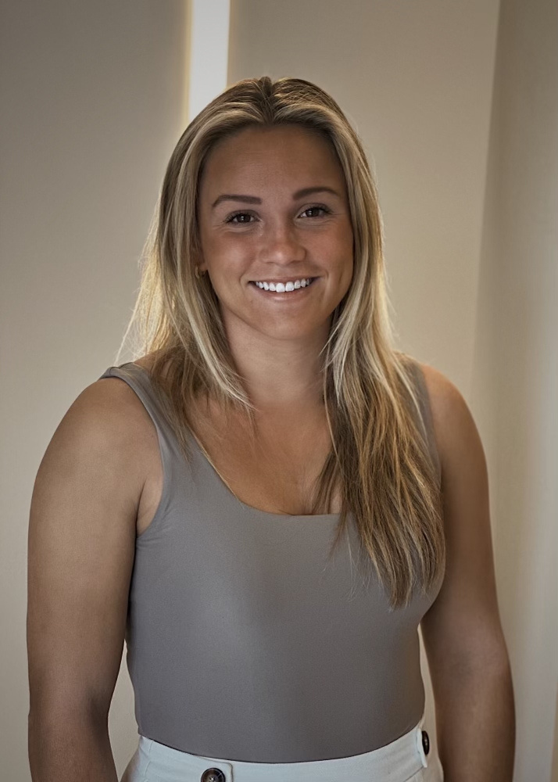
The Founder
Livi Lawton
Downingtown, PA
The University of North Carolina at Chapel Hill
B.A. in Media and Journalism (Advertising and Public Relations
M.A. in Educational Innovation, Technology, and Entrepreneurship

Slide 3
AthleteConnect
AthleteConnect is a digital platform that links collegiate athletes with former athletes now in the workforce. Addressing the demand for athletes’ unique skills, it simplifies the career search for both athletes and employers and also includes mentorship programs. AthleteConnect facilitates connections between job-seeking college athletes and professionals in various industries Available as a smartphone app, it offers a comprehensive solution for seamlessly connection athletes with industry professionals.

Slide 4
The Idea
Mentorship Opportunities
Job Search
Workshops
Community

Slide 5
The Ask
$150,000 in support of AthleteConnect. We will work together to...
Gather essential resources to launch the app
Establish core members of the team
Initiate key marketing efforts

Slide 6
The Problem
Employers miss out on top talent from the collegiate athlete graduate pool. AthleteConnect is the one-stop-shop for everything you need post grad in the workforce. You have top-level, moldable graduates looking to make a difference at your business.
College graduates have a really difficult time finding jobs. Collegiate athletes are also trying to navigate translating not only their academic achievements but also athletic skills to the workforce.

Slide 7
The Impact
Long-Term Mentors
Sense of Community
Improved Preparation Skills
Resume Building
Career Landings
Hungrier Workforce

Slide 8
Theory of Change

Slide 9
MVP

Slide 10
Thank You
Livi Lawton
AthleteConnect
484-252-3442
livi@live.unc.edu

