Slide 1


Slide 2
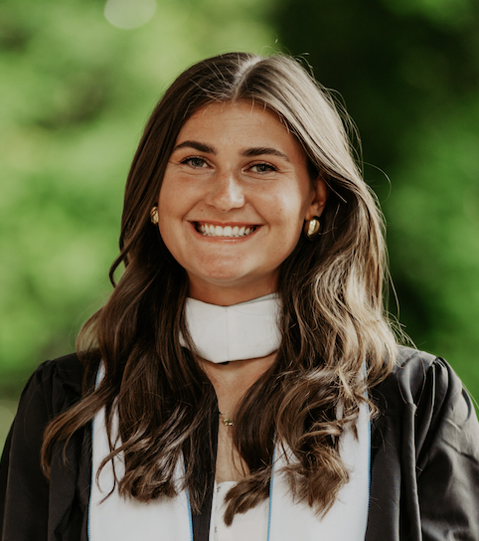
Our Founder
Our founder and CEO, Flynn Reed is a recent graduate from the University of North Carolina at Chapel Hill’s MEITE program. Before MEITE, Flynn was student teaching at a public Elementary School in North Carolina. While teaching a science lesson about the environment, she was advised not to discuss global warming or human environmental impacts with her students. She also saw a common theme of limited environmental education being taught. Wanting to combine her passion for education, while also pursuing the possibility to make a change, Flynn launched EnvironEd.
Flynn Reed

Slide 3
Mission
Educate
Educate young students ages 5-8 about ecosystems, environmental impacts, and conservation of various ecosystems and regions in North Carolina.
Target
Students ages 5-8 years old
Inspire
Eliciting student interest in exploring the world and environments around them.
change
We want to rewrite the future of the environment and create strides towards positive conservation efforts and tackling issues like climate change.

Slide 4

About us
Accessible
Engaging
Interactive
Students can download the app onto portable devices, so they can learn outside of school hours.
Has games, videos, and maps to help engage students in the process of learning more about environments and climate issues specifically within North Carolina.
Utilizes AR features, where students can explore and learn about species and environments within North Carolina regions.

Slide 5

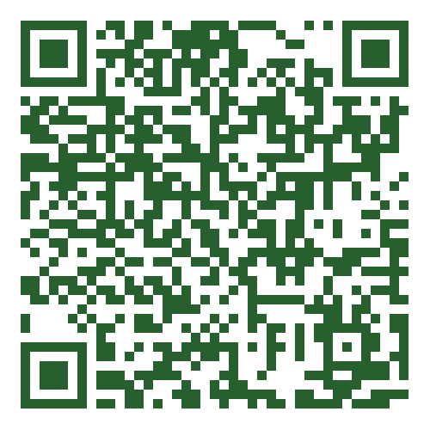
How to get involved
Donate
Seek donations from individuals, corporations and foundations interested in contributing to educational initiatives for children.
Support
EnvironEd wants to spread the word of their purpose and message behind the purpose of the product.
Partner
Seek partnerships and sponsorships that aligns with their mission to educate young students about the environment, species, and environmental conservation.
We are seeking to reach a target goal of 185,000 of initial funding

