Slide 1
Champion Training
Autumn Owen

Slide 2
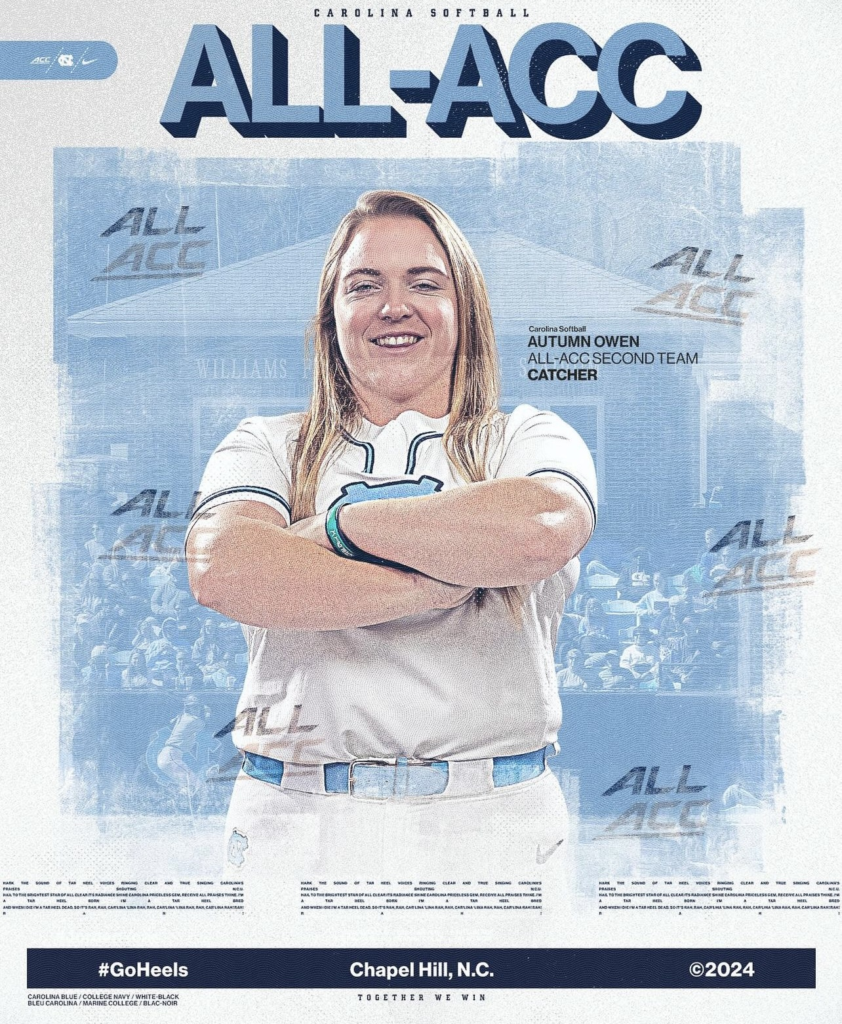
My Story

Slide 3
Services Available
Private Lessons
Rental of individual cages/facility
Weight training program

Slide 4
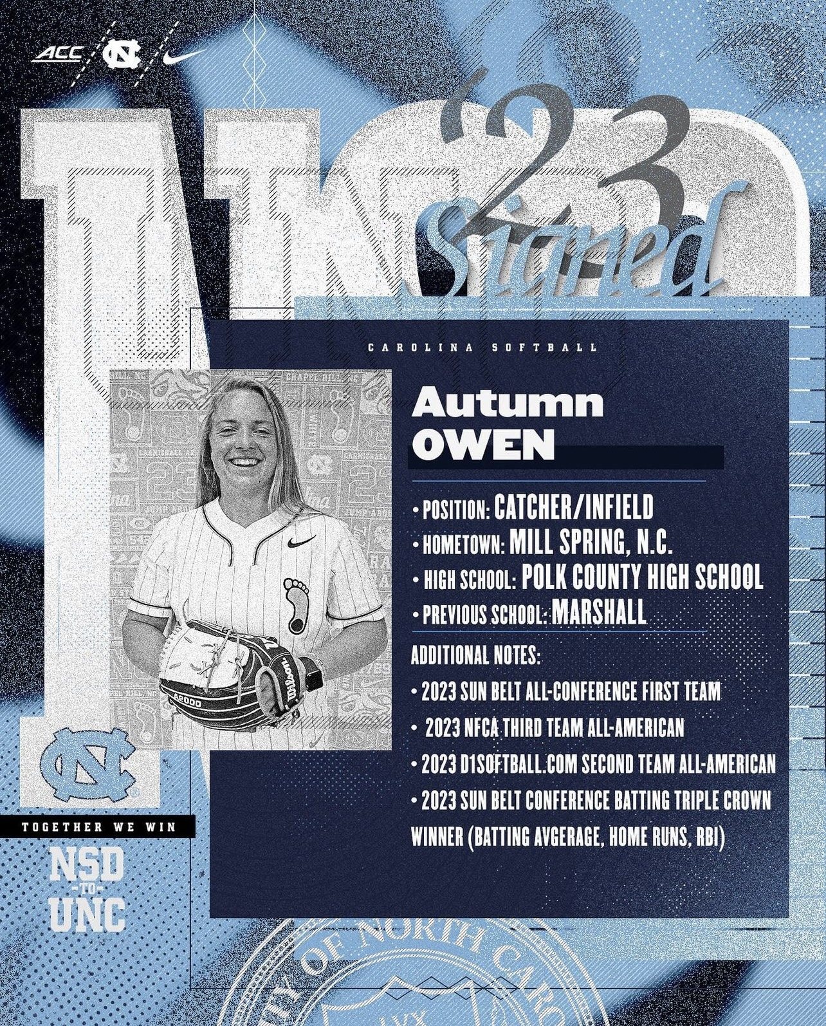
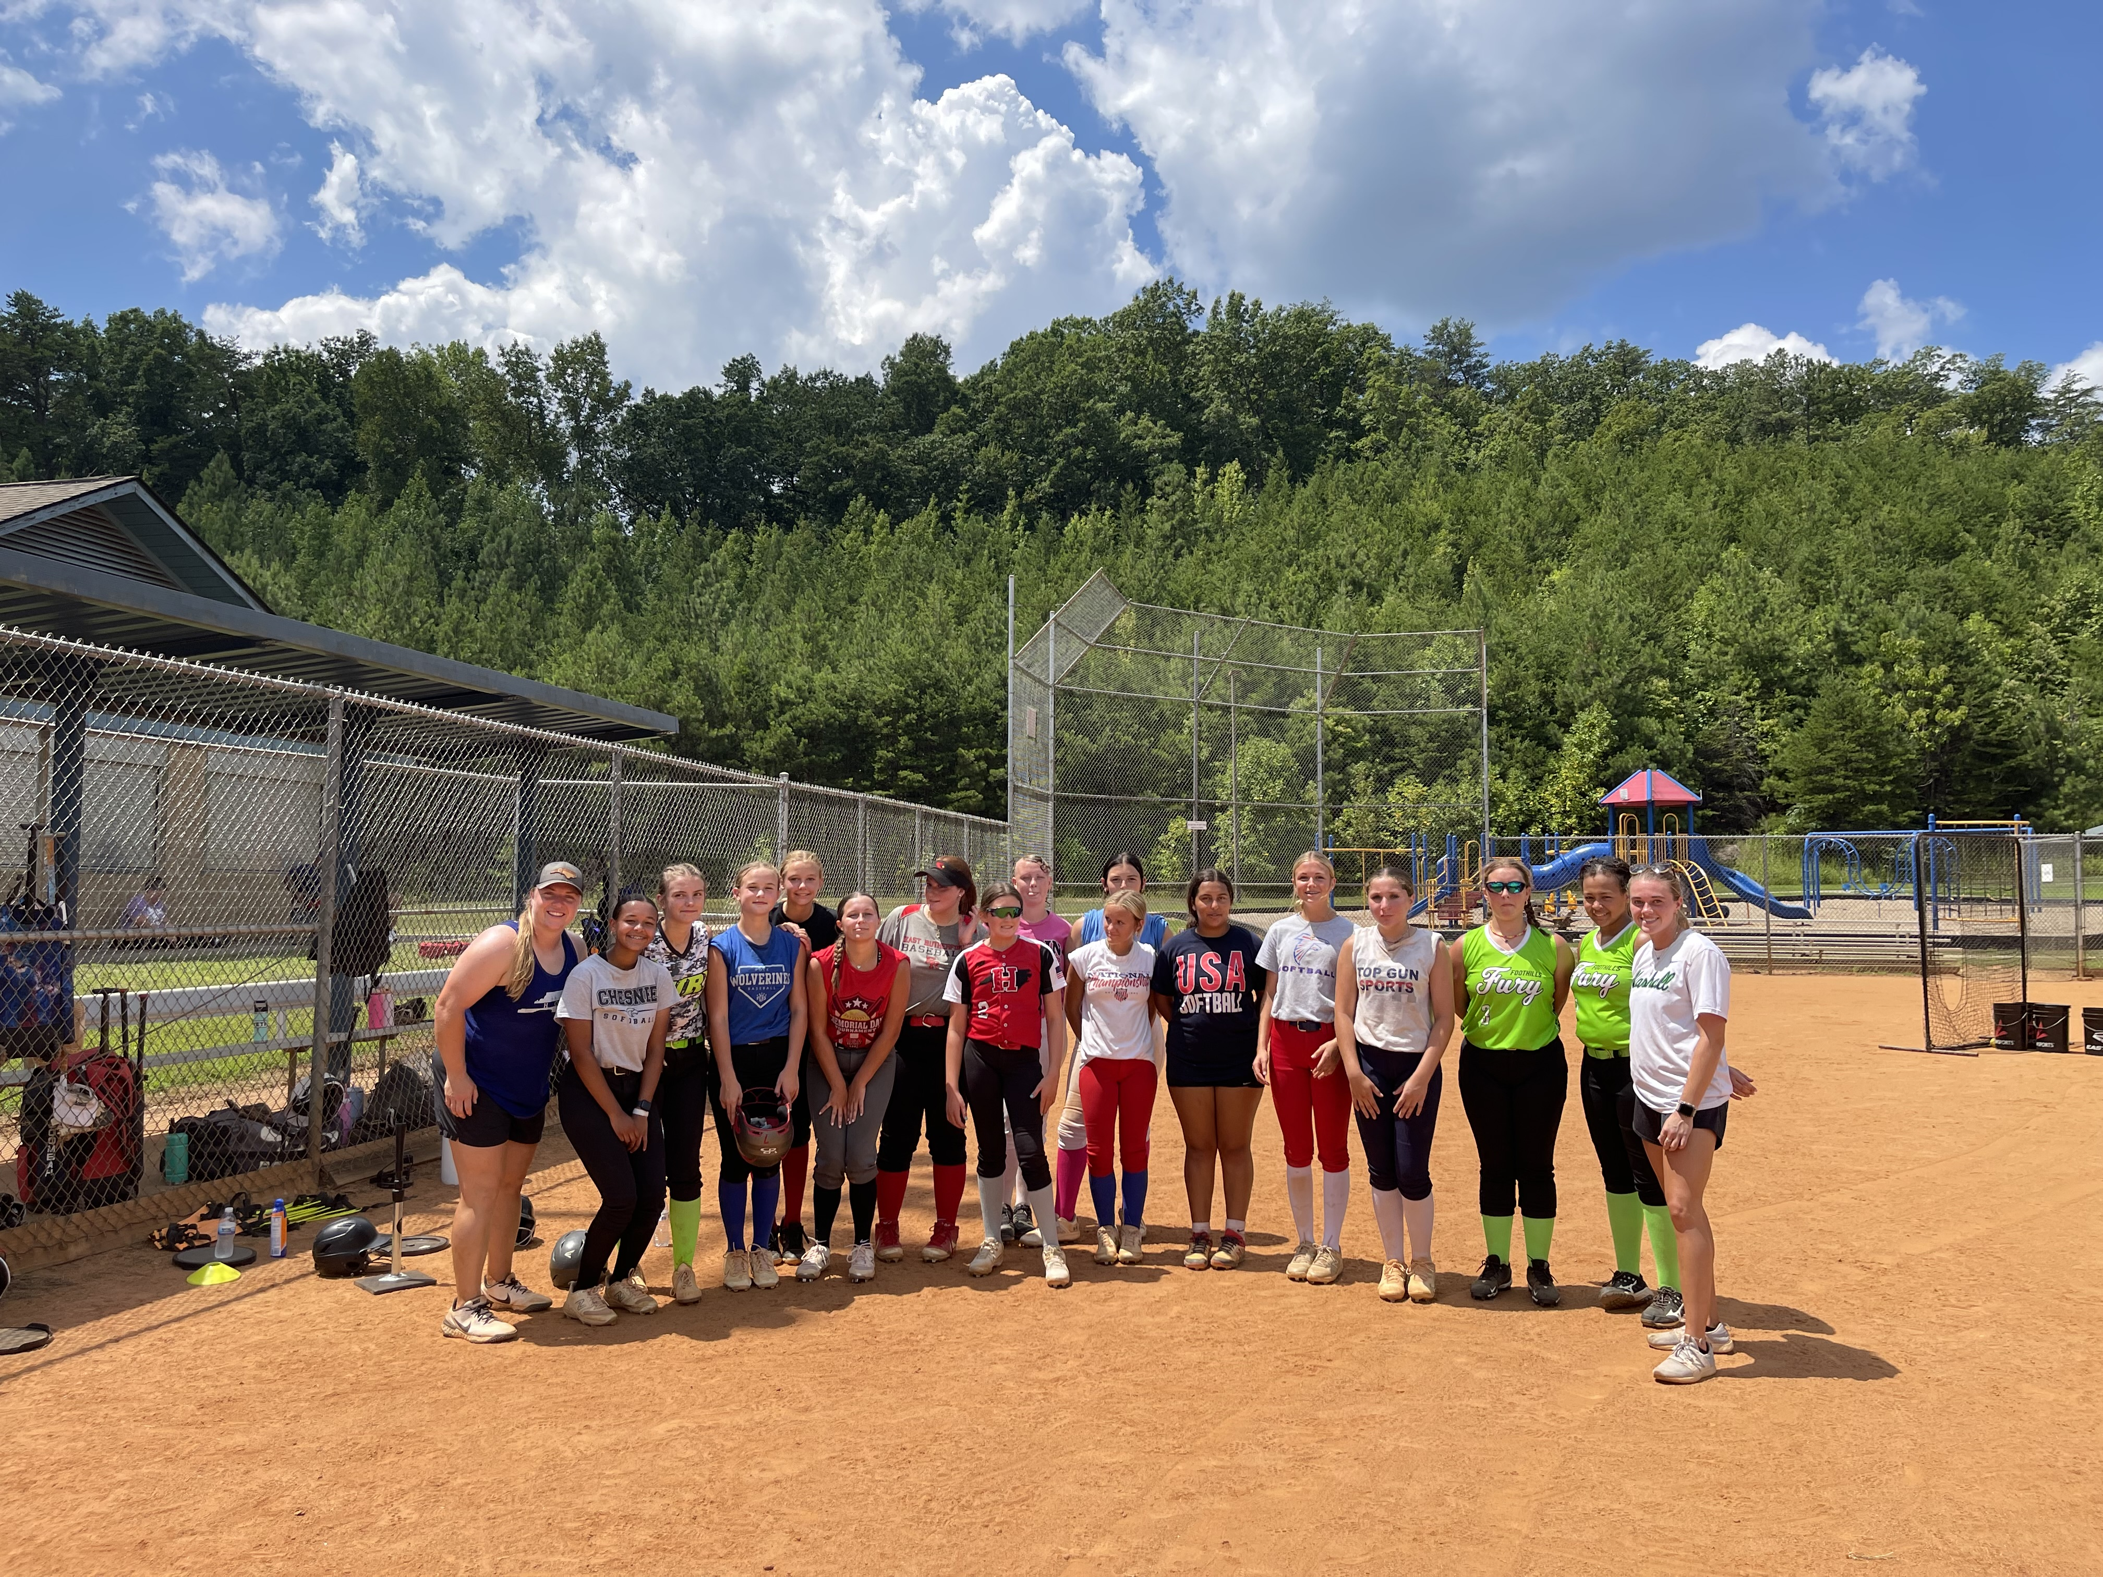
Impact

Slide 5
What do we need?
($700,000)
Upfront cost for warehouse
Installment of cages/turf
Basic gym equipment

