Slide 1
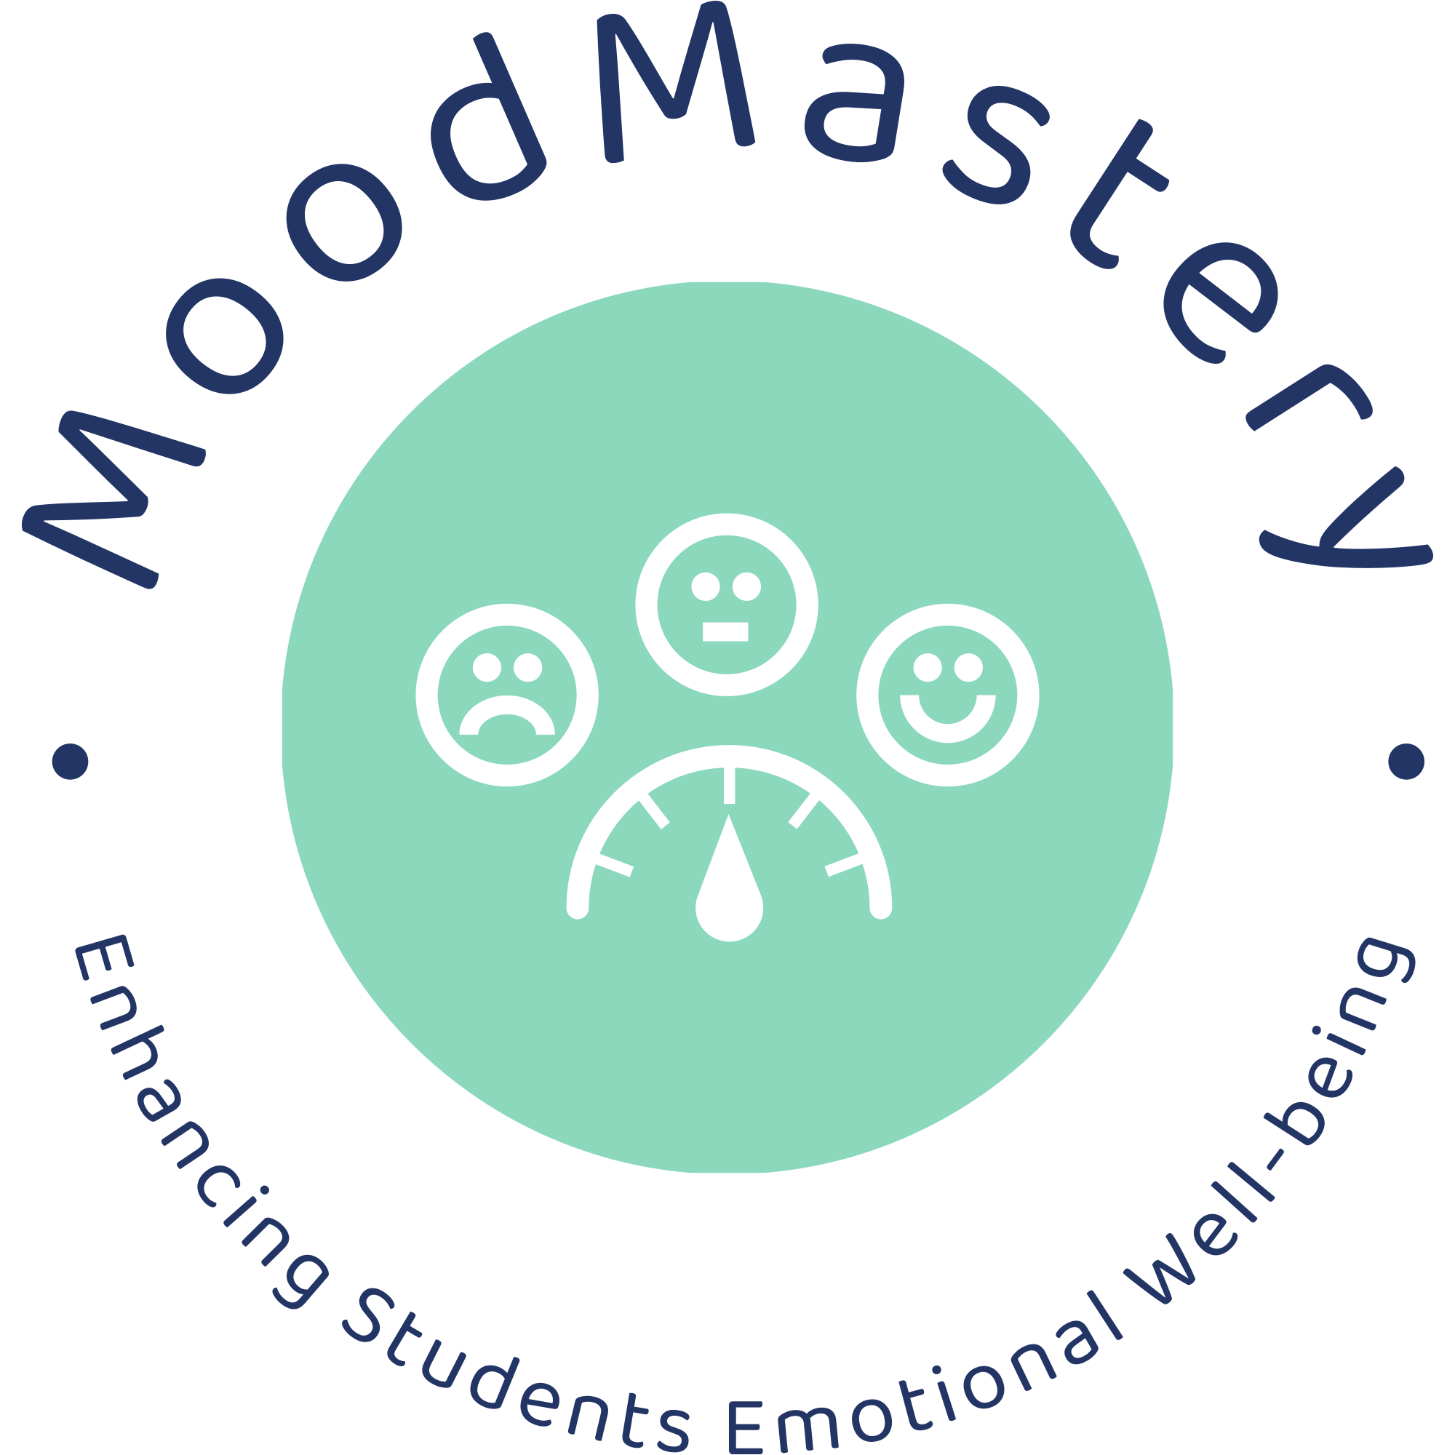
MoodMastery Adaptive learning environment ---prioritize emotional well-being
Zixing Li

Slide 2
Course Modules
High school students who fail to regulate emotions cannot engage in learning activities actively
Basic Emotion regulation principle learning
Emotion regulation journey
Emotion regulation evaluation
Explain the framework of emotion regulation theory
Recognize emotional state and use effective emotion regulation strategies
Assessing Personal Emotion Regulation Skills to Enhance Emotion Management Capabilities

Slide 3
Personalized learning
1
Prior Knowledge
Learner will take pre-test to check their prior knowledge level. Depending the results, different learning paths are provided.

Slide 4
Personalized learning
1
2
Monitoring emotion states
Prior Knowledge
Learner will take pre-test to check their prior knowledge level. Depending the results, different learning paths are provided.
After detecting leaners emotional states, the platform offers different support strategies

Slide 5
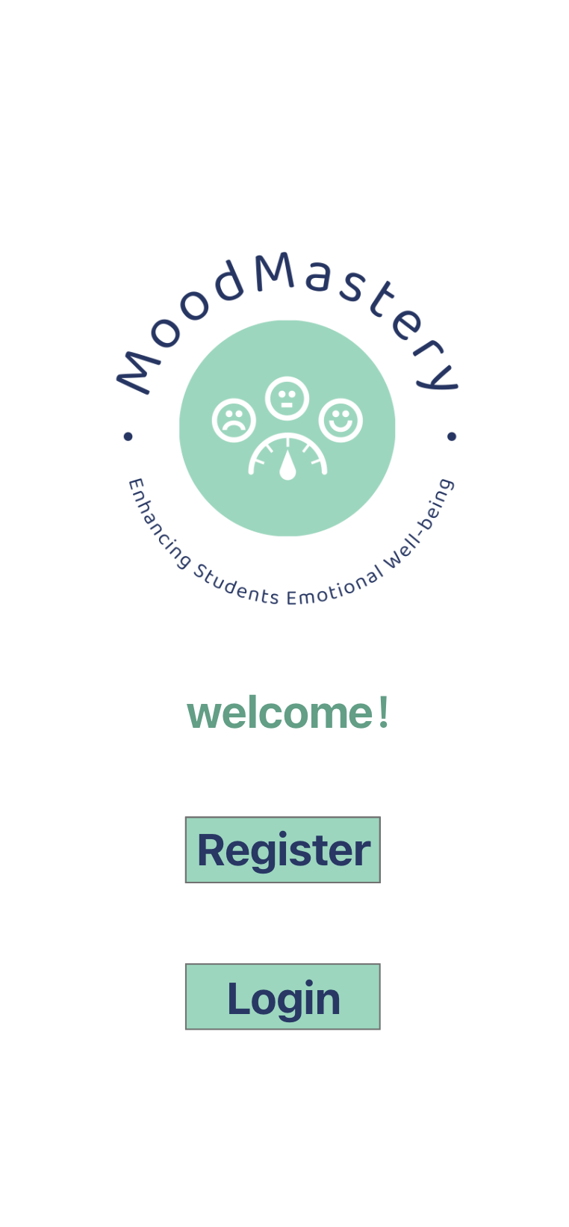
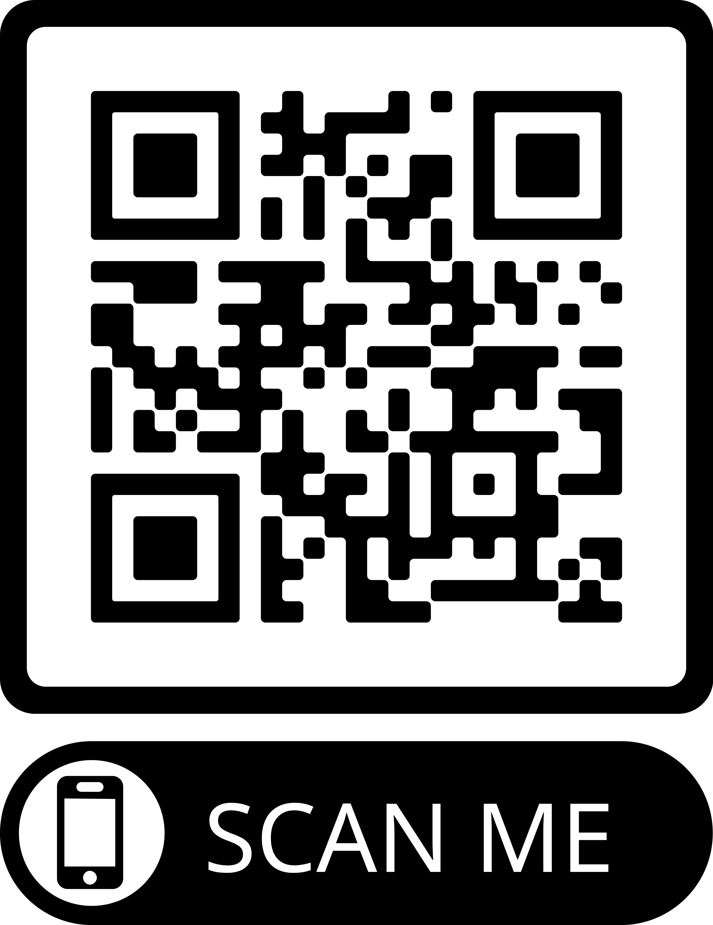
Access the Modules

Slide 6
Thanks!
Do you have any questions?
lizixing@unc.edu
+1 919 358 6766

