Slide 1

Let’s Study Together
Peizhe Zhang
Adaptive Learning Analyst Track

Slide 2





  Middle and High School Students
  Teachers
  Parents
Knowledge Course
Ability Course
Emotion Course
Improve the knowledge points that appear in the activities
Improve students' corresponding abilities according to the types of classroom activities
Regulate students’ emotions based on their comments
  Monitor students' classroom activities
  Provide Comprehensive Evaluation
  Promote Metacognitive Development
  Provide an adaptive learning system after discovering problems in students' classroom activities

Slide 3
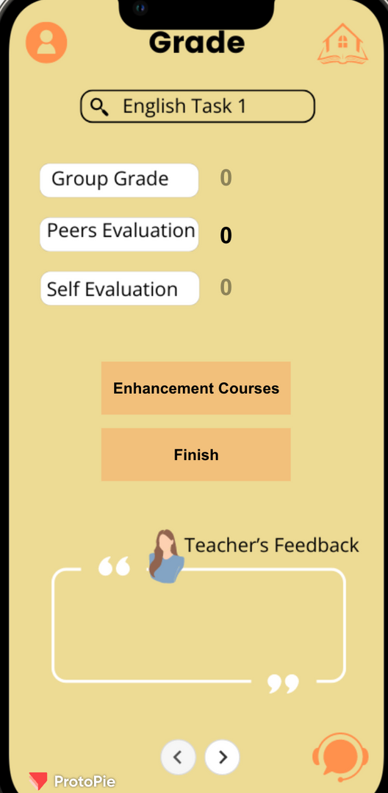
Grade and Performance

Slide 4
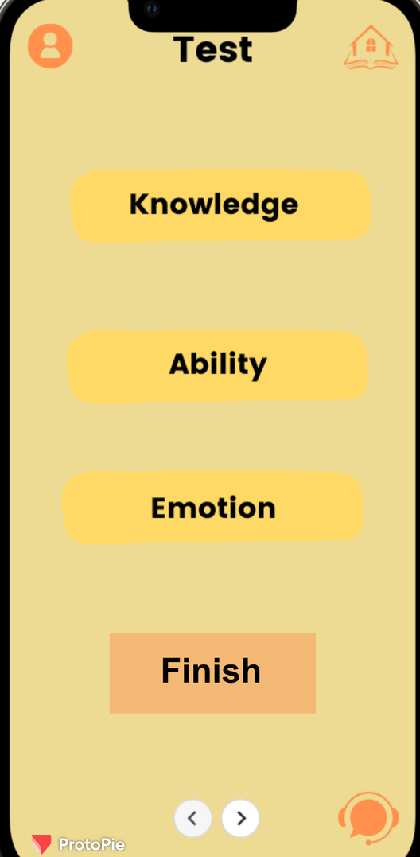
Adaptive Test

Slide 5
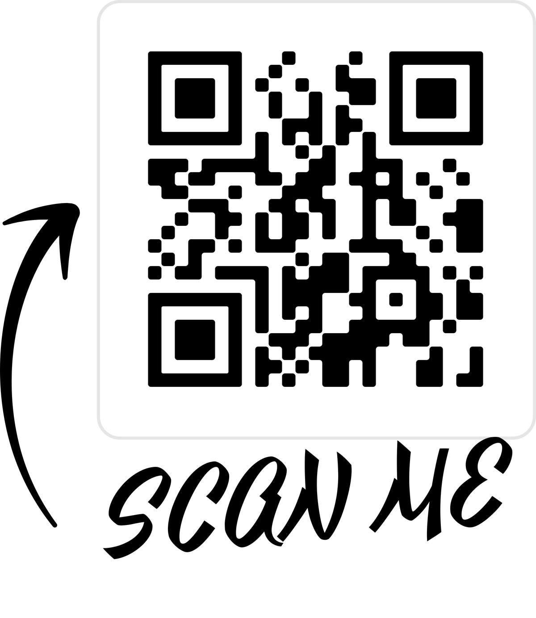



THANK YOU!
  Peizhe Zhang
  9193586812
  peizhe@unc.edu

