Slide 1
LINGO CAMPUS
Educational Innovation, Technology, and Entrepreneurship
Adaptive Learning Analyst

Slide 3
Purpose
Purpose
Objectives
Objectives
Target
Audience
Better academic performance and smoother transition
into the university environment.
- Boost English Skills
- Encourage Self-Learning
- Master Academic Skills
International Undergraduate Students

Slide 4
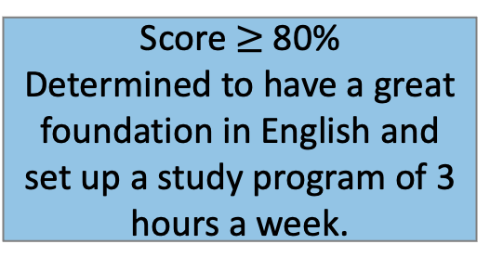
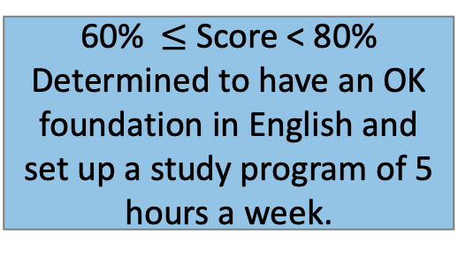
Step Loop
English Level Exam (Pre-Test)
Grade by Instructor
$<$60%?
$≥$80%?
NO
YES
NO
YES
Score < 60%
Determined to have a weak foundation in English and set up a study program of 8 hours a week.
60% $≤$Score < 80%
Determined to have an OK foundation in English and set up a study program of 5 hours a week.
Score $≥$80%
Determined to have a great foundation in English and set up a study program of 3 hours a week.

Slide 5
Task Loop
Module Learning Material
Dwell time check/Note
Meeting Duration Requirements?
NO
YES
Return to Study Materials to Complete the Study
Go to Next Steps

Slide 6
Navy Slide with White UNC Logo

