Slide 1
International Teachers Exchange Program for Foreign Language Development
Izzete Encarnacion
Innovation Specialist
July 2023
MA in Educational Innovation Technology and Entrepreneurship | School of Education | UNC-CH

Slide 2
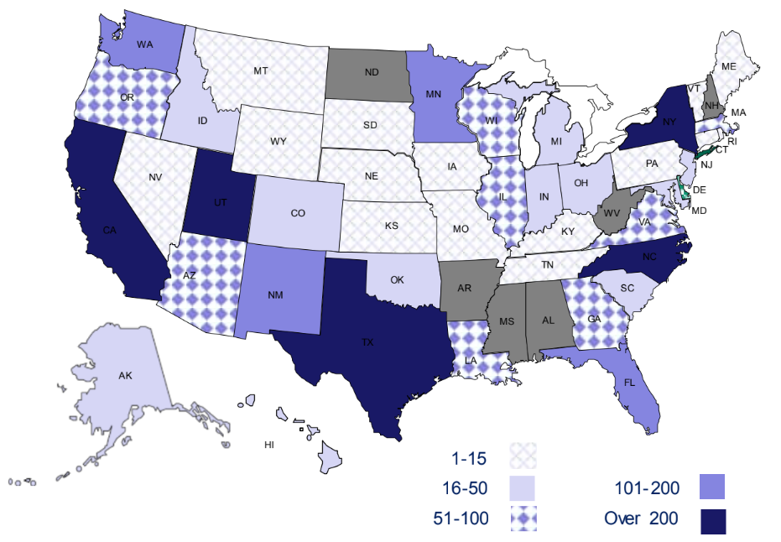
Dual Language Immersion Programs in 2021
20+ Languages
3,649 DLI Programs
2,936 Spanish Programs

Slide 3
The United States
Other Nations
Sponsors
Certified and experienced Teachers
Hosts
Heritage Speakers
ESL Learners
Dual Language Immersion Programs and World Language Learners
Content Areas

Slide 4
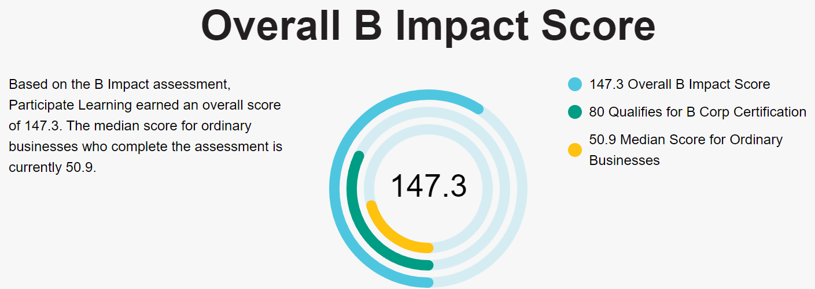
Identified Sponsor
Since 1987
North Carolina, South Carolina and Virginia
1,200+ International Teachers

Slide 5
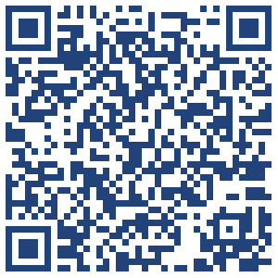
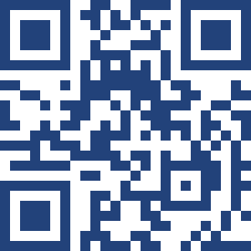
Scan for more information!
Industry Report
Professional Site
MA in Educational Innovation Technology and Entrepreneurship | Izzete Encarnacion

