Slide 1
Camp Counselor 101
By: Emma Goldin

Slide 2
The Problem: Gaps in Staff Training
Modules
Activities

Slide 3
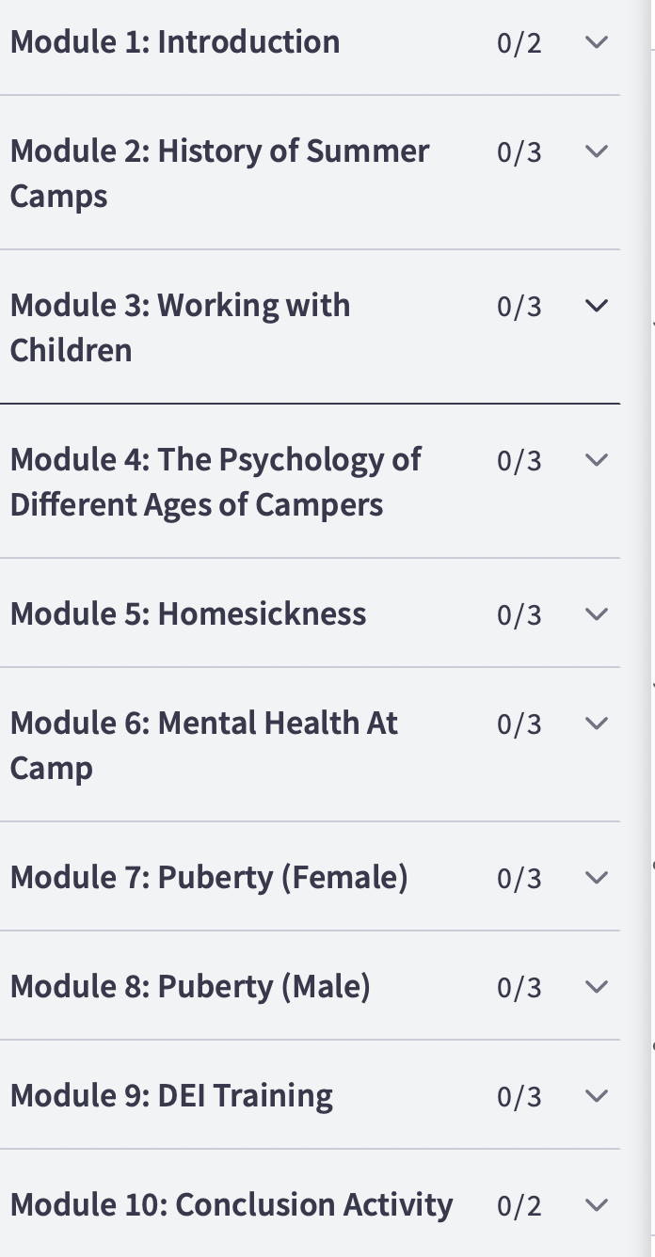
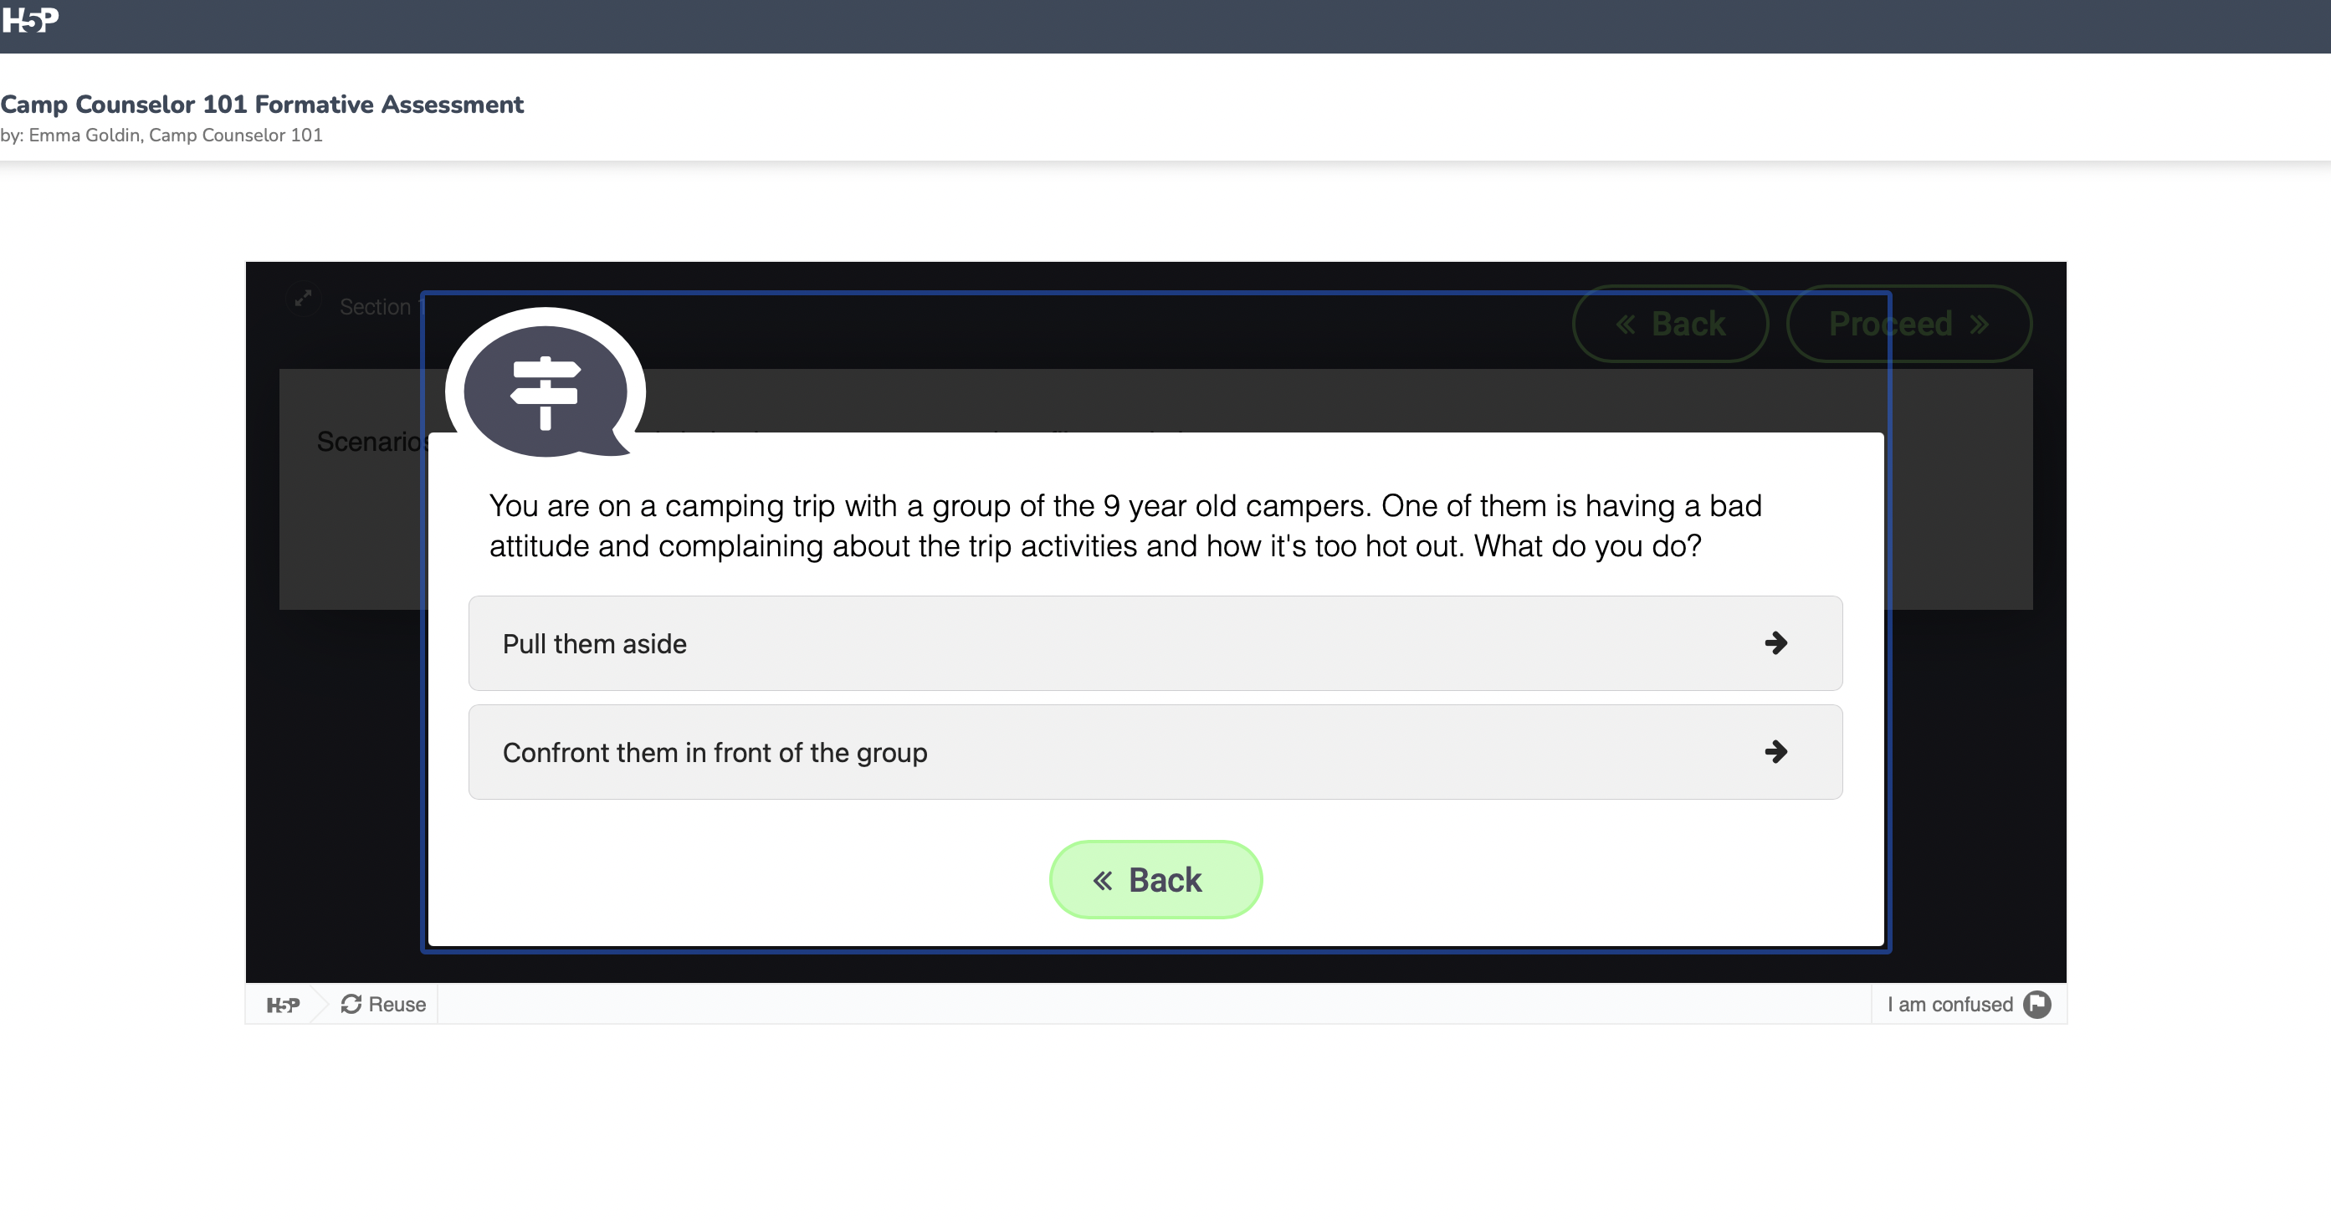
Modules
Activities

Slide 4
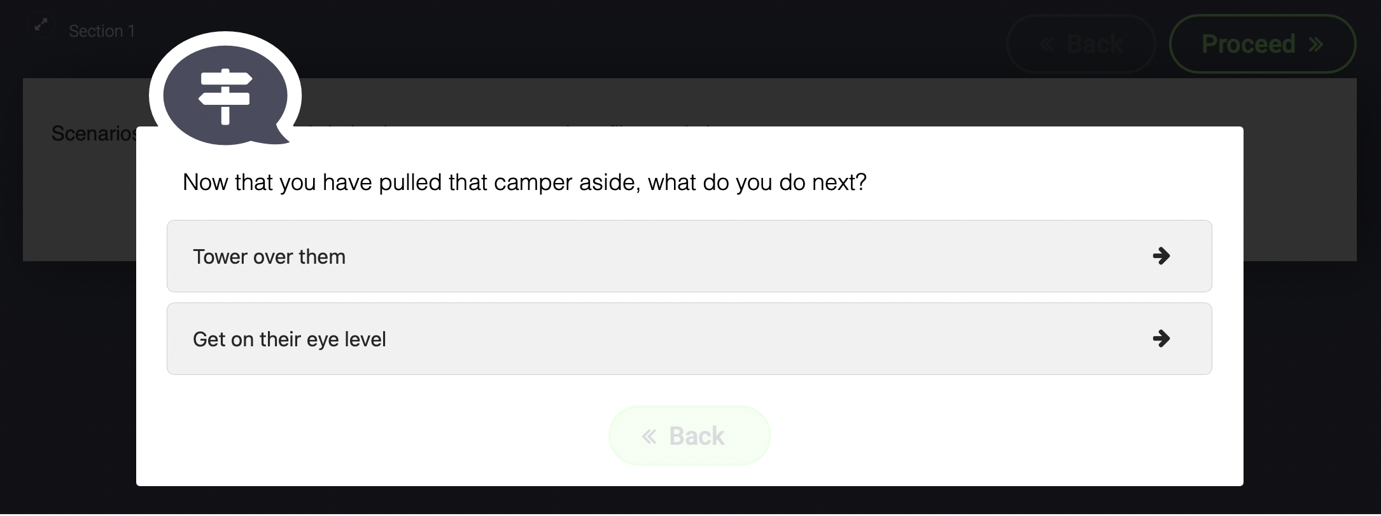

Slide 5
Thanks for listening!

