Slide 1
SOLID-ify
Emily Trabert
Notes:
Hello everyone and thank you for coming. My name is Emily Trabert and I’m excited to give you a quick overview of my new course SOLID-ify.

Slide 2
Writing Code
Developing
Designing Software
Notes:
Developing software is a union of two skills. The first is (click) writing code: the technical know-how to write code in order to have the computer do what you want. There are many free courses online that teach the syntax and lexicon of a multitude of languages. However, it’s equally important to consider (click) designing software: the problem solving, thinking and planning skills to make the code you write more readable, maintainable, extensible, and testable. While there are some online courses that teach this, there are fewer available and tend to be behind a paywall. Therefore, I wanted to offer a course that teaches some of software design skills while being free to everyone.

Slide 3
Software Development
Learning Strategy
SOLID Principles
Single Responsibility
Open-Closed
Liskov Substitution
Interface Segregation
Dependency Inversion
+
Self-Explanation
Notes:
SOLID-ify teaches a software development concept called the (click) SOLID principles. SOLID is a mnemonic of the five object-oriented design principles: (click) single-responsibility, (click) open-closed, (click) Liskov substitution, (click) interface segregation, and (click) dependency inversion. (click) In addition to the SOLID principles, this course teaches a learning strategy called (click) self-explanation, which teach you one way of maximizing the effect of your time spent learning.

Slide 4
Course Outline
1
Overview
Liskov Substitution, Part 1
7
2
Self-Explanation
Liskov Substitution, Part 2
8
3
Single Responsibility, Part 1
Interface Segregation, Part 1
9
4
Single Responsibility, Part 2
Interface Segregation, Part 2
10
5
Open-Closed, Part 1
Dependency Inversion, Part 1
11
6
Open-Closed, Part 2
Dependency Inversion, Part 2
12
Notes:
The course is hosted on CodingRooms and comprised of 12 modules. Unfortunately I don’t have time to dig into each module but I wanted to highlight components of the second module for each principle, using module 4 as an example.

Slide 5
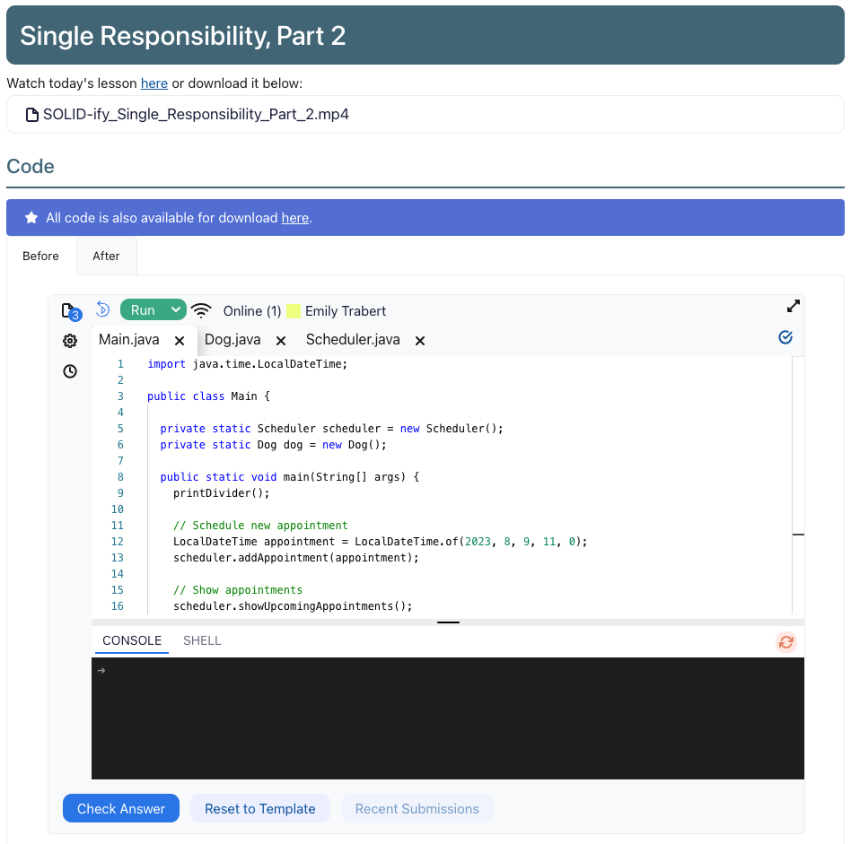
Notes:
The second module focuses on the utility of the principle - why following this principle is beneficial. The (click) video lesson continues to build on a course-long example and one of the great benefits of Coding Rooms is that it allows the learner to write and run code in the browser - no need to download or install anything. So learners can make changes to the (click) code along with the video and compare (click) their code with the final code from the end of the video.

Slide 6
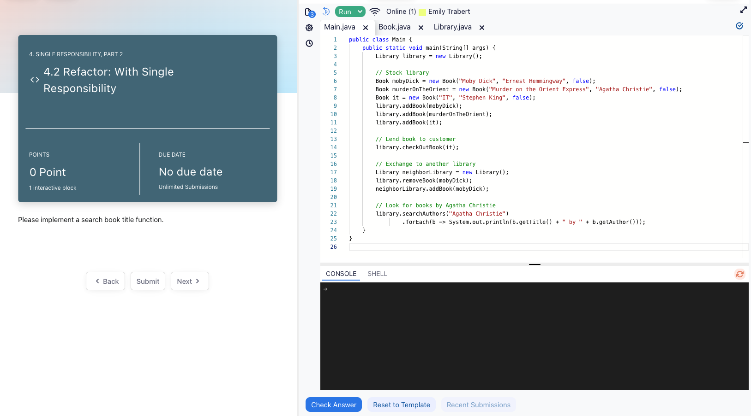
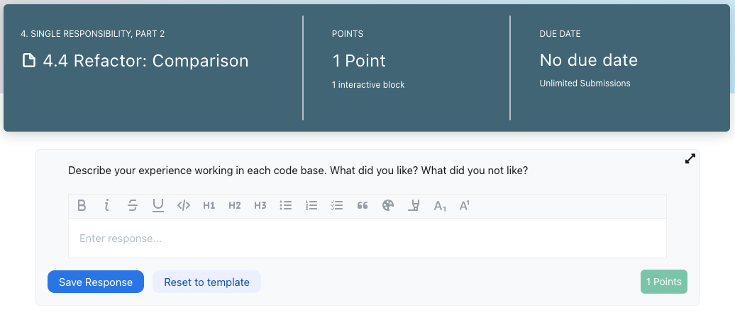
Notes:
Learners then add a new (click) feature to two existing code bases, one which (click) follows the principle and one which (click) does not. Learners then write (click) a short reflection comparing their experience working in each code base. This is a unique experience, and being able to compare these code bases directly is intended to give the learner an appreciation for following theses principles.

Slide 7
Thank you!
For more info, visit:
https://dev-cred.com
https://app.codingrooms.com/app/?joinCode=C-C8kcJCw
Coding Rooms. (2020, August 25). Coding Rooms - The First Virtual Classroom for Teaching Programming. https://qa-mktg.codingrooms.com/
Notes:
Thank you so much!

