Slide 1
Austin O’Connor
M.E.I.T.E Graduate Program | Innovative Specialist
University of North Carolina at Chapel Hill

Slide 2
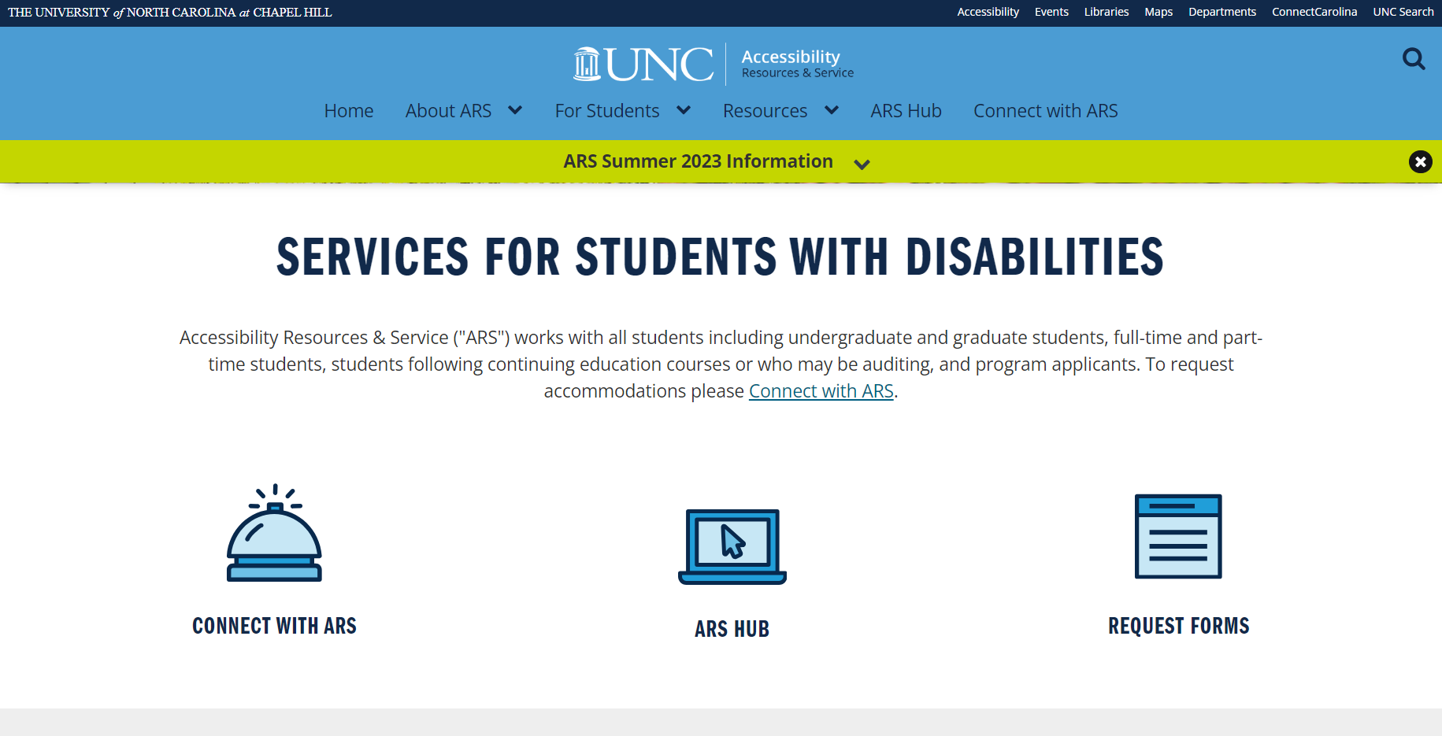
What is ARS/SES?
Through the project, ARS and SES(Supplemental Education Services) are used as interchangeable terms.

Slide 3
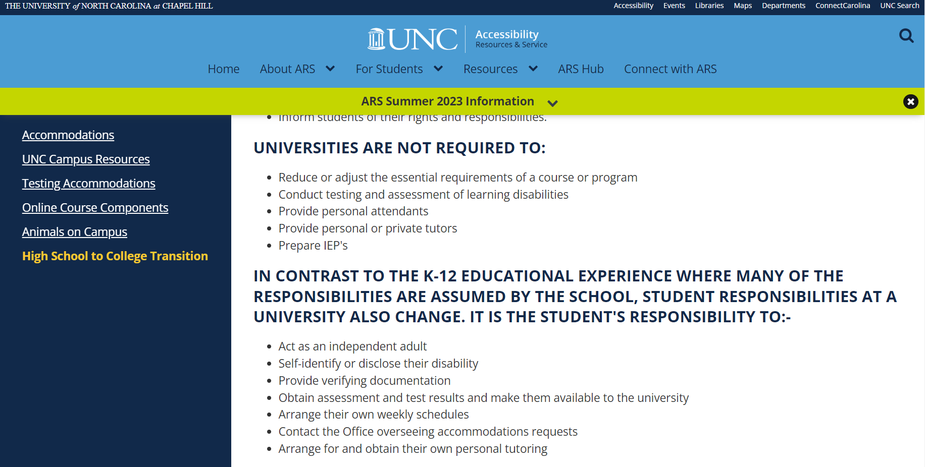
How Could SES Offer More?

Slide 4
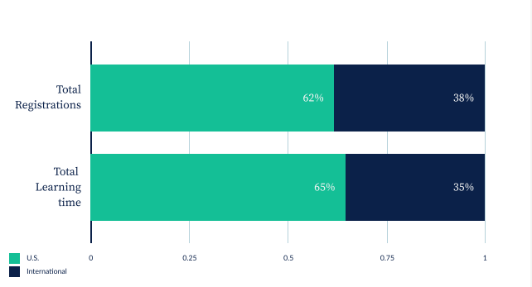
Khan Academy and Mastery Learning
“Our mission is to provide a free, world‑class education for anyone, anywhere.” - Khan Academy’s Mission Statement.

Slide 5
Closing Remarks
Khan Academy’s goal is to improve students is by…
Confidence
Resiliency
Accountability
Through ownership of their gaps in learning that are causing them to struggle with courses at UNC.

