Slide 1
ANDREA MELENDEZ | MEITE 2023
The Gamification of Language Learning
Notes:
Hi everyone, my name is Andrea Melendez and I went deep into the Gamification of Language Learning phenomenon.

Slide 2
Gamification or
Game-based learning
Practice Testing
Spacing
Extrinsic Motivation
Embodied Cognition
Andrea Melendez
Notes:
Have you ever played Duolingo? And I want to emphasize the word PLAY here. You see, Duolingo is a company that sells gaming but competes in the language learning market. It uses a GAMIFICATION technique. The content is divided into small chunks, and you get to COMPETE against other in your learning trajectory. This technique is based on different learning theories, like:
-Practice Testing
-Spacing
-Extrinsic motivation
-Embodied Cognition
-others

Slide 3
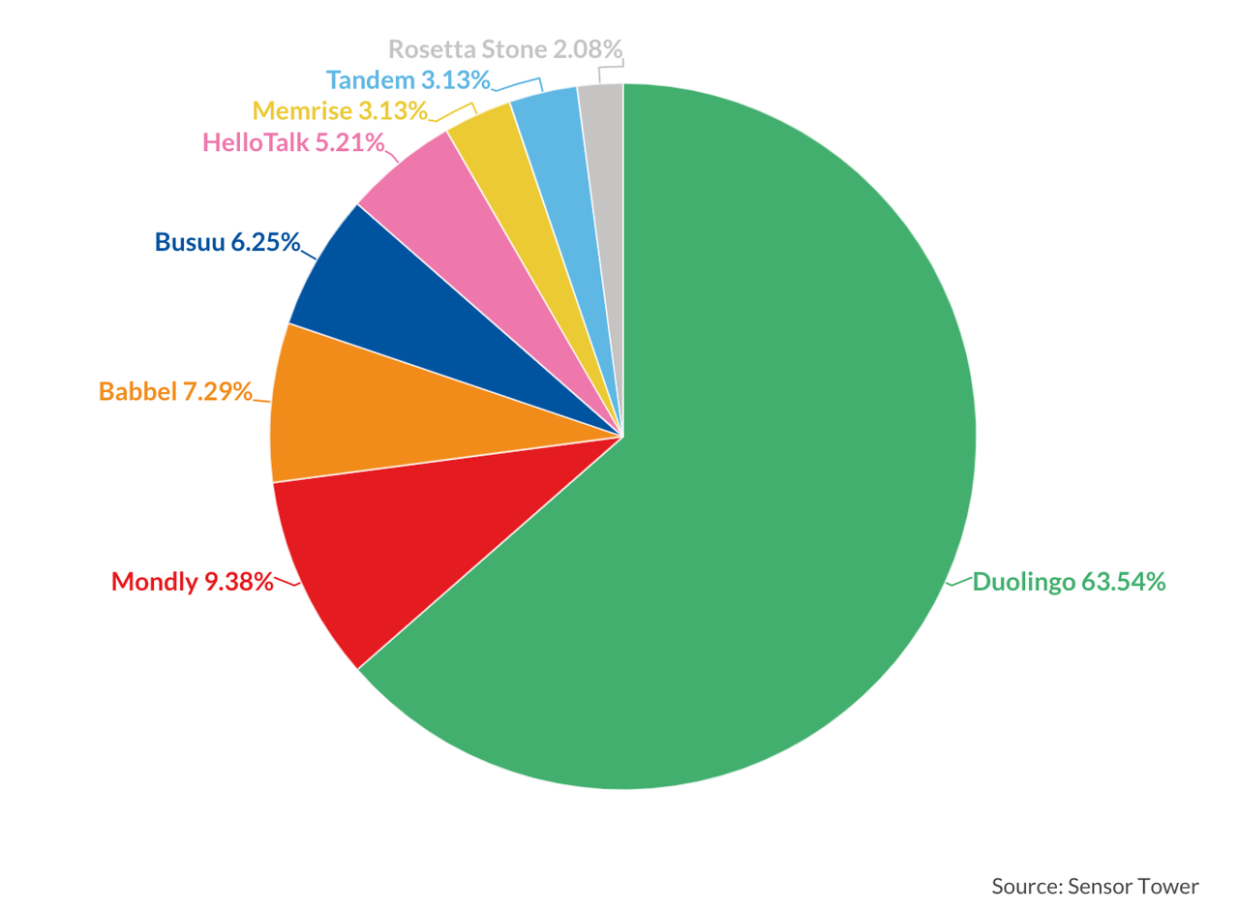
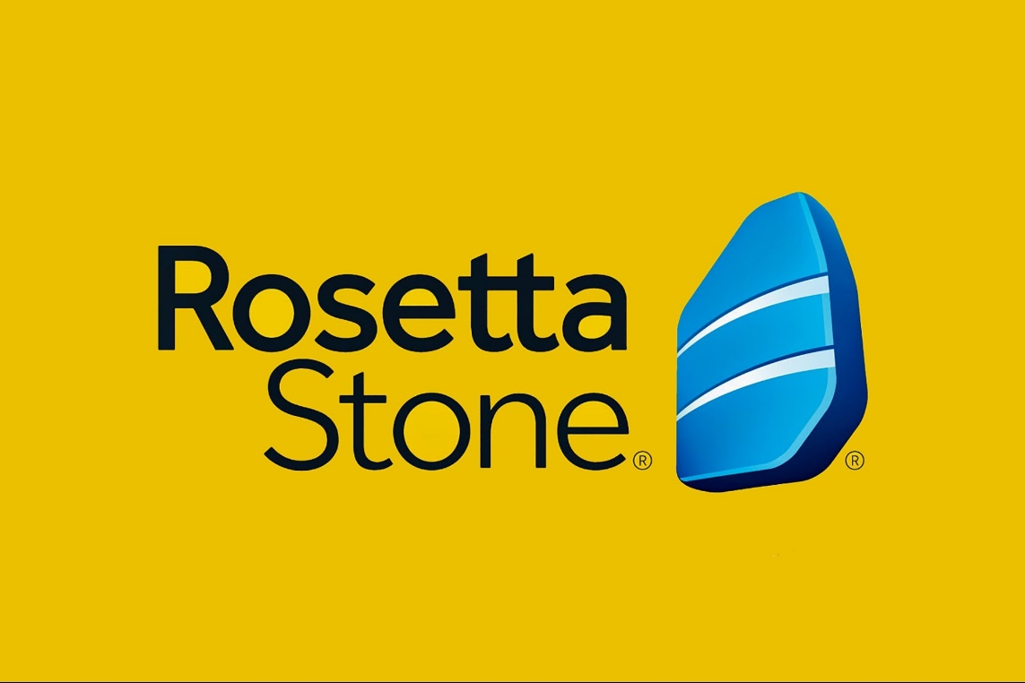
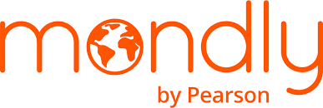
Competition?
Andrea Melendez
Notes:
Is it the only app offering an online language-learning product?
No, Duolingo’s competitors,
Babbel,
Rosetta stone
And Mondly
have been relatively successful in terms of learning outcomes.
But Duolingo has the lions share in terms of App installs.

Slide 4
The Language Learning Market
$52.7BN
$337.2BN
20.8%
Market Value
(2022)
Market value
(2032)
CAGR
(2023-2032)
Source: https://www.gminsights.com/industry-analysis/language-learning-market
Andrea Melendez
Notes:
If it’s a highly saturated market then, is there room to grow?
YES, the market was valued at $52.7 BILLION in 2022 and expected to reach 337.2 BILLION by 2032 with a Compound Annual Growth of 20.8% over the forecast period. This is a 7X growth!
https://www.gminsights.com/industry-analysis/language-learning-market

Slide 5
Current Trends
Increasing Smarphone and Internet Access Worldwide
Extended Reality market growth
Artificial Intelligence Boom
Andrea Melendez
Notes:
This is due to several reasons including the increased demand for language proficiency in the workplace and changing demographics worldwide.
On top of these, the increase of smartphones and internet access globally will make the demand grow, and D2C products will have the upper hand, especially those who’ll get into XR and AI technologies first.

Slide 6
Duolingo’s Freemium Business Model
Andrea Melendez
Notes:
But the upperhand of duolingo comes from its Freemium business model. Offering a free product to attract a large user base that will produce data to gain more insights, and have an engagement effect, having its free users make the conversion to paid subscribers for greater efficacy.

Slide 7
Recommendations
Speaking Practice
User Conversions
Advanced Levels Offerings
AI and XR Immersion
Andrea Melendez
Notes:
So what does Duolingo desperately needs to hold this advantage?
-Enhancing their speaking practice by using AI speech recognition and XR real-world settings.
-Offering advanced levels, extending the period of “customer service” to current graduating users
-Making the experience significant, using new technology like AI to personalize further and XR to make an embodied cognition experience.

Slide 8
Learn more...
Andrea Melendez
andrea-melendez-rosas
andreamr@unc.edu
www.andreaeduca.wordpress.com
Notes:
Thank you for listening to me and if you want to learn more about the market report you can scan this QR code which will take you to the report. If any questions arise, be sure to contact me.

