Slide 1
Understanding and developing corporate culture online course -- Shiqi Tao MEITE, class 2022

Slide 2
Agenda
1. Problem
2. Course design
3. Interactive experience

Slide 3
One day, my boss asked me to make a corporate culture transformation plan…
How
What
Why

Slide 4
Some problems
Theory-based
Too long time
Only one stage is covered
Lack of practical tools.
It needs take a long time to complete the course.
Students need to learn another course to know about another stage.

Slide 5
Intro-level Simple & fast
Price: $13.9
Canvas platform

Slide 6
Target audiences
Startup Leaders
Human resources managers/staff
Beginning learners who want to learn corporate culture

Slide 7
Learning Outcomes
Build
Design an action plan/rituals canvas
Assess
Develop a culture assessment survey
Cultural Tranformation
Apply Kotter’s change model by writing a proposal
General Strategies
Describe general strategies for sustaining a positive corporate culture

Slide 8
Module structure--Backward design
Step 1
Step 3
Step 5
Pre-discussion
Microlearning
Reflection
Step 2
Step 4
Lecture video
Mini-quiz

Slide 9
C
Interactive experience
B
A

Slide 10
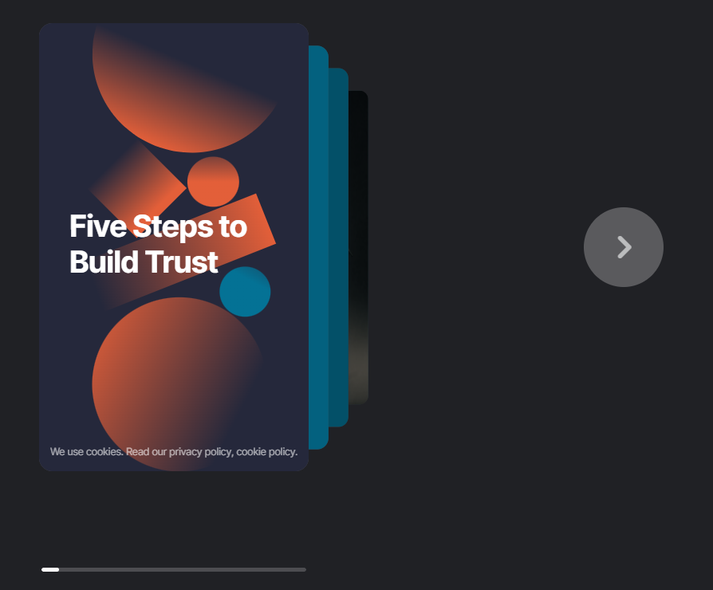
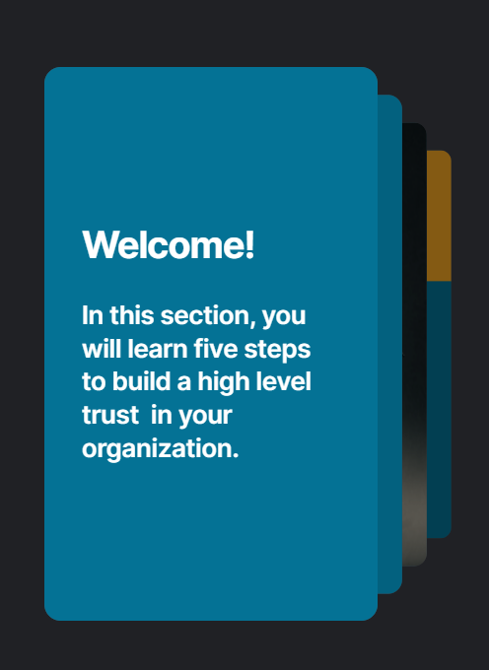

Slide 11
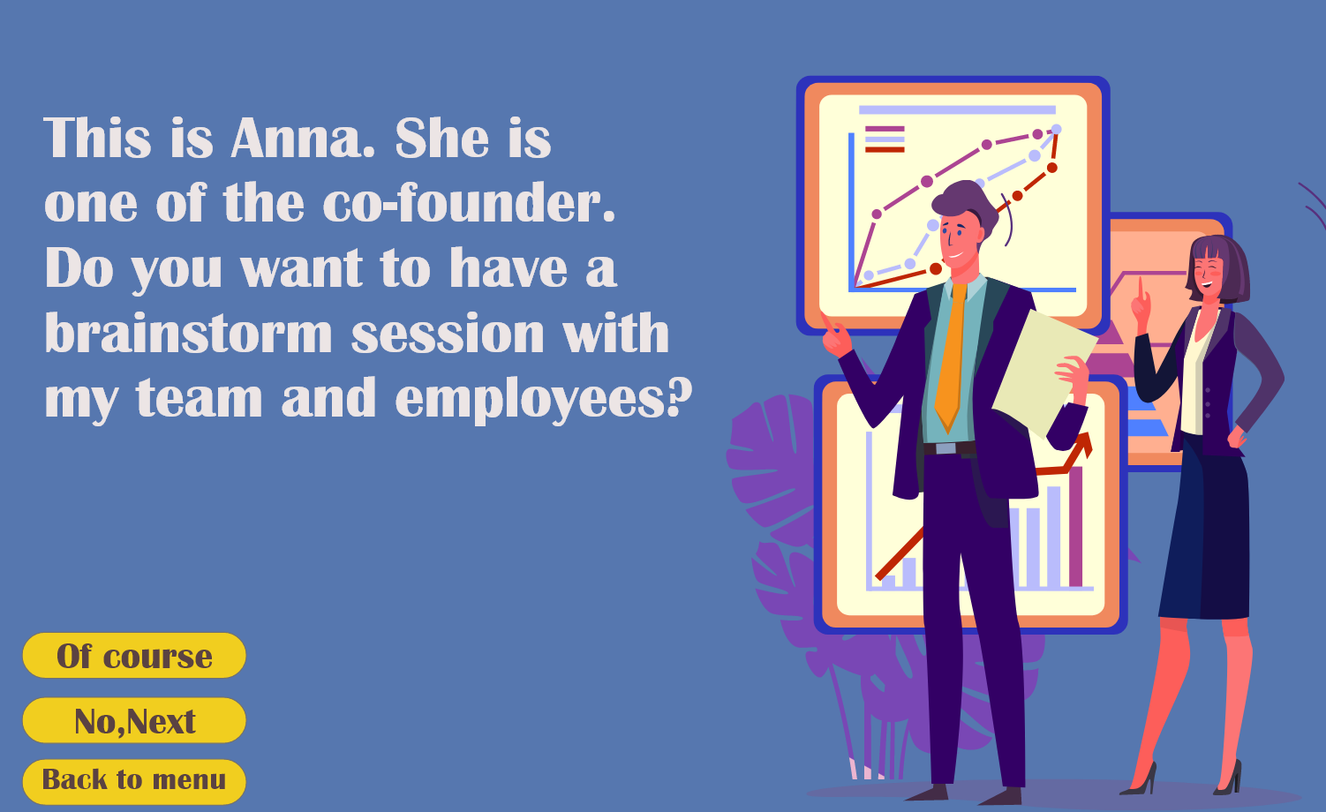
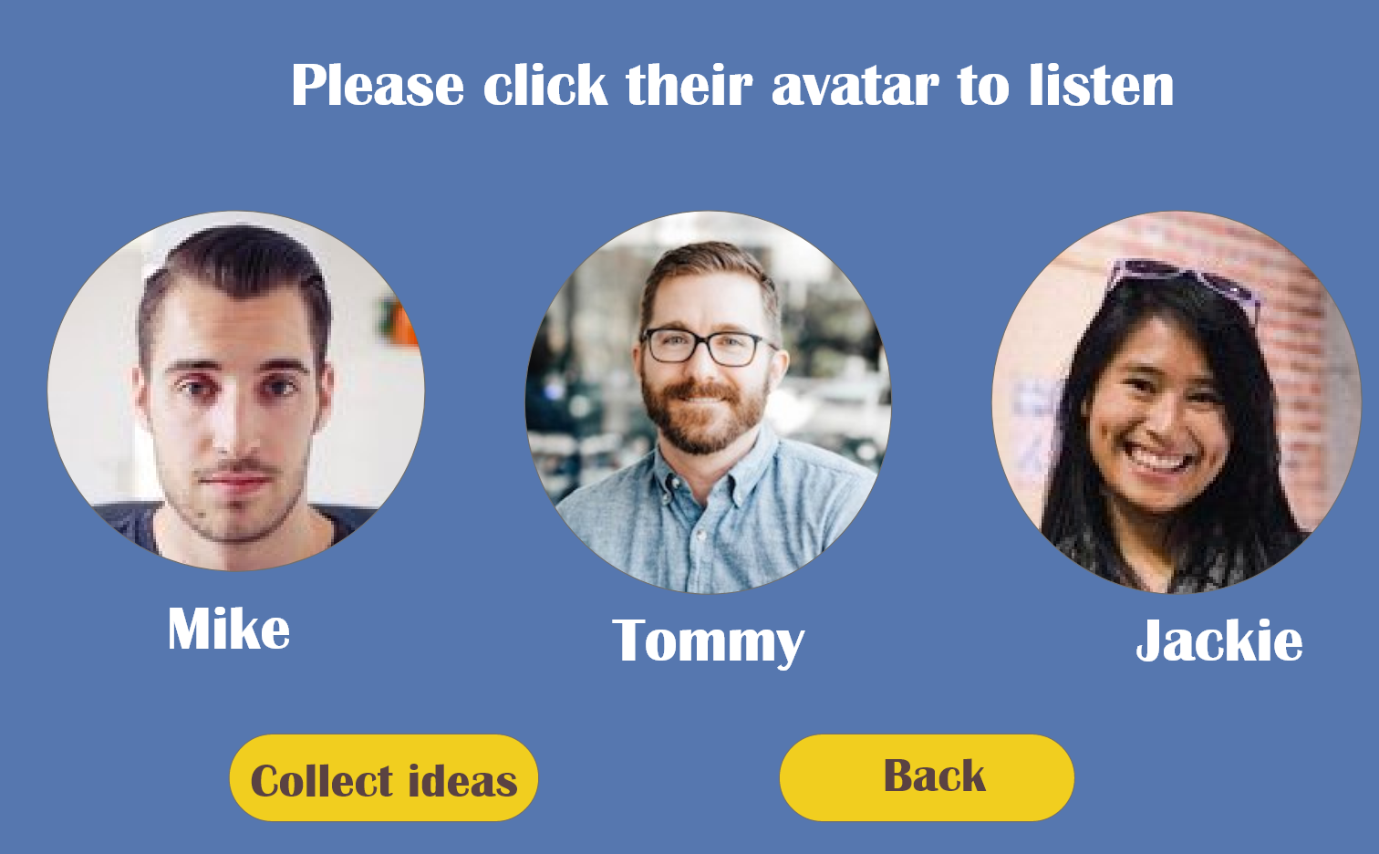

Slide 12
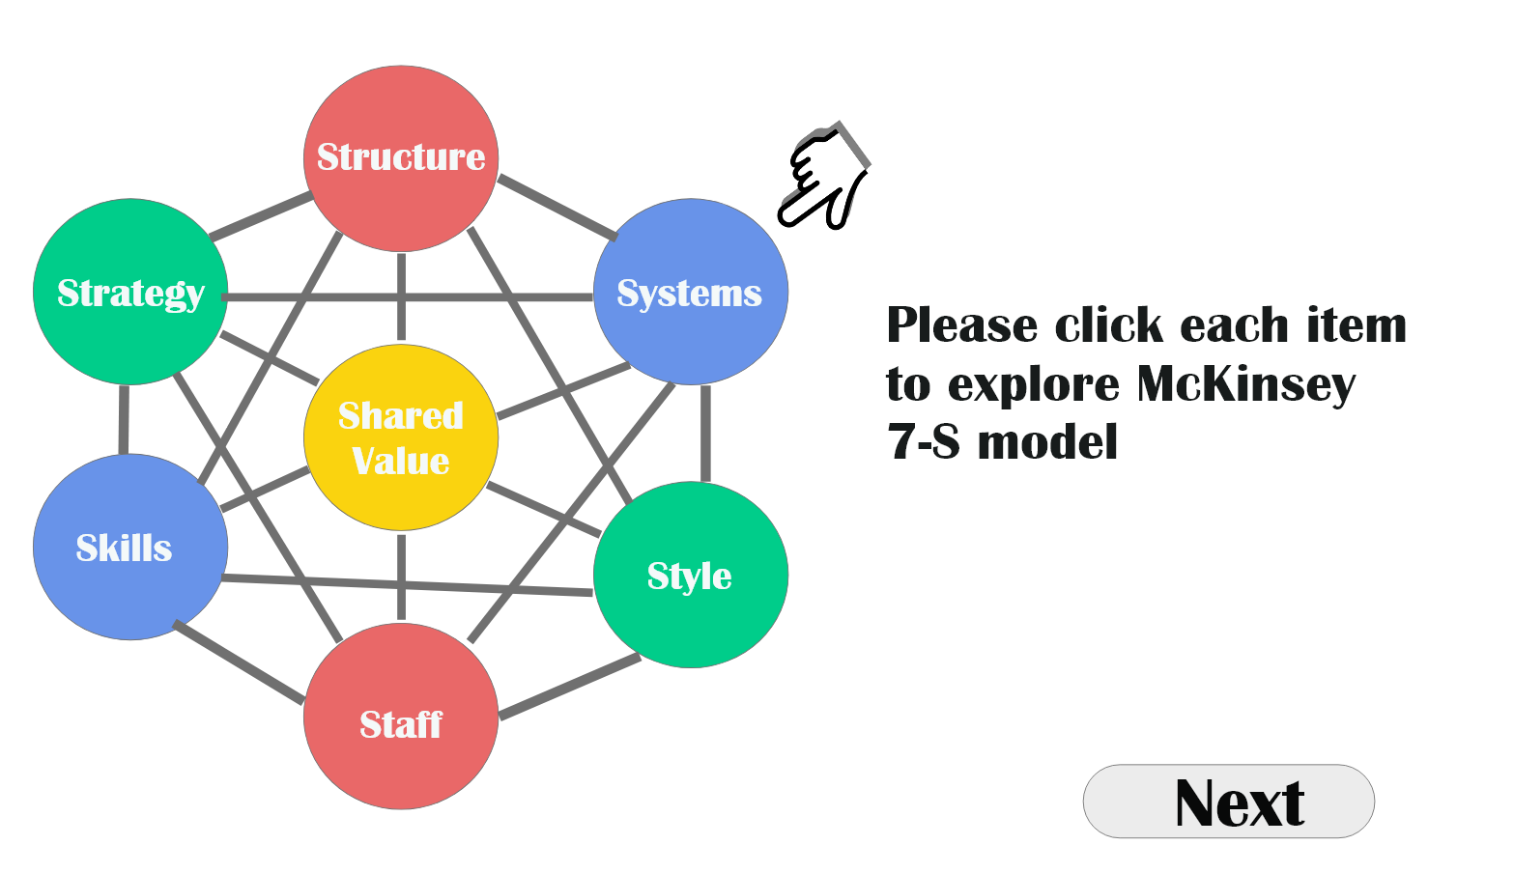

Slide 13
