Slide 1
Creating Change: Foundations of Diversity, Equity, Inclusion, and Belonging
Taylor Redmond

Slide 2
Background
Target Learners: Adults in work settings
Knowledge to be applied to spaces that they enter on a regular basis
Business Strategy: Hosted on Thinkific, $40 per learner enrollment fee
Course developed using Backward Design

Slide 3
Course Objectives
01
02
03
Systemic
Interpersonal
Create Change
- Describe systems of inequity
Define intersectionality and apply it to real-life contexts
Name strategies for overcoming unconscious bias
Identify microaggressions in conversations
Identify ways to be an upstander in day-to-day scenarios
Apply inclusive language to real life contexts

Slide 4
Creating A Safe Space For Learning
Community Norms
Be open to learning and unlearning
Become comfortable with being uncomfortable
Avoid placing blame & prioritize taking accountability
Maintain a growth mindset

Slide 5
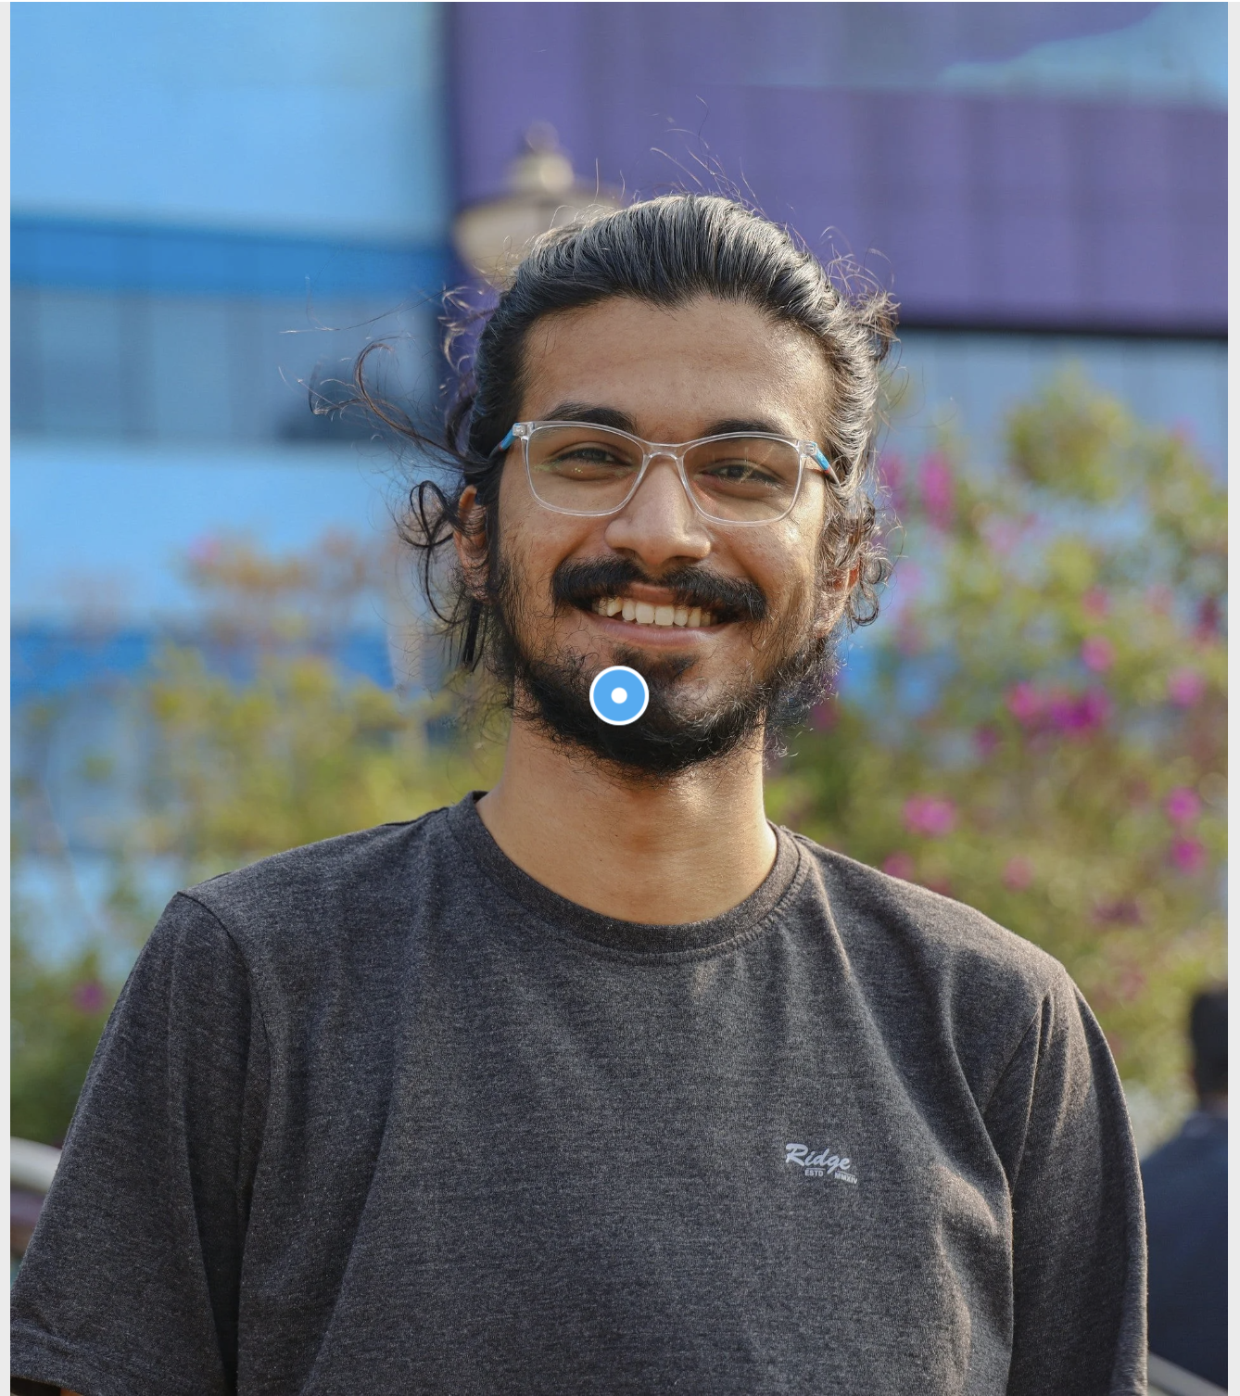
Scenario Based Assessments

Slide 6
Thank You!
Credit: This presentation template was a creation from Slidesgo.com

