Slide 1
TAYLOR MORENO

Slide 2
PROBLEM
How do we educate and protect collegiate student-athletes on the NCAA’s Name, Image, and Likeness policy so that they may engage in NIL endeavors without risking their reputation and eligibility?

Slide 3
SOLUTION
An all-in-one education and resource platform that provides student-athletes with information and strategies to take full advantage of their NIL while maintaining their eligibility and managing their social, institutional and athletic reputation.

Slide 4
CUSTOMERS / USERS
STUDENT-ATHLETES
BRANDS, BUSINESS AND CAMPAIGNS
COLLEGIATE INSTITUTIONS & ATHLETIC DEPARTMENTS

Slide 5
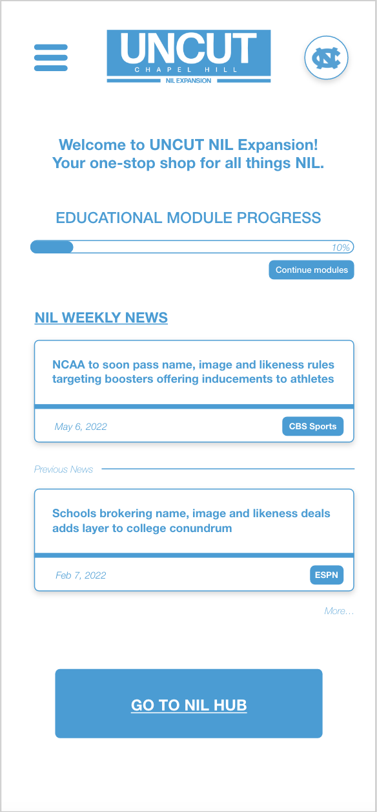
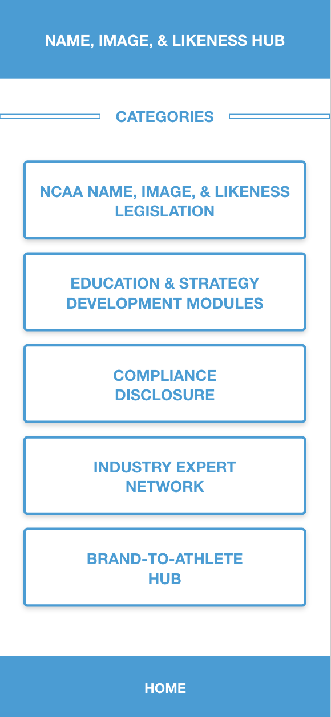
MVP
INFORMATION LIBRARY
INDUSTRY EXPERT
NETWORK
EDUCATIONAL MODULES
BRAND-TO-ATHLETE
NETWORK
COMPLIANCE DISCLOSURE

Slide 6
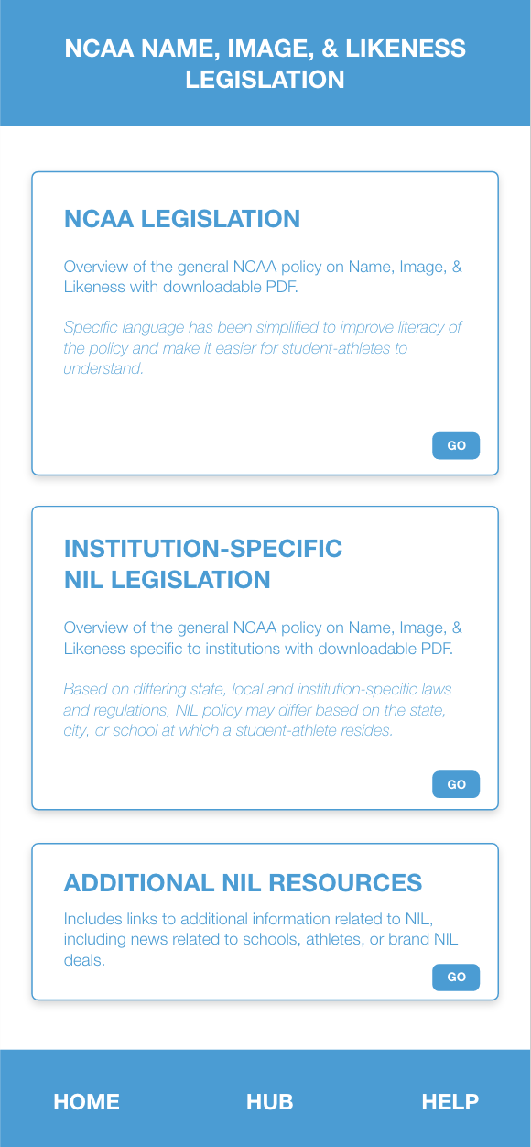
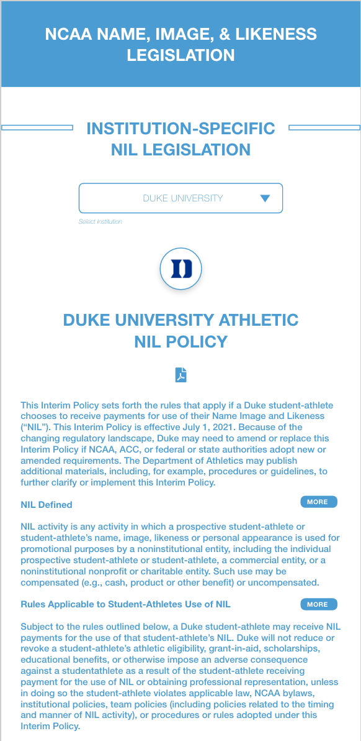
INFORMATION LIBRARY

Slide 7
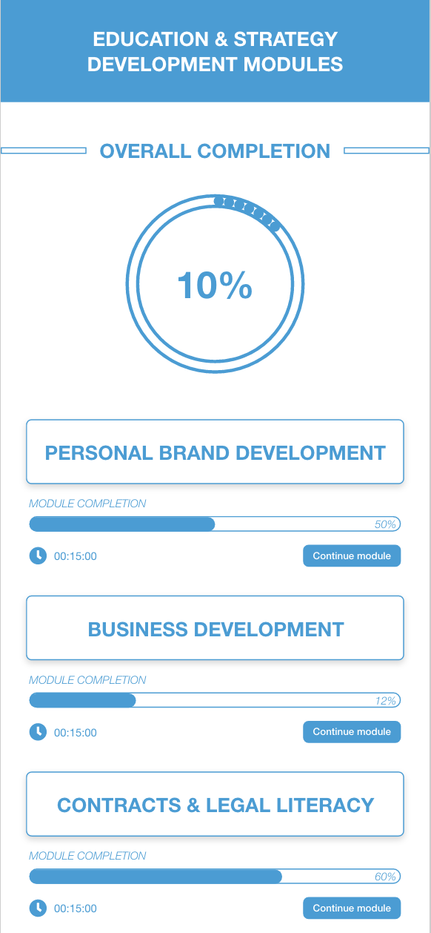
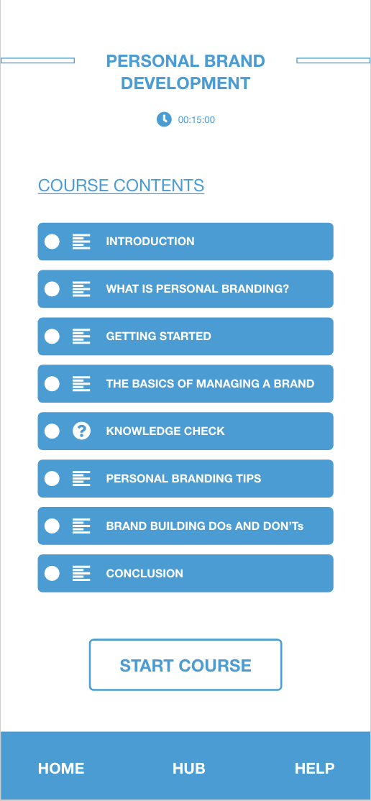
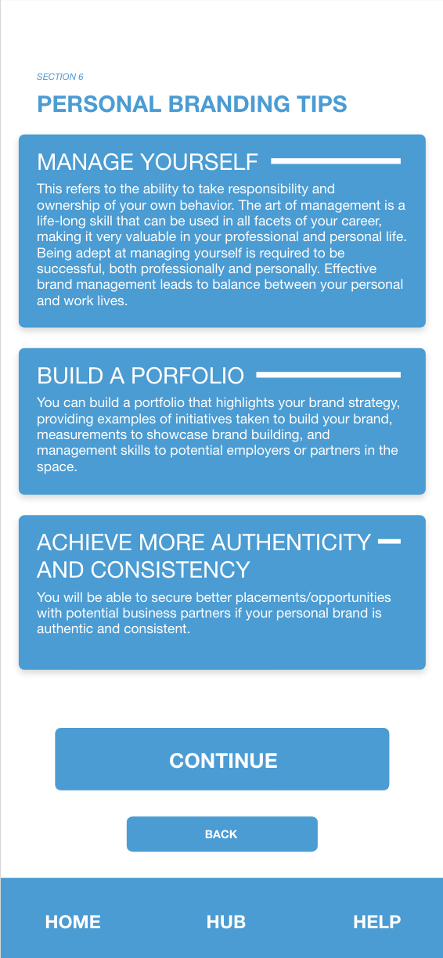
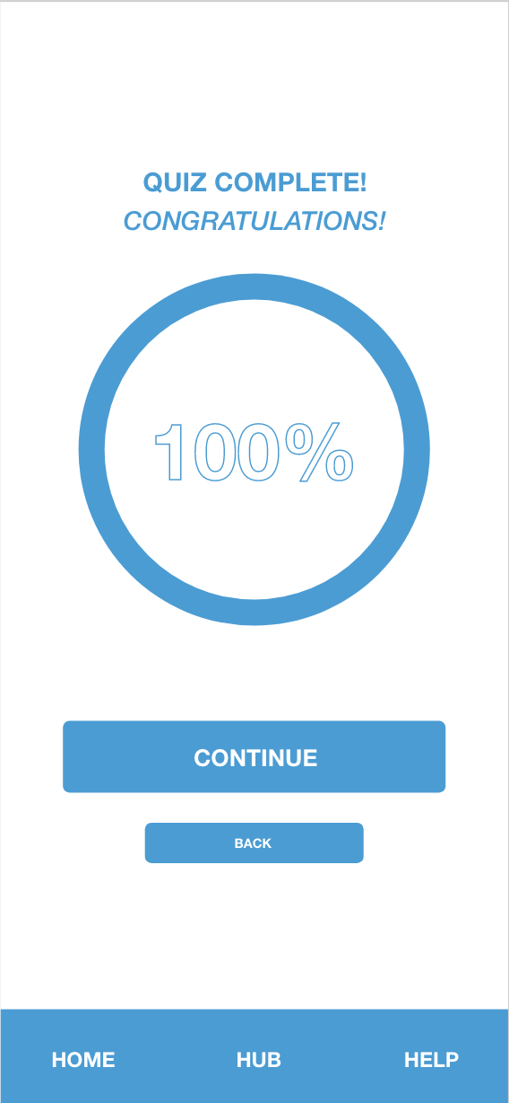
EDUCATIONAL MODULES

Slide 8
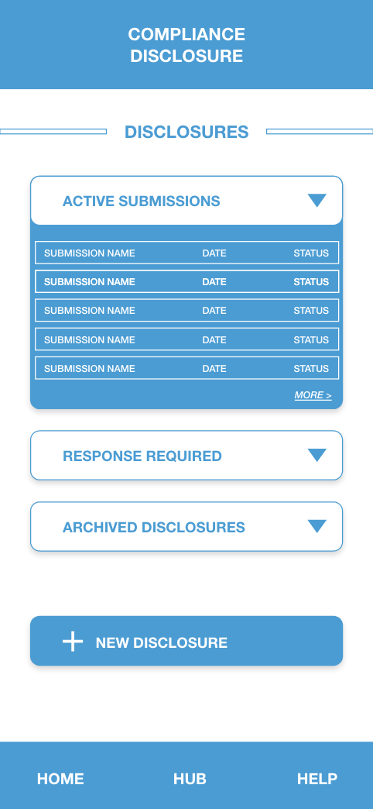
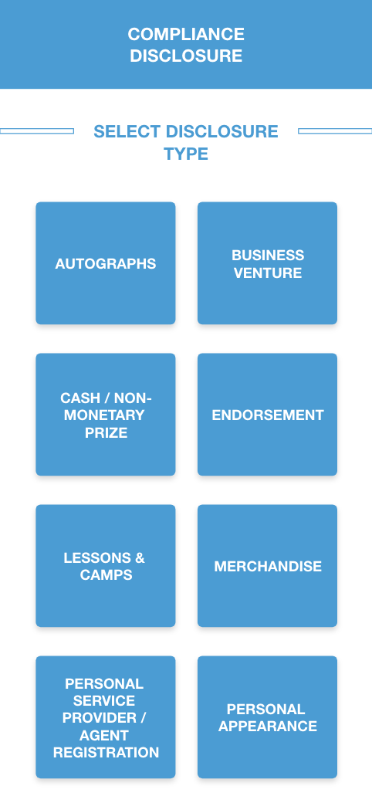
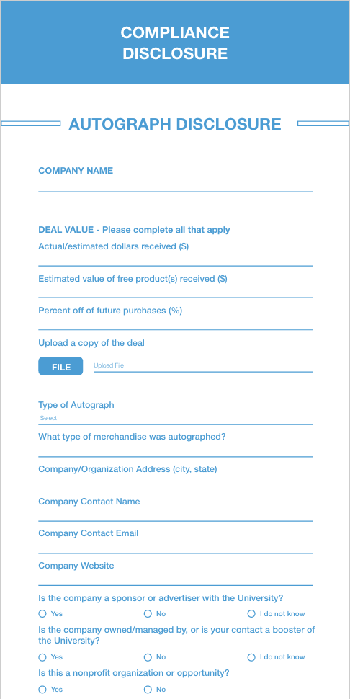
COMPLIANCE DISCLOSURE

Slide 9
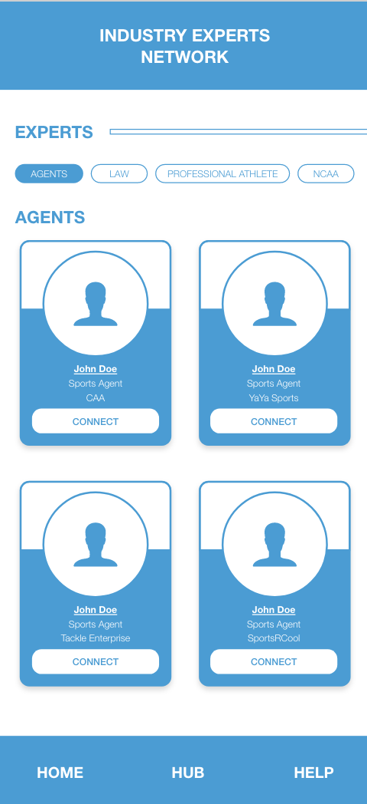
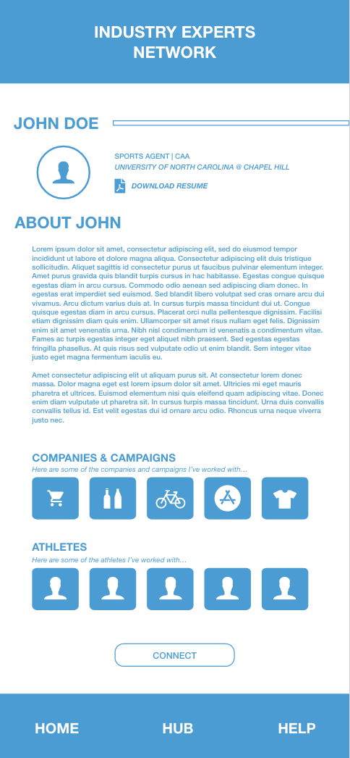
INDUSTRY EXPERT NETWORK

Slide 10
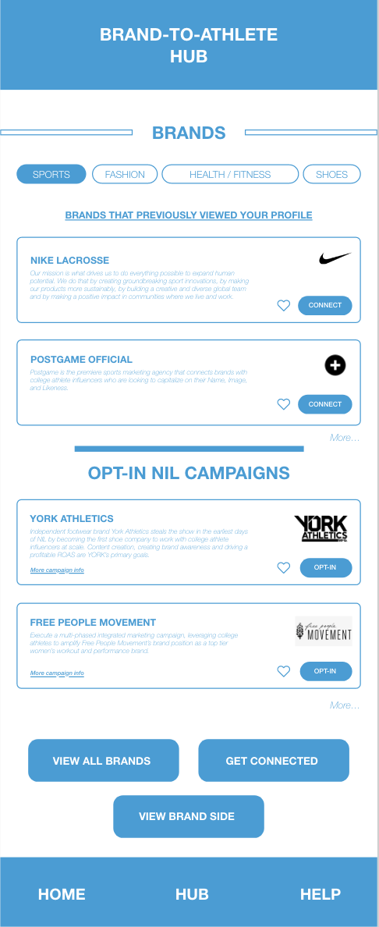
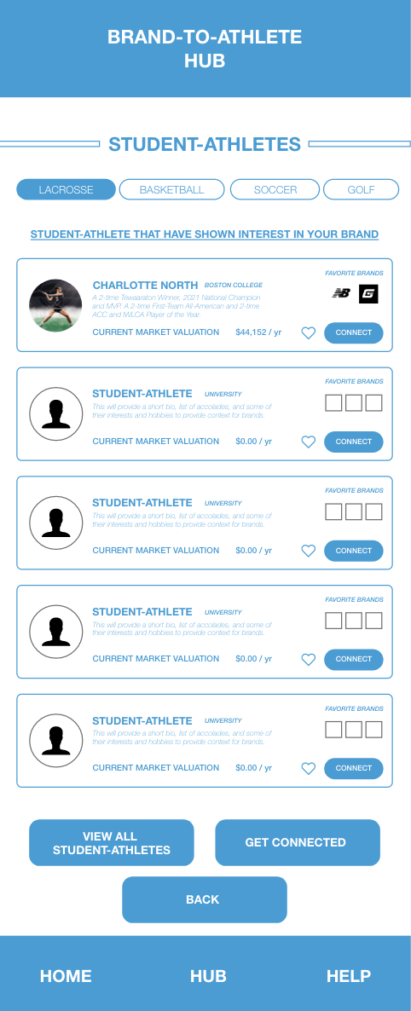
BRAND-TO-ATHLETE NETWORK
STUDENT-ATHLETE VIEW
BRAND VIEW

Slide 11
VALUE PROPOSITIONS
1
2
3
RISK REDUCTION
CONVENIENCE / USABILITY
ACCESSIBILITY

Slide 12
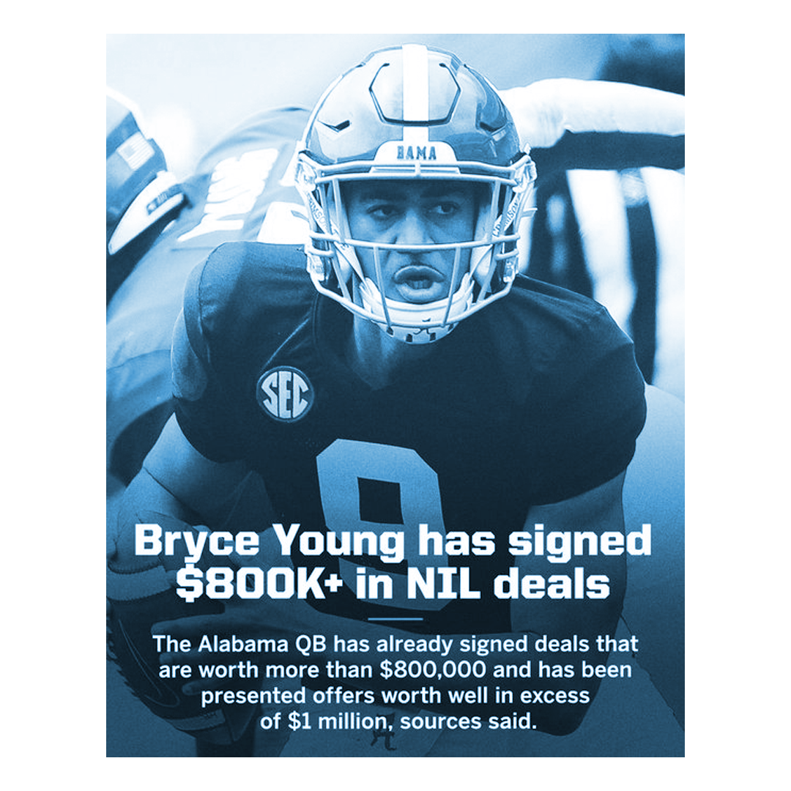
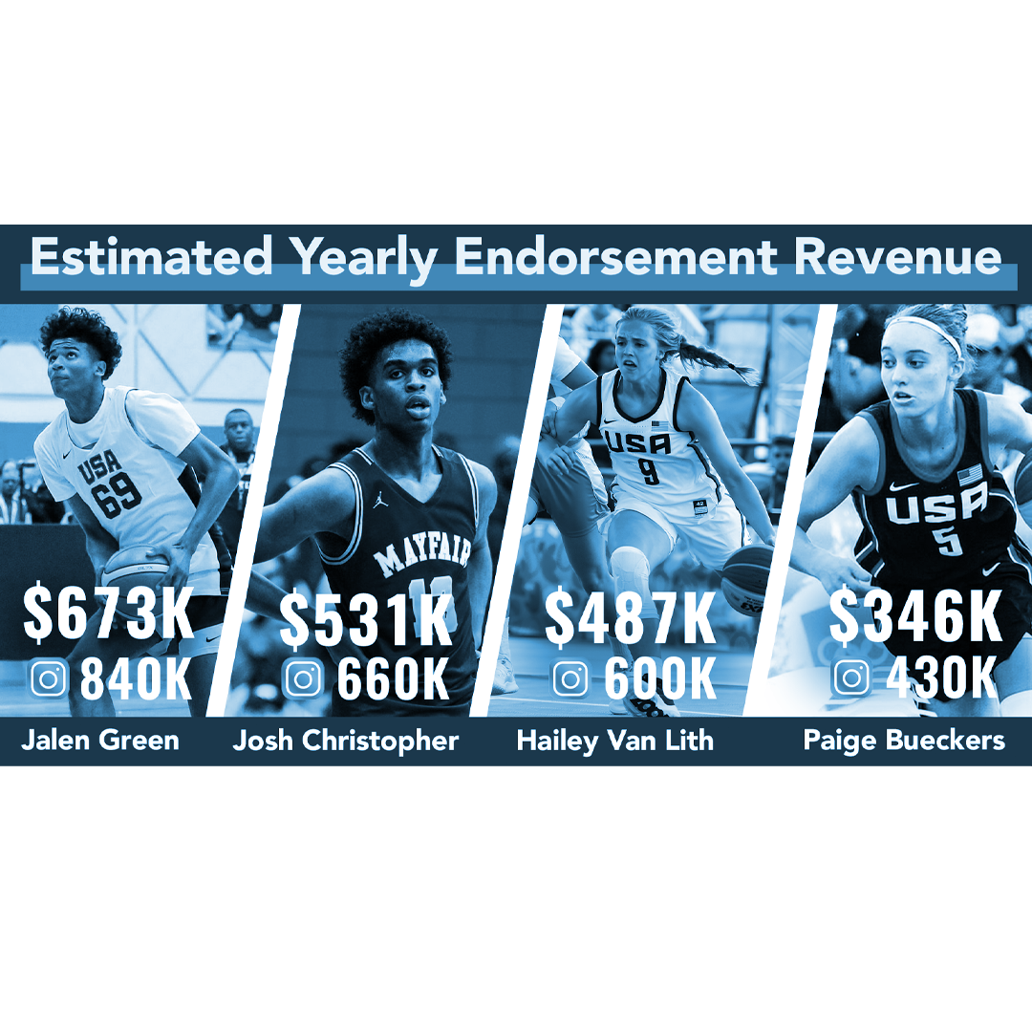
DESIRABILITY
With some student-athletes making six figures within the first 2 months of the policy change, it is evident that brands, business and campaigns are eager to get involved.

Slide 13
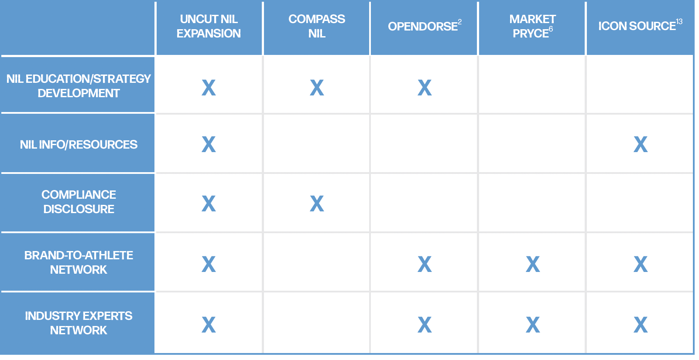
FEASIBILITY
With UNCUT NIL Expansion being the only streamlined all-in-one NIL education app, student-athletes won’t have to rely on multiple platforms to achieve the education and protection they need.

Slide 14
SUSTAINABILITY
With nearly 500,000 student-athletes across three collegiate divisions, there will be no shortage of collegiate athletes. Each with new talents, athletic success, and social presences that will continue to evolve as the NIL landscape grows.
I
DIVISION
II
DIVISION
III
DIVISION
PARTICIPATION
PARTICIPATION
PARTICIPATION
173,500 Student-athletes
346 Colleges & Universities
109,100 Student-athletes
300 Colleges & Universities
183,500 Student-athletes
450 Colleges & Universities
AVERAGE ENROLLMENT
AVERAGE ENROLLMENT
AVERAGE ENROLLMENT
12,900
4,200
2,600

Slide 15
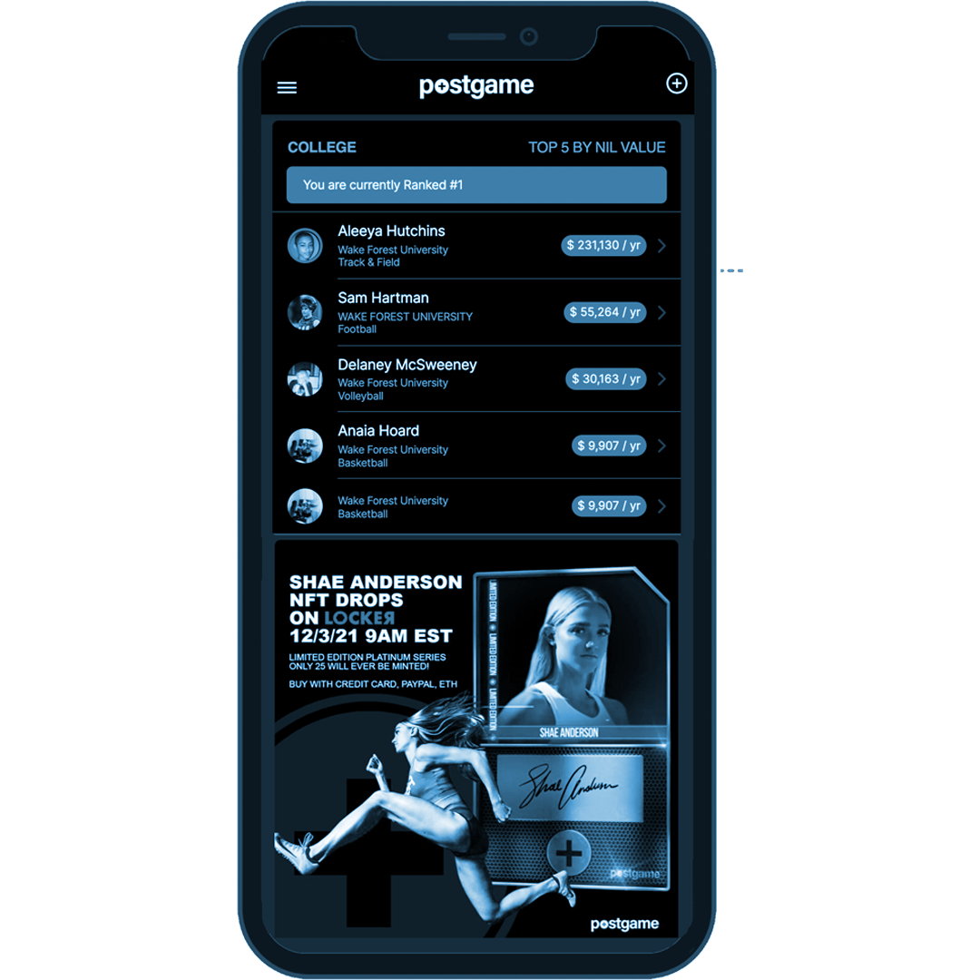
MARKET OPPORTUNITY
Three major players exist in the NIL education landscape, and these companies include COMPASS NIL, Opendorse, and INFLCR. However, in comparison to UNCUT NIL Expansion, these platforms do not house all the same features under one application.
In terms of the market itself, the NIL landscape’s current market valuation as of 2022 is $500 million. This valuation is projected to reach $1 billion by 2023.
POSTGAME Valuation of student-athlete NIL value

Slide 16
UNCUT NIL EXPANSION
ASK
$200,000
UNCUT NIL EXPANSION

