Slide 1
The Financial Aid Management Software Industry: A Market Analysis
Paige Hofstad
MEITE Thesis 2022
This Photo by Unknown Author is licensed under CC BY-NC-ND

Slide 2
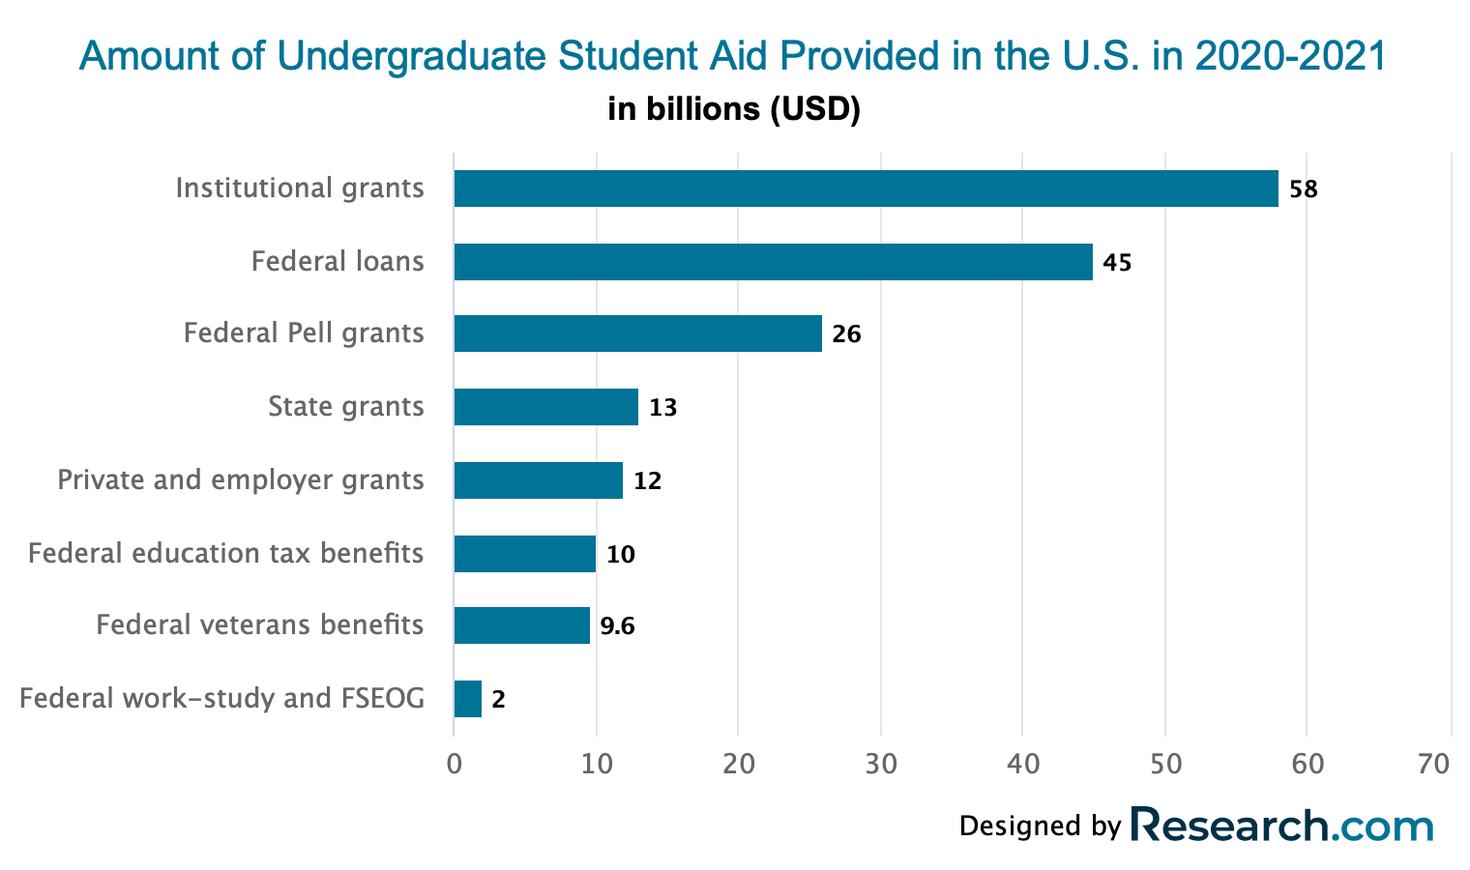
Financial Aid is Extremely Important for Students Pursuing Higher Education
Undergraduate and Graduate students received $234.9 billion in grants, federal loans, tax credits, and federal work-study aid in the 2020-21 school year (College Board, 2021) .
The average student borrows $11,836 per year to afford school (EducationData.org, 2021).
The amount every student borrows has grown at a yearly rate of 1.961%. (EducationData.org, 2021).
Parents borrowing on behalf of their children receive an average of $12,535. (EducationData.org, 2021).
The average loan debt balance per student is $28,400 and may be as high as $40,904 at the end of their college careers (College Board, 2021).

Slide 3
The current system of financial aid management is misinformative, complex, counterintuitive and confusing for both students and parents.
History of financial aid policy has been focused on increasing accessibility for underserved students but has failed to implement essential services that help students with financial aid management and operations.
This has led to consequences for both high education students and institutions.
Nytimes.com

Slide 4
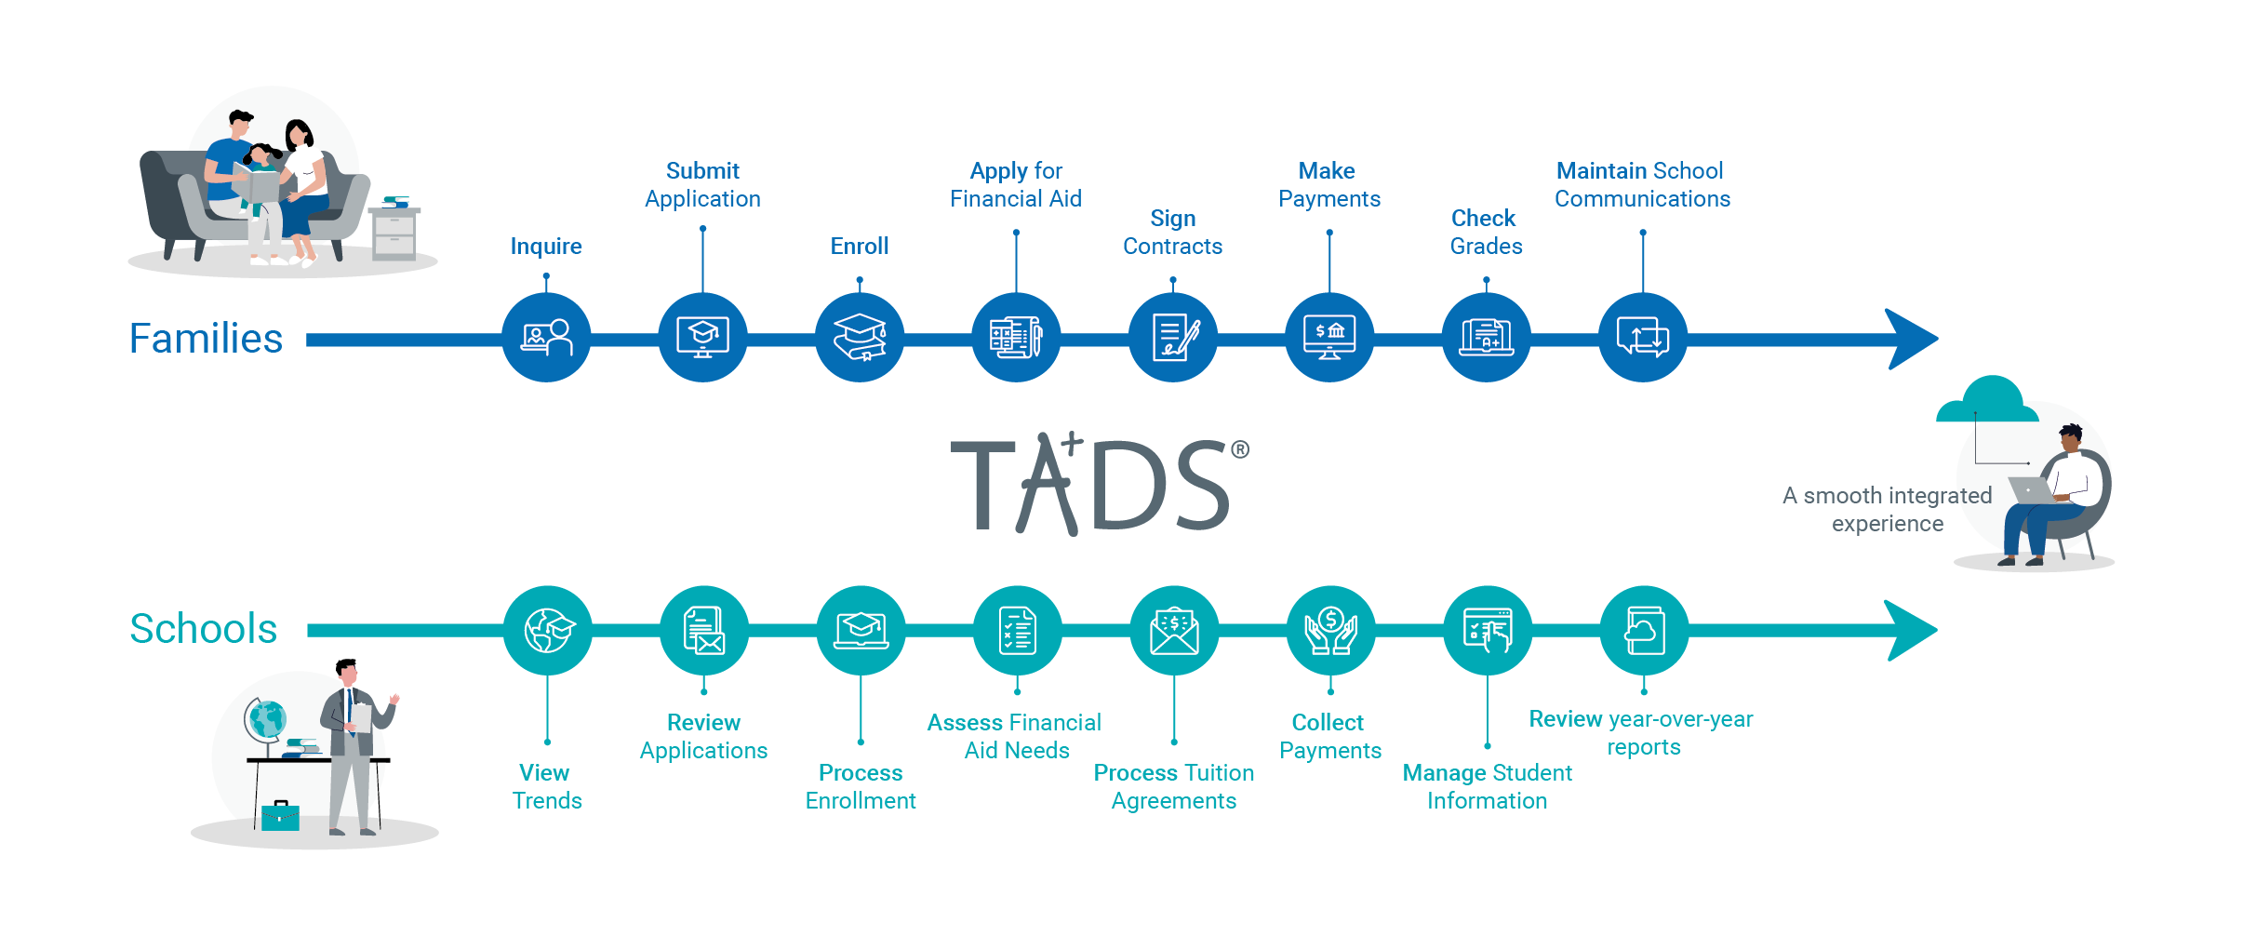
The Financial Aid Management Software Industry
To qualify for inclusion in the financial aid management category, a product must:
Process student financial aid forms
Automate portions of the financial aid process
Provide a dashboard for administrative professionals to manage all student financial aid
*University students and their parents can access their financial aid rewards and decisions and other essential financial aid resources by logging into the software digital interface.
*University financial aid administrators use the software to manage, track and automate student aid.
TADS Financial Aid Software Overview (www.tads.com)

Slide 5
Positive Impact on both Education and Society
For Students:
User friendly interface
Accessible on any digital device
Financial Aid offers are more transparent and straightforward
Automated and student-focused processes
For Institutions:
Makes more accurate and compliant financial aid offers
Boosts enrollment rates
Boosts retention rates

Slide 6
Key Player: CampusLogic
An Award-Winning SaaS Technology That Eliminates Barriers in Providing and Processing Financial Aid
Financial Aid Automation solutions allow students to make informed financial decisions and chart a personal financial pathway.
Student Forms
Campus Communicator
Virtual Advisor
Scholarship Universe
Enrollment Acceleration solutions encourage college readiness, financial preparedness, and financial emergency mitigation.
Raise Me Enrollment
Clear Cost
Sponsored Scholar
Research.com

Slide 7
S.W.O.T Analysis
Strengths Comprehensive Platform: Enrollment and Financial Aid Automation Solutions Promotional & Expansive Website Merge with Ellucian | Weaknesses A New National System of Financial Aid Processing Political Climate: The Human Labor Conflict The Risk of New Competitors
Opportunities Continue to Establish Partnerships Expand Social Media Presence Extend Customer Base to K-12 Schools | Threats Requires Institutional/Employee Buy-in Weak Customer Relationship Channels Loss of Brand Identity

Slide 8
Recommendations For CampusLogic and Other Industry Leaders
Expand
Expand specific resources to K-12 schools.
Partner
Establish partnerships with SIS providers and other educational technologies
Build
Continue to build an online presence
Push
Push for recognition and changes in policy.

Slide 9
Future Predictions
The software will have a positive impact on student financial success and institutional enrollment and retention rates
National and state policies will advocate for the financial aid management software industry
The number of investors and investment dollars will increase
The financial aid system will be accessed and utilized at a higher rate by underserved students
There will be more informative sessions and training about the software and its resources

