Slide 1
America During the Crash, Depression, and New Deal
MEITE Showcase
Erica Harreveld
Notes:
Start with the problem

Slide 2
Course Topic
Audience: Advanced secondary (6-12) history students looking to develop their historical skills, or teachers looking for a unit that is ready to implement
Topic: The stock market crash, Great Depression, and New Deal
Goal: Encourage students to engage with historical content in an authentic way through…
reading primary sources
making connections to current events
producing assignments that demonstrate their understanding

Slide 3
Course
Objectives
By the end of this course, students will be able to…
03
01
02
03
04
Make connections between the political, economic, and social events of the Great Depression era and the modern day
Identify the relevant racial and gender issues during the Great Depression era
Comprehend primary source material from the Great Depression era
Explain the key historical knowledge and concepts related to the Crash, Depression, and New Deal

Slide 4
Course Innovations

Slide 5
01
Assignments versus Assessments

Slide 6
Stock Market Crash Infographic

Slide 7
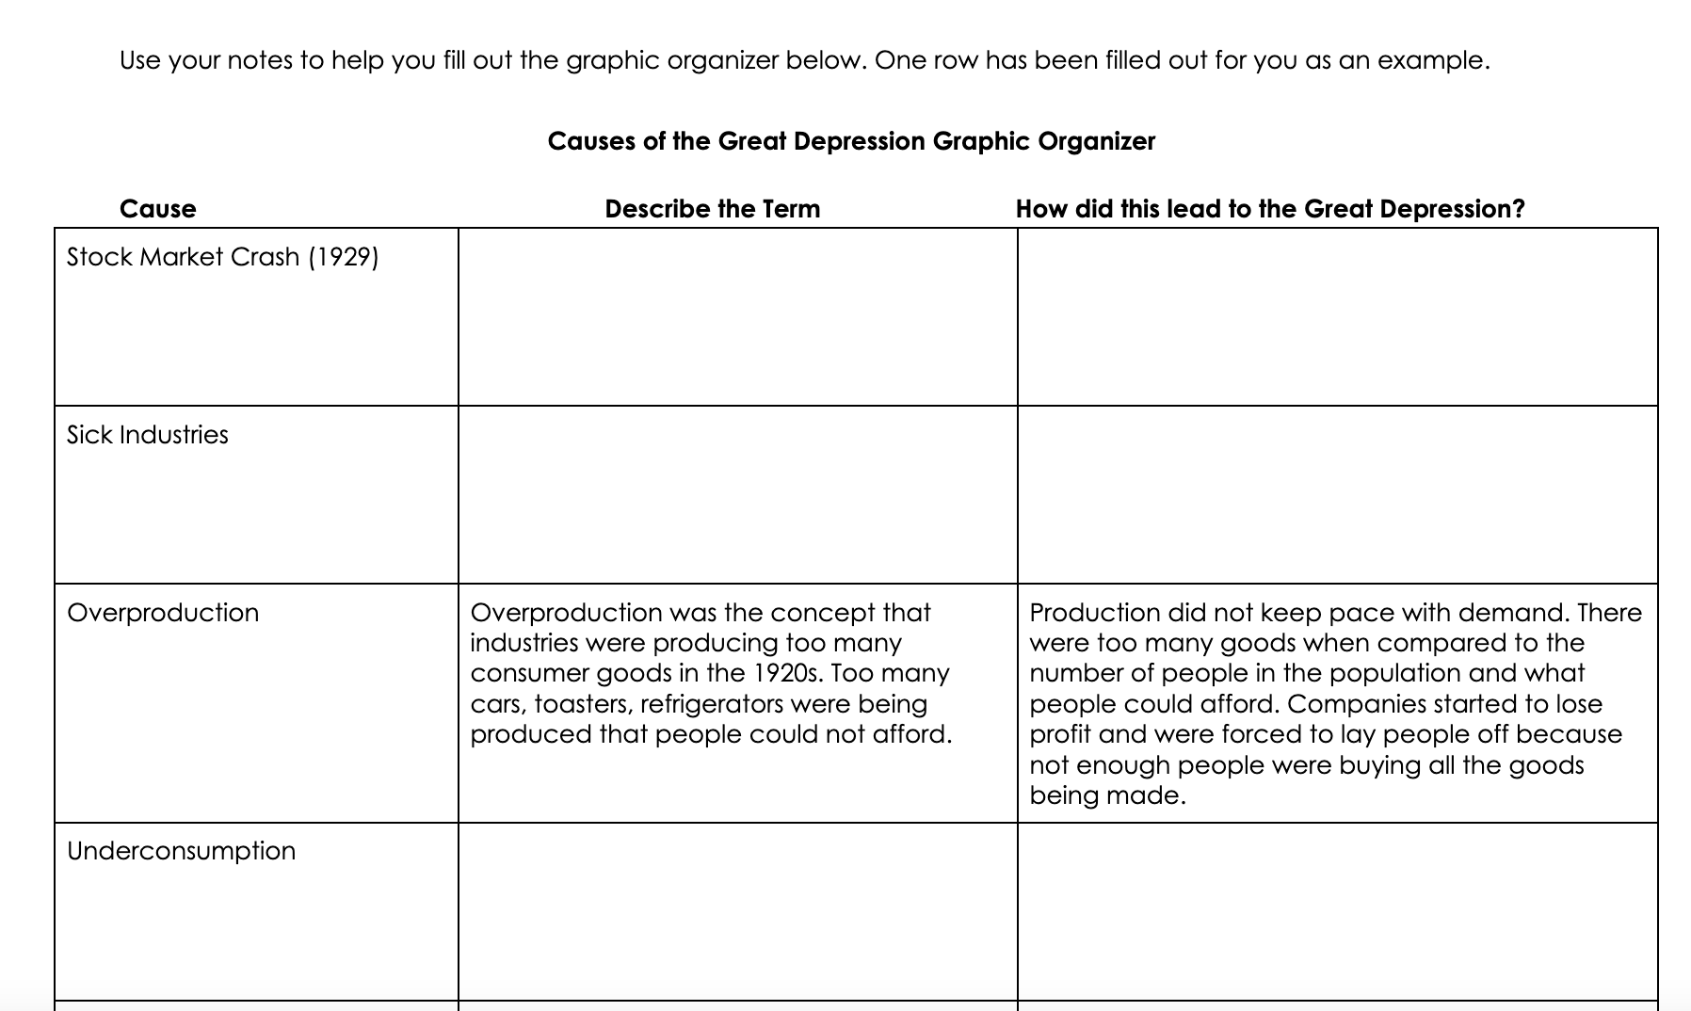
Causes of the Great Depression Graphic Organizer

Slide 8
New Deal Research Project

Slide 9
02
Active and Constructive Learning

Slide 10
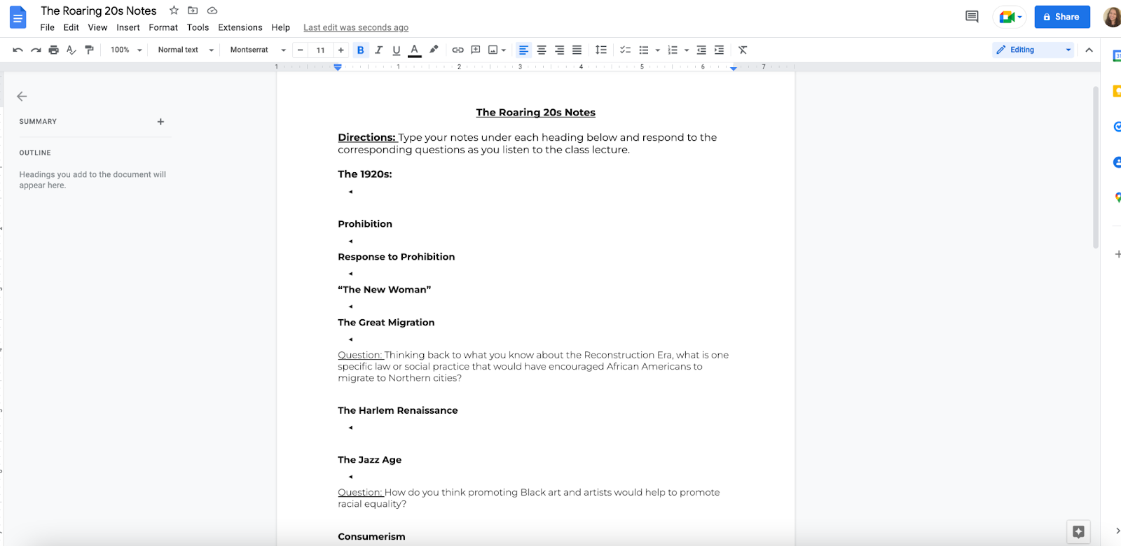
Scaffolded Notes

Slide 11
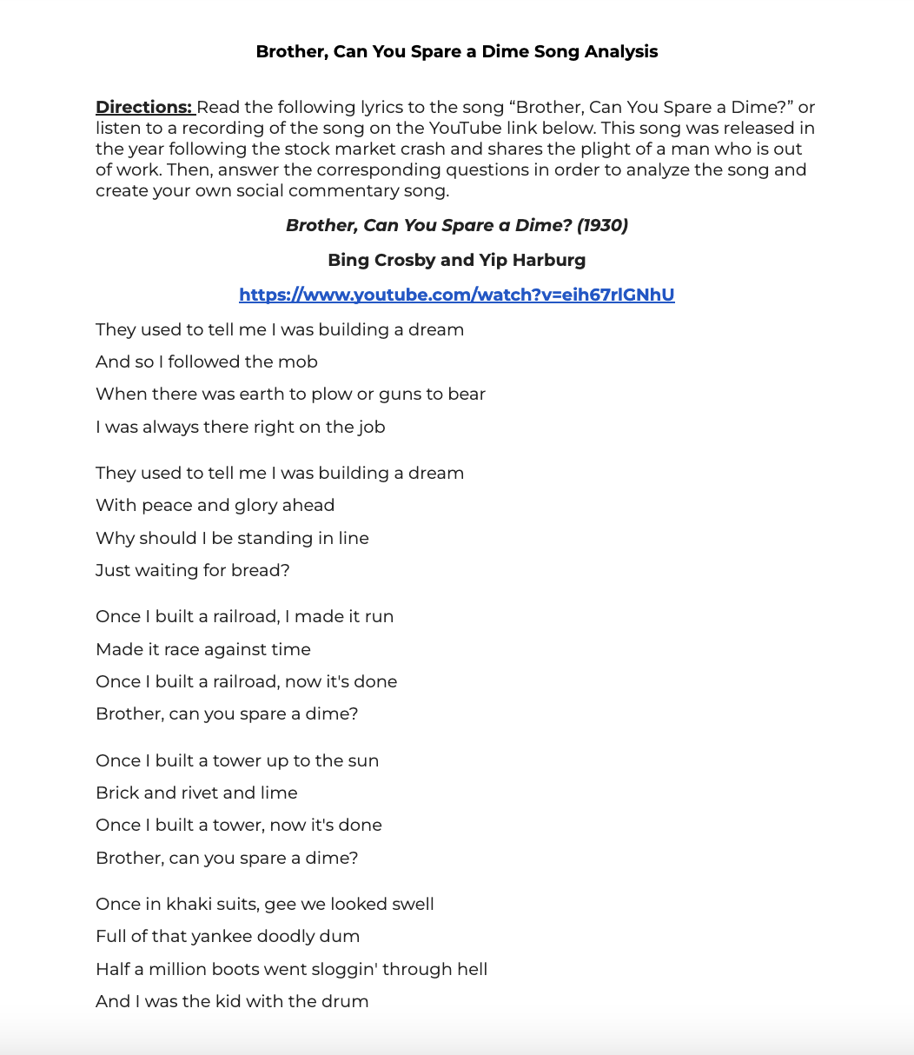
Song Analysis and Creation

Slide 12
03
Universal Design for Learning

Slide 13
Provide Multiple Means of Representation

Slide 17
Provide Multiple Means of Expression

Slide 18
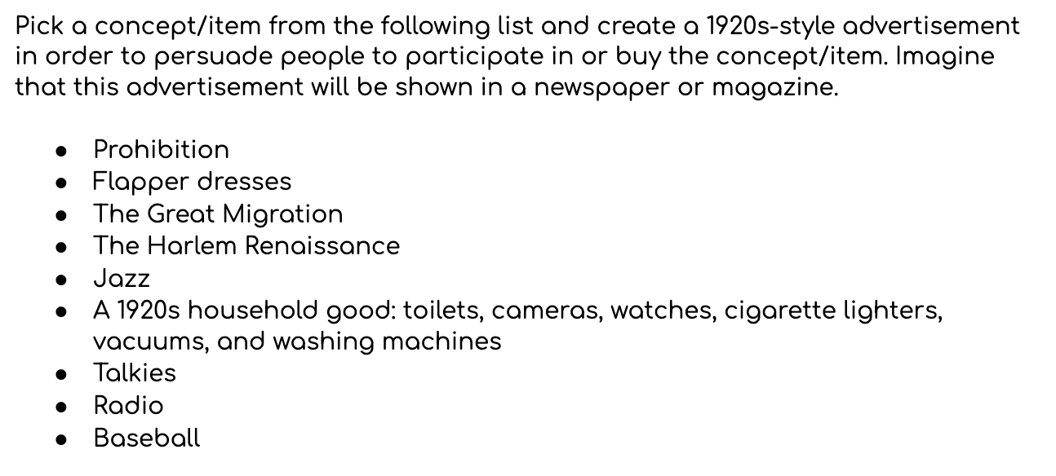
1920s Advertisement Topic Options

Slide 19
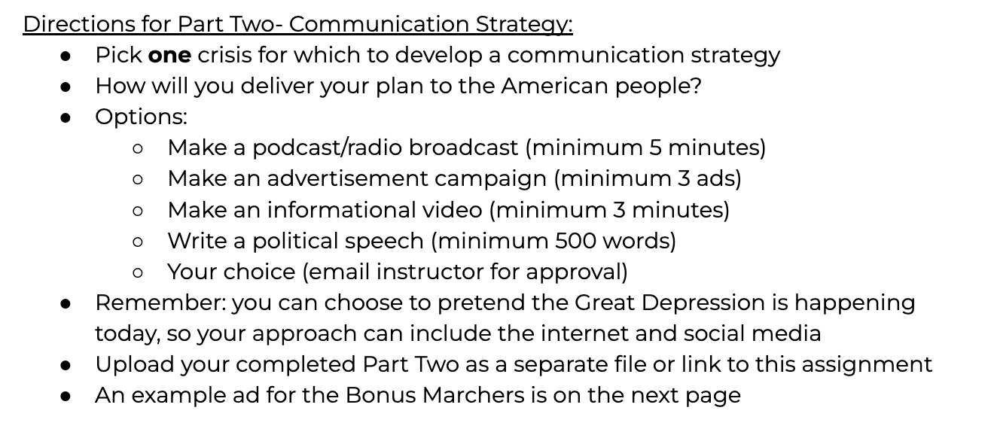
Final Project Options

Slide 20
Thank you!

