Slide 1
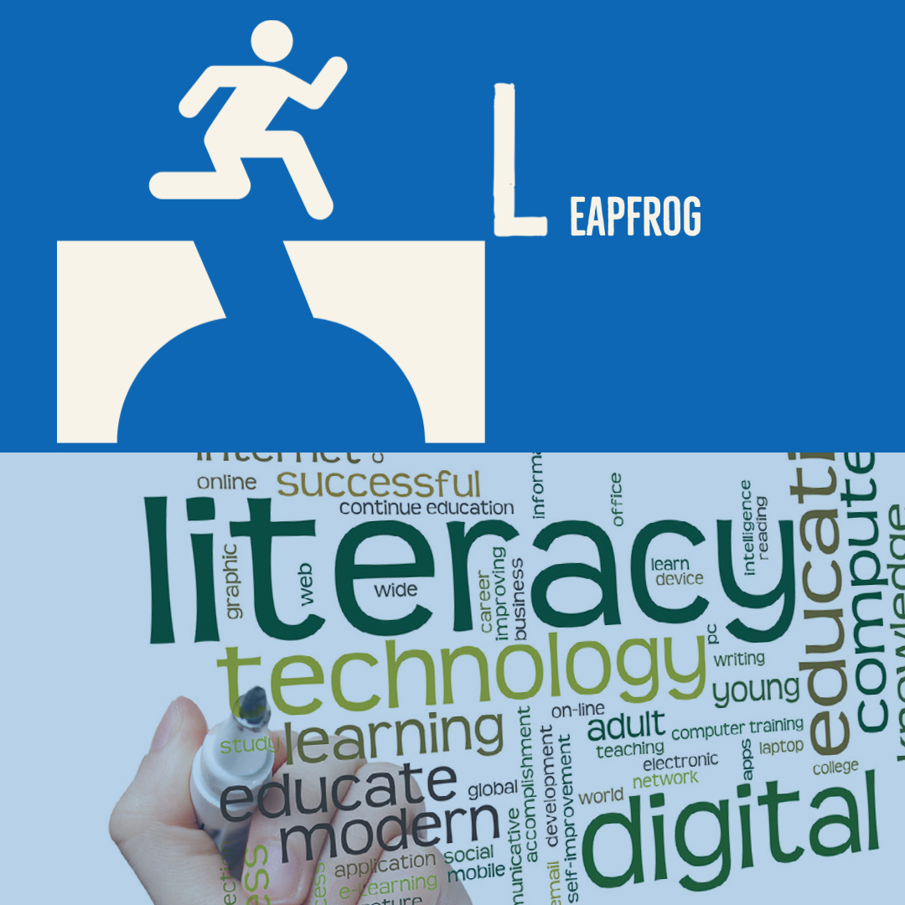
Adult Education in Digital Contexts
Leapfrogging the Education & Skills Gap with Digital Literacy
Notes:
I will be sharing highlights from my report how adult education in digital contexts can help adult learners leapfrog over the education and skills gap WITH DIGITAL LITERACY

Slide 2
outline
WHO IS THE ADULT LEARNER
ADULT EDUCATION TRENDS
ADULT EDUCATION & OPPORTUNITY GAP
CLOSING WITH GAP
PROJECT KITTY HAWK
PROJECT KITTY HAWK BUSINESS MODEL
SWOT
RECOMMENDATIONS
Notes:
WE WILL SPEND THE FIRST HALF OF THE PRESENTATION EXPLORING THE PROBLEM SPACE BEFORE JUMPING INTO THE SOLUTION SPACE

Slide 3
Who is the adult learner
“I WAS NAÏVE WHEN I FIRST STARTED COLLEGE…”
Older than 25 years
Started College but dropped out…..
NC HAS 1.2M ADULTS 25+ WITH SOME CREDIT NO DEGREE
* MyFutureNC 2019 Report
Notes:
*At the center of my report is the adult learner – older than 25 years. who started college but dropped out due to financial reasons, to raise a family, or due to early academic setbacks. Many of us know someone in this demographic – in fact there are about 1.2 M adults in NC who have some college credit but no degree. - this has been a traditionally underserved learner group in NC

Slide 4
Adult Education trends
ADULT LEARNER MOTIVATIONS
INTRINSIC
EXTRINSIC
“I HOPE TO BE A ROLE MODEL FOR MY KIDS”
INTEREST IN ONLINE INSTRUCTION | INTEREST IN NEW EDUCATION MODELS | OTHER SHIFTS
ONLINE INSTRUCTION EXPECTED DESPITE EARLY CHALLENGES | HIGH COST OF HIGHER ED : GROWING DEMAND FOR FLEXIBLE PROGRAMS | MORE FAMILY SUPPORT HIGHER ENROLLMENT OF 25+ THAN FOR(18-24)
SOME CREDIT NO DEGREE
Notes:
These adult learners have motivations both intrinsic and extrinsic (role model for kids, personal goal to graduate college, better financial prospects)
In addition –
*there has been an openness to online instruction, which allows these learners to balance work and family with their educational pursuit.
*Rising cost of higher ed has led to DEMAND FOR affordable and flexible programs – year-round or competency based that provide micro credentials.
*We are also seeing HIGHER ENROLLMENT AMONG OLDER ADULT LEARNERS *WHO HAVE SOME CREDIT NO DEGREE

Slide 5
ADULT EDUCATION & OPPORTUNITY GAP
67%
49%
50%
75%
NEED
DIGITAL SKILLS
SOME CREDIT NO DEGREE
GAP OF 400K BY 2030
* MyFutureNC 2019 Report
Notes:
But is there a market demand for upskilling this adult population who have SCND?
AS IT TURNS OUT….IN NC
*67% of NC jobs require post secondary degree or high-quality accreditation by 2030.
*75% *Need Digital skills
*Only 49% of NC residents Ages 25-44 have needed level of Education
* SCND
*More than 50% of NC employers are not finding workers with the right skills.
* There is expected to be a gap of 400K workers by 2030 -> DRIVEN BY SOME OF THE TRENDS HIGHLIGHTED ON THE PREV SLIDE.

Slide 6
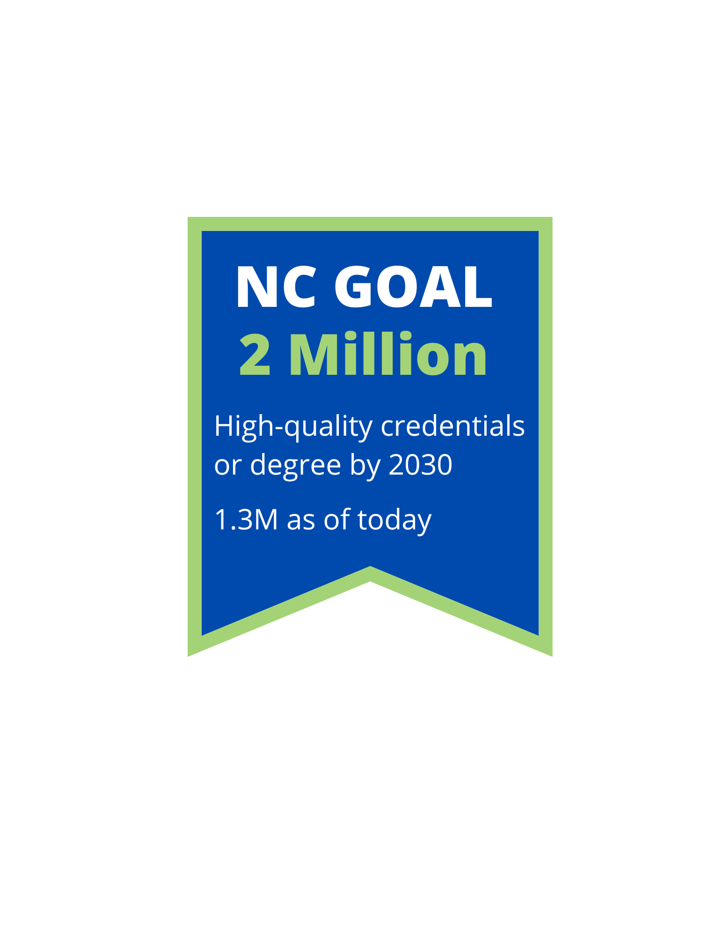
CLOSING THE GAP – State response
DIGITAL LITERACY SKILLS ARE CRITICAL FOR BRIDGING THE GAP
EXTEND HIGHER ED BENEFIT TO THE UNDERSERVED LEARNER POPULATION
SOME CREDIT NO DEGREE
Notes:
There is urgency in bridging this digital skills GAP.
EXPERTS BELIEVE that Digital literacy skills are critical in BRIDGING the GAP
*The State has set an ambitious attainment goal of 2 million North Carolinians upskilling by 2030. To reach the goal, UNC System IS focusing on
* extending the benefits of higher education to adults beyond the traditional college age adult population. – WHO HAVE SCND

Slide 7
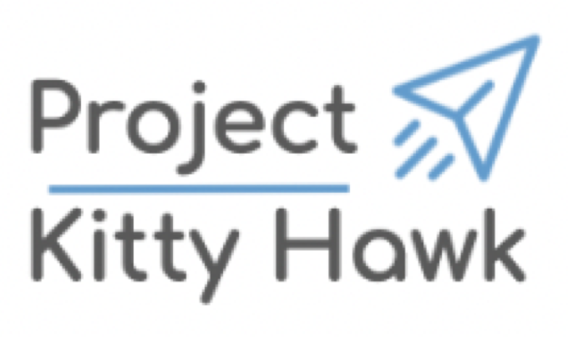
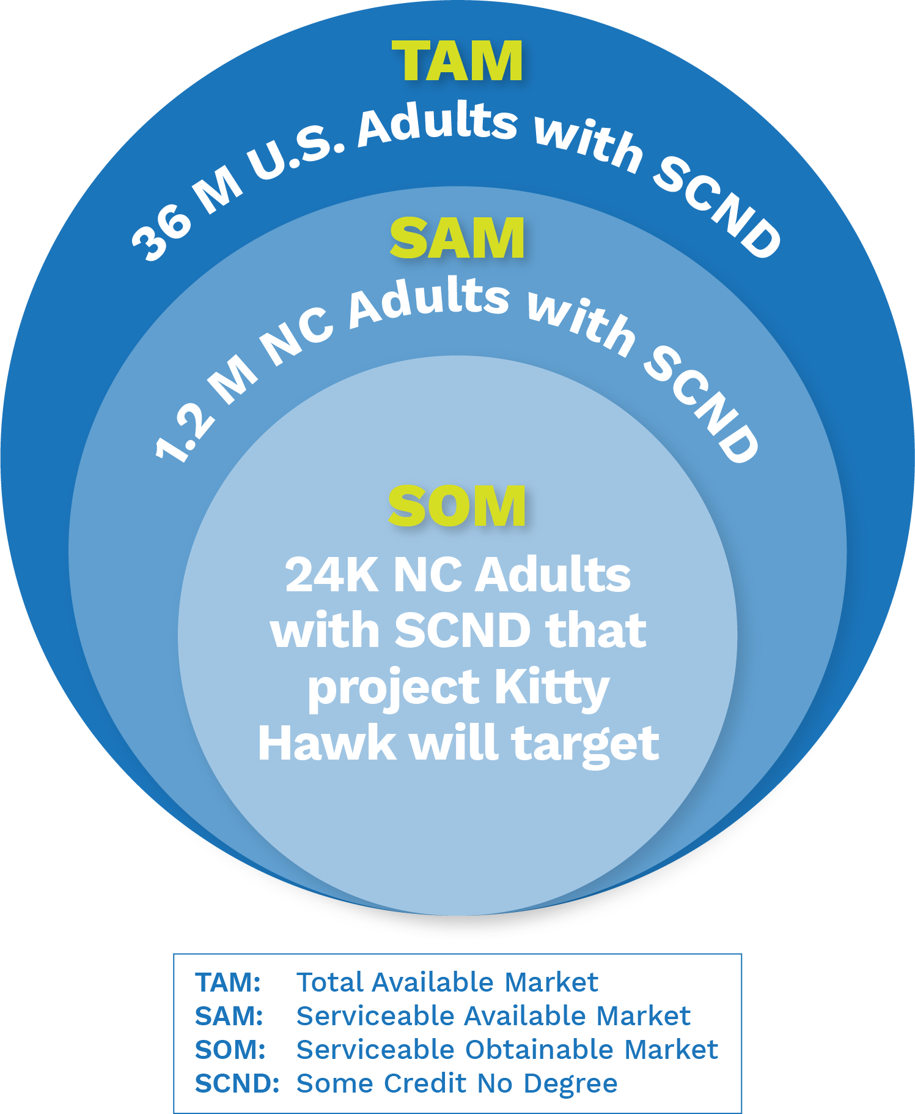
PROJECT KITTY HAWK
A NONPROFIT EDTECH STARTUP
ONLINE PROGRAM MANAGER
UNC UNIVERSITIES AS CUSTOMERS
PROVIDE SERVICES TO UNC UNIVERSITIES TO IMPROVE THEIR ONLINE OFFERINGS
TARGET LEARNERS
$97M
Notes:
*AND THIS LED TO THE LAUNCH OF PROJECT KH in Dec 2021, WITH *$97M ALLOCATED FOR AN *OPM
*SERVING AS a COMMON RESOURCE TO UNC UNIVERSITIES
*to enable THE UNIVERSITIES to create high quality online programs.
*Target learners will be NC Adults *25+ with *SCND

Slide 8
Kitty hawk business model
FLEXIBILITY
ACCESSIBILITY
AFFORDABILITY
Notes:
* THIS IS OPM MODEL - market demand and enrollment ARE BETTER KNOWN FOR KH.
Program Design, Technology, and Success Support ASPECTS OF THE KH MODEL ARE STILL EMERGING. I WILL FOCUS ON THESE IN THE recommendations SECTION LATER.
*KH WILL advise UNC universities :
to create flexible ONLINE program based on market demand data to MAKE UNIVERSITIES COMPETITIVE
MAKE PROGRAMS ACCESSBILE TO ITS LEARBNRS &
OFFER AFFORDABLE PROGRAMS due to its NONPROFIT OPM MODEL

Slide 9
SWOT analysis
STRENGTHS
Nonprofit
Decentralized
Growth w/o Physical Infra
WEAKNESS
Unclear Shared Vision
Buy in from Existing Programs
OPPORTUNITIES
Efficiency Affordability
Flexibility
THREATS
New Entrants
Pressure from Substitutes
Notes:
given that KH is in its early stages,
Its Strengths and Weaknesses ARE POTENTIAL - OPPORTUNITIES AND THREATS ARE REAL.
*BEING A NONPROFIT FREES KH TO OFFER AFFORDABLE SERVICES VS ITS FOR PROFIT COMPETITORS,
Its DECENTRALIZED model gives universities the flexibility to select its services
*W – its shared vision is under wraps & it is unclear UNC universities with existing online programs will welcome KH services
*O – It has Opp to create efficiency across UNC system to create affordable and flexible programs that enable underserved adult population to bridge education and skills gap
Threats – Out of state universities like ASU may be interested in leveraging their deep experience in online postsecondary education to enter North Carolina’s market. Comparable successful niche online programs from other UNC universities may offer to scale up to KH

Slide 10
recommendations
HUMAN IMPACT
Student-Faculty relationships
Student Success Coaches
Support for Faculty
Peer Relations
LEARNER ECOSYSTEM
TECHNOLOGY
Best Practices
Common Infra & Services
Faculty PD
Digital Literacy Framework
PROGRAM DESIGN
UDL & Adult Learning
Flexible Programs
Instructional Design
Accessibility
POLICY
Digital Equity
Connected Services
Financial Aid
Employers
Notes:
*Human impact goes beyond student-faculty relationship. KH model should be intentional about supporting students from enrollment to employment. AS WELL AS faculty as they adapt to online teaching.
Tech - Project Kitty Hawk can instrument creation of best practices, common services and professional development that University programs can use to gain efficiency,
*Elements of Program Design can customize programs that serve diverse needs of adult learners, while embedding Digital Literacy in its core
Policy - though furthest away from the learner can have long term impact on learner success
It is important to recognize the complex reality of a learner’s environment – it is not static nor are the factors impacting the learner experience either directly or indirectly.
*BUT THEY ARE CONNECTED VIA A * LEARNER ECOSYSTEM THAT is a system of people, content, technology, culture, existing both within and outside of a learning environment.
Ecosystem model will allow KH to influence policies and adapt practices that remove barriers to enable full participation of the adult learner – allowing them to leapfrog over their accumulated lack of formal education and digital skills
A wider and a wiser use of technology can help the state achieve and sustain its attainment goal.

Slide 11
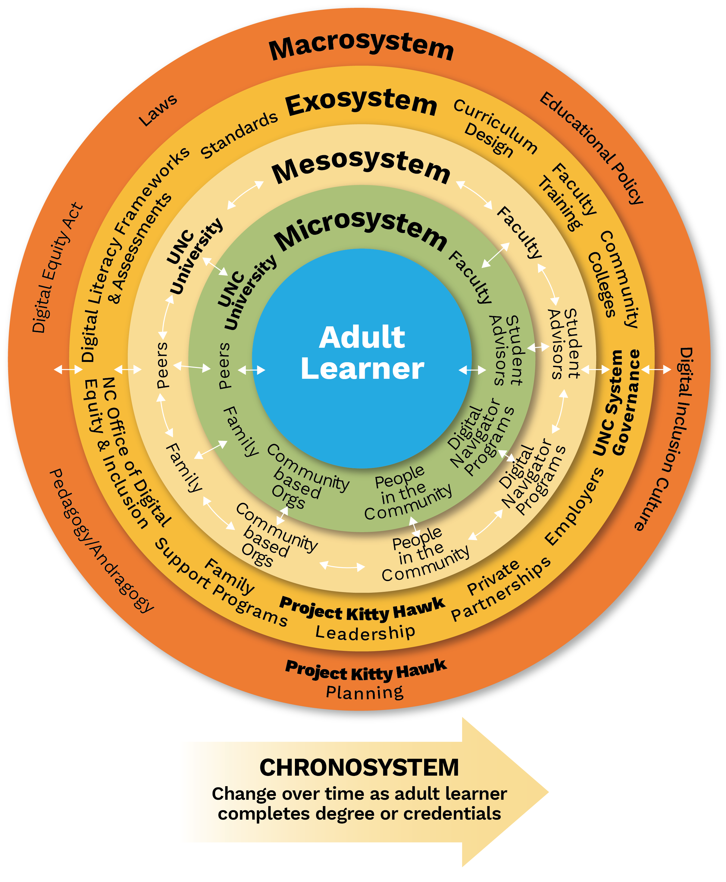
Thank you Questions??
LEARNER ECOSYSTEM
Notes:
I’ll leave you with a more interesting representation of Learner Ecosystem. Happy to talk to anyone who is curious about it.

Slide 12
BACKUP

Slide 13
PROBLEM: DIGITAL OPPORTUNITY GAP
Jobs Requiring Digital Skills
Unemployed Lacking Digital Skills
6,925,017
3,261,536
>
ACROSS U.S.
248,332
81,488
ACROSS NC
>
* U.S. Bureau of Labor Statistics
Notes:
TECHNOLOGY -> NEW ECONOMY -> 21ST CENTURY JOBS -> DIGITAL SKILLS
LEFT COLUMN * RIGHT COLUMN *
*DIGITAL OPPORTUNITY GAP ACROSS THE U.S. AND * ACROSS NC

Slide 14
RECOMMENDATIONS
LEARNING ECOSYSTEM
HUMAN IMPACT
LEARNING OUTCOME
POLICY
ACCESSIBILITY
TECHNOLOGY
Notes:
The recommendations for adult education and project Kitty Hawk along * the five metrics done can be mapped into *a learning ecosystem – loosely defined as a system of people, content, technology, culture, and strategy, existing both within and outside of a learning environment,
IT encapsulates the complex reality of a learner’s environment as multiple nested systems that directly and indirectly impact the learner’s development. These systems are not static and present themselves as factors that influence the learner experiences,
One concrete example as lack of access to affordable broadband and/or device caused by changes in access to free services like public library or as complex as changes in family situation. In either situation, availability of online courses or multiple access points into the UNC system is necessary but not sufficient.
This is where project Kitty Hawk can influence how UNC system can go beyond believing “if we build it, they will come” and show commitment to removing barriers to learning and empower the adult learner to participate in higher education online. A learner-centered solution can be availability of a scholarship that covers broadband and device access and connecting the learner to digital navigator services in the area, that are funded through state of North Carolina’s office of Digital Equity.

