Slide 1
Gaming To LEarn
By Alex Conte

Slide 2
The Science Behind Math Video Games
Research has shown incorporating gaming characteristics and experiences into non-game contexts can increase student engagement in learning situations
Between 2010 and 2015, the number of teachers using computer games in the classroom more than doubled. Also, global game-based learning revenues were projected to be more than $7 billion in 2021

Slide 3
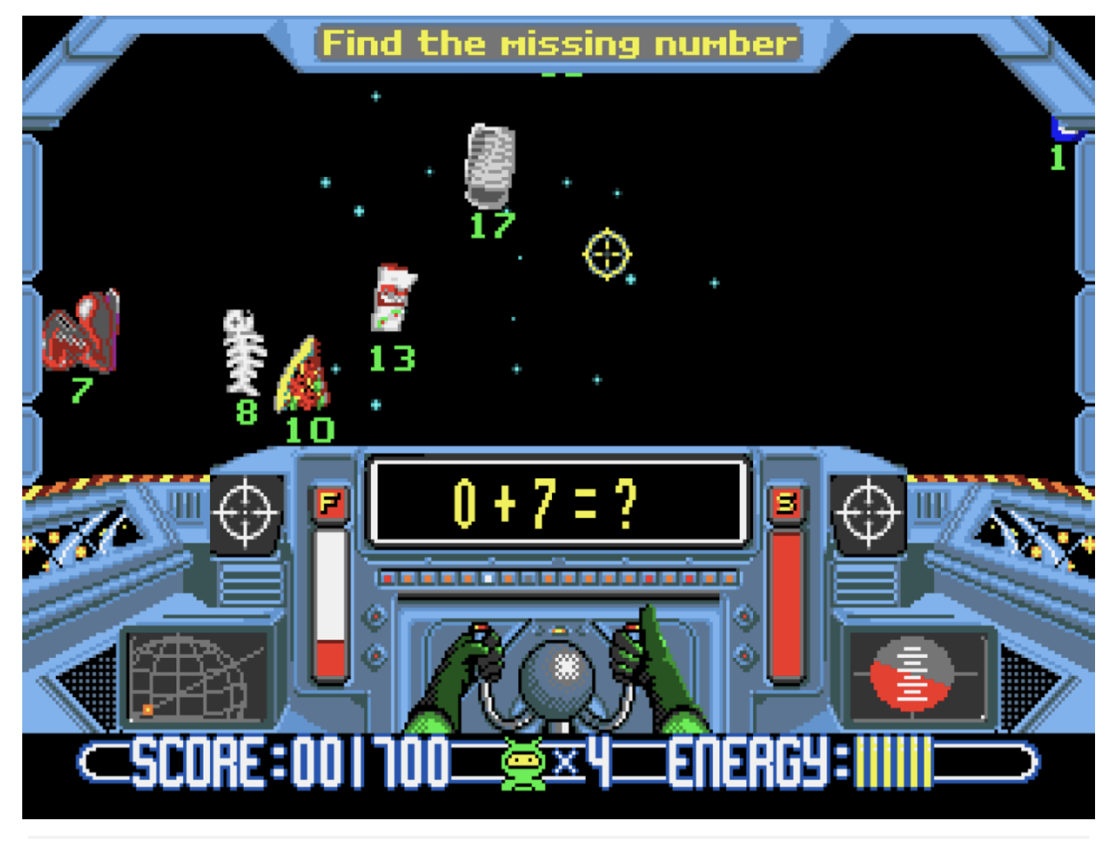
Pioneers Within the Math Video Gaming Industry
Lemonade Stand (1973)
Created by Minnesota Educational Computing Consortium
Math Blaster! (1983)
Created by Davidson and Associates
Number Munchers(1986)
Created by Minnesota Educational Computing Consortium
Prodigy Math Game (2011)
Created by Prodigy Education

Slide 4
Prodigy Education
The company was founded by Alex Peters and Rohan Mahimker as a graduate school project
Prodigy Education has over 100 million users. includes over 500, 000 teachers
Recently raised over 150 million dollars in private investment

Slide 5
Highlights of my Swot Analysis
Weaknesses:
Prodigy Education’s revenue streams are possibly exploitative in nature
Prodigy Education can improve how they support students struggling with English
Threats:
Parents could decide they do not want Prodigy Education in the classroom

Slide 6
Recommendations
Play a role in connecting rural America to high speed internet
Make a console game

