Slide 1
VIRTUAL SLIDES FOR EDUCATION DAY
Here is where your presentation begins
Notes:
For this presentation, share the topic of your course along with the learning objectives/outcomes for students. While explaining the objectives/outcomes, discuss who your target learners are and how they will benefit from completing your course. Next, highlight 2-3 elements of your course that are innovative, which could be learning activities, course design/structure, assessments, etc. Depending on your course, these elements will vary, but the important aspect is that you explain the innovation behind them, feel free to quote research and theory to support your claims.

Slide 2
AGENDA
01
02
04
05
03
PROBLEM
LEARNING OBJECTIVES
TARGET LEARNERS
DESIGN PHILOSOPHY
COURSE FEATURES

Slide 3
00
CONTEXT

Slide 4
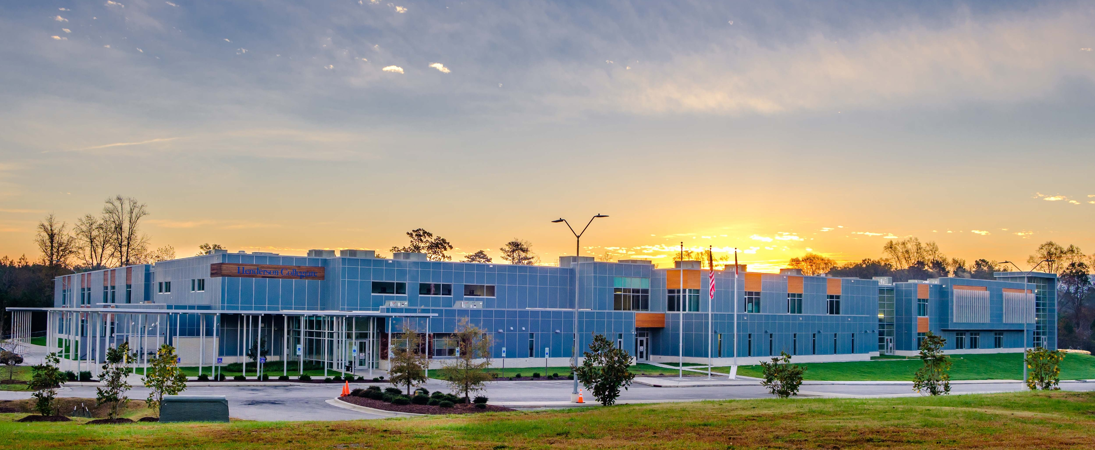
CONTEXT
Notes:
It’s important to have context that this course was born out of necessity for students in the population who had a lack of technology exposure at the middle school level.
I wanted to design this course to offer it to them specifically with the resources the school has available but am aware there might be an opportunity to provide this content to other title 1 schools and offer coaching services to teachers who may need assistance navigating the material on their own who are not content experts.

Slide 5
01
PROBLEM

Slide 6
PROBLEM
Digital literacy is needed to help student learners build skills such as self-efficacy and self-directed learning in blended courses to be successful

Slide 7
PROBLEM
≠
Notes:
Its well publicized the achievement gap between affluent and non-affluent schools.
Student achievement has only widened post pandemic and college success is increasingly more focused on digital literacy to be successful in most classes
Unfortunately for most Title 1 schools, they have a limitation of either a lack of money or time which leads to lack of access to technology or instructors to teach a digital course
Which then results in less affluent students struggling in the work force and college due to lack of access.

Slide 8
SOLUTION

Slide 9
02
LEARNING OBJECTIVES

Slide 10
LEARNING OBJECTIVES
Notes:
Learning objectives are touch typing, word processing, research / source validation, writing a research paper and presentation
The end goal of the course is to build capacity in students to independently research a topic that interests them and have them find credible online sources to write an MLA formatted paper. They will then be able to transform that paper into a presentation using multimedia elements to communicate their findings, much like they would do in an undergraduate program.

Slide 11
LEARNING OBJECTIVES
Notes:
For the purposes of this course, one module / unit was built out focusing on learning Microsoft Word.
Skills included:
Navigating the Word interface
Font formatting
Page layout
Tables
Inserting images / shapes
Proofreading / feedback
The big project at the end of the unit will be formatting a memo and building a poster which requires everything from this unit to complete the project successfully

Slide 12
03
TARGET LEARNERS

Slide 13
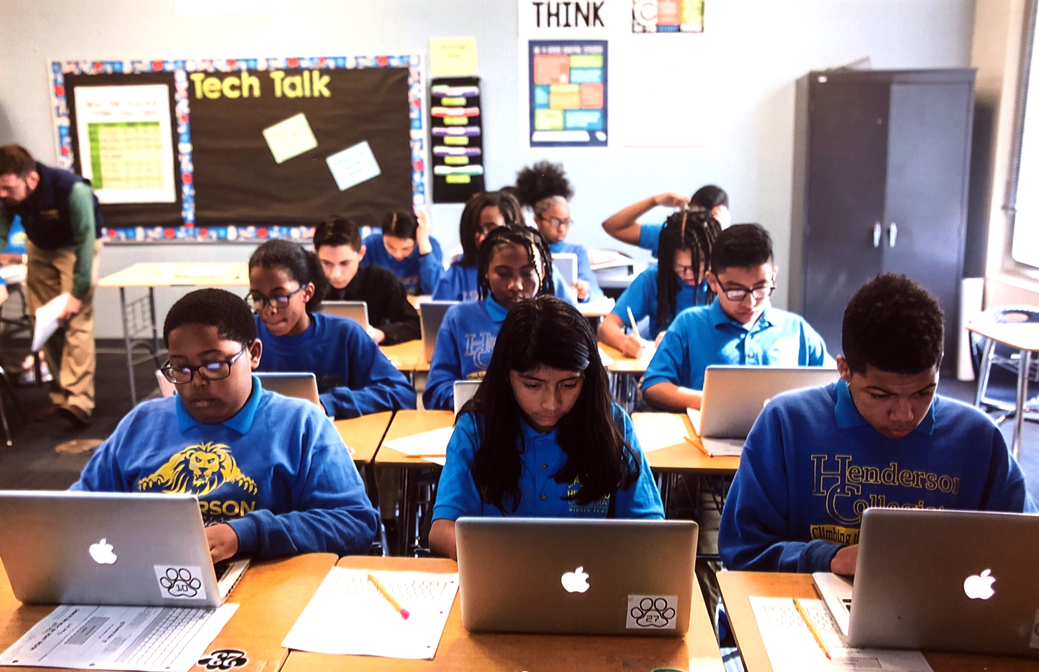
TARGET LEARNERS
Notes:
The market for the 7th Grade Research & Technology course is niche and primarily targetted at schools / charter schools that are defined as Title 1 who may have limited resources due to budget or staffing that may prevent students from getting the digital literacy skills, they need to be competitive in college and in the workforce. We are looking at expanding and selling course to schools that do not qualify under this criteria and offering paid instructional coaching opportunities to teachers leading the course who may have content questions, etc.

Slide 14
04
DESIGN PHILOSOPHY

Slide 15
DESIGN PHILOSOPHY
Notes:
Philosophy is own it, learn it, and share it
Students own their learning by answering/discussing some questions related to the topic they are learning that day
They then learn skills procedurally through a video demo/tutorial on the program and then replicate the skills in a new form of a project to get a conceptual understanding.

Slide 16
05
COURSE FEATURES

Slide 17
COURSE FEATURES
Notes:
Most work is done in Microsoft Word.
Students can watch the video during the learn it phase then replicate the tasks or watch the video to help them complete the tasks simultaneously and watch it as many times as they need
Projects require student feedback (up to 2-3 students) giving each other feedback on what they like / needs to be fixed as part of the class participoation
Projects are then graded through canvas speed grader feature where direct annotated feedback is given to the students as part of the rubric grading process with a rubric that is aligned to each lessons objective

Slide 18
CLOSING
While educators work to close the achievement gap to help students succeed…
..we strive to close the digital literacy gap so students can be successful in a modern workplace and collegiate settings.

Slide 19
VIRTUAL SLIDES FOR EDUCATION DAY
Here is where your presentation begins

