Slide 1
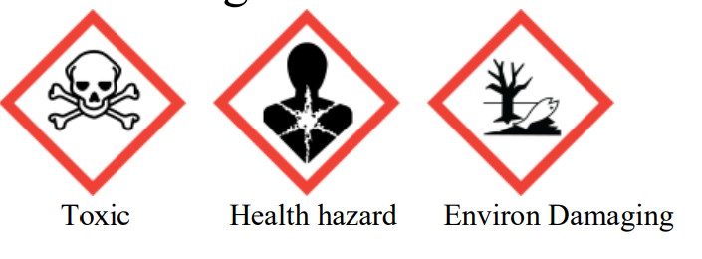
Tar Heel Safety: Uranyl Acetate - A Stain On Your Lab
Uses:
Uranium acetate is a commonly used staining reagent for electron microscopy.
Uranyl acetate is a naturally-occurring radiological material.
Uranium is a radioactive element with alpha, beta, and gamma emissions.
General Safety:
EHS Radiation training is available here.
Inhalation is the primary radiological and chemical hazard of this chemical.
In addition to full PPE, a disposable mask should be worn.
You should always work in a fume hood when dealing with uranium salts.
Uranium waste must be segregated from other waste streams and labeled radioactive.
If you have questions, call a EHS radiation safety officer at (919)-962-5507 from 8 am to 5 pm.
Additional Resources:
Radiation Emergency Telephone Numbers: https://policies.unc.edu/TDClient/2833/Portal/KB/ArticleDet?ID=132051
UNC EHS Radiation Safety Policies: https://ehs.unc.edu/departments/radiation-safety/
Uranyl Acetate-Specific Resource: https://ehs.weill.cornell.edu/sites/default/files/uranyl_acetate.pdf

