Slide 1
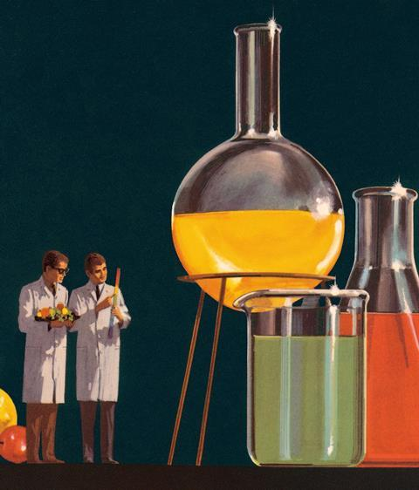
Tar Heel Safety: Reaction Scale Ups
General Reaction Considerations
Reactions behave differently on a larger scale.
Scaled up reactions take longer to set up, conduct, and work up.
It’s harder to control the temperature of a reaction in a larger flask, even if the percent reaction contained volume is held constant.
Reaction heat is generated in volumes (r³) but heat is removed with vessel surface area (r²), leading to a heat-generation-to-dissipation ratio of r
Tips for Scaling Up Reactions
Carefully monitor the internal and/or bath/mantle temperature with a thermometer.
Scaled up reactions must be set up carefully.
Avoid “all in” conditions, or reactions in which everything reacts suddenly, all at once. Addition funnels become your friend with scale up – adding solutions/liquid reagents by addition funnel helps the chemist monitor and control exotherms.
Don’t scale up more than 3x.
You’re dealing with a large amount of chemicals, so extreme caution has to be taken.
Make sure there is nothing in close proximity to the reaction set up that might react with the reaction mixture if the vessel breaks or some other mishap occurs.
Consider more strongly the use of overhead stirrers as you scale up.
Resources: https://drs.illinois.edu/Page/SafetyLibrary/ScaleUpReactionSafety ; https://www.labmanager.com/big-picture/reducing-risk-in-drug-development/how-to-scale-up-a-new-synthesis-reaction-28996 ;

