Slide 1
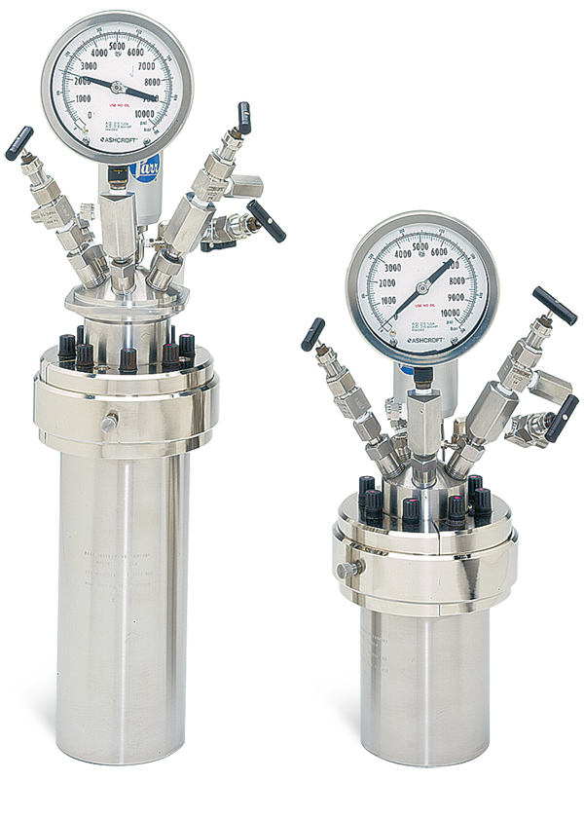
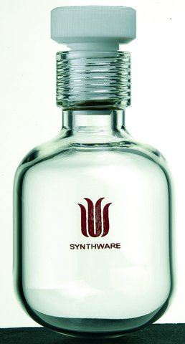
Tar Heel Safety: Pressurized Reaction Vessels
Reasons to run a reaction in a pressure vessel include:
The reaction requires conditions above the atmospheric solvent/reagent boiling point – the boiling point at 1 atmosphere isn’t hot enough, so the reaction needs to be heated in a sealed vessel (known as “passive” pressurization).
Intentionally pressurizing a reaction with an inert gas can be a strategy to have reactions go faster; this generally increases the solvent boiling point and allows higher temperatures to be used (known as “active” pressurization).
The reaction has a gaseous reagent; thus, higher pressures could mean higher solubility in solution and faster reaction rates.
The selectivity could change as the pressure of the gaseous reagent is increased
Types: Types of pressurized reaction vessels include “pressure tubes” (right), used in lower pressure situations often for “passive” pressurization, and “high pressure batch reactors” (left), often used when high pressure gases are involved (e.g. hydrogenations, “active” pressurization). High pressure batch reactors are used at much higher pressures than pressure tubes.
High Pressure Batch Reactors – Higher pressure ratings
Pressure Tubes –
Lower pressure ratings

Slide 2
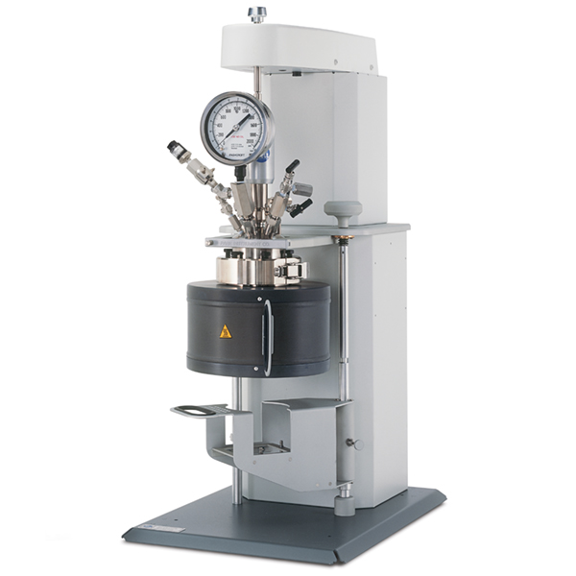
Tar Heel Safety: Pressurized Reaction Vessels
Considerations and hazards:
Check manufacturer pressure rating and maximum volume recommendation before use. Check for presence of cracks or surface scratches, and condition of O-ring and screw-top before use. Scratched metal reactors can be safe to use, but all scratched glass reactors need to be disposed of. Check the reactor material’s compatibility with reagents and products.
Always use a blast shield for pressurized reactions.
When filling a reactor with gas, ensure that the gas bottle and reactor have proper fittings in good condition.
Keep the fume hood sash down (if applicable)
Leak test the pressure apparatus beforehand (if applicable)
Avoid filling a reactor greater than ¾ the vessel volume (liquid volume expansion)
Cool vessel to room temperature slowly and submerge in ice water before opening slowly.
Do not submit glass pressure vessels to base baths.
Do you ever have to use pressurized reactors? You may find the following resources useful:
General SOP for pressure vessels: https://ehs.umass.edu/sites/default/files/High%20Pressure%20Reaction%20Vessel%20SOP.pdf
Solvent compatibility with O-rings: https://www.kemtech-america.com/Article/Article_Info.aspx?ClassID=13
Parr reactor safety and potential explosive molecule moieties: https://www.ccmr.cornell.edu/wp-content/uploads/sites/2/2015/11/ParrReactorSafetyInfo-230m.pdf
Example of reaction selectivity changing with gaseous reagent pressure: C. R. Landis et al. J. Am. Chem. Soc. 2010, 132, 10306

