Slide 1
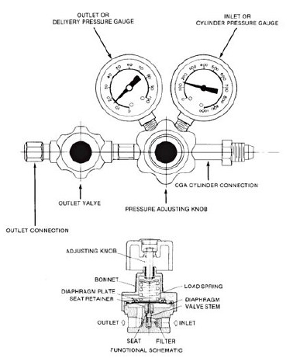
Tar Heel Safety: Pressure Regulators
Pressure Regulators & CGA Fittings
Pressure regulators are used to control how much gas is being released from a compressed gas source
There are specific connections on regulators for specific compressed gases
Nonflammable gases have regular threads, so pressure regulators can be tightened by going clockwise
Flammable gases have reverse threads, so pressure regulators can be tightened by going counterclockwise
CGA numbers listed on the tank and regulator should always be the same! These are etched into the regulator and tank valve. Ensure they match! If the CGA cylinder connection does not easily screw into the valve, you are likely using the wrong regulator!
Check for gas leaks using soapy water each time you change a tank.
Pressure Gauges & Controlling Pressure
Most pressure regulators have two pressure gauges
The right most gauge (closest to the compressed gas tank) measures the inlet pressure, or pressure within the gas cylinder
The left most gauge (farthest from the compressed gas tank) measures the delivery pressure
Pressure regulators also have one valve and one knob
The regulator outlet valve is used to control gas flow
The regulator hand knob is used to adjust the delivery pressure. This should not be used as a flow controller, meaning you should not adjust the pressure to obtain different flow rates.
Resources: https://chemistry.osu.edu/sites/chemistry.osu.edu/files/Guide%20to%20Regulators.pdf and https://www.ndsu.edu/pubweb/~qifzhang/S7-Compressed_Gas-2.pdf

