Slide 1
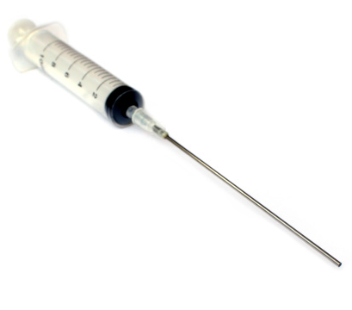
Tar Heel Safety: Needles
General Precautions:
Only use new disposable needles
Use the correct sized needle for your application
Longer needles may be needed to reach the liquid without tipping the vessel the liquid is in
Use an appropriate gauge (smaller gauge = larger diameters)
Thin needles may bend or break easily
Bigger needles may cause damage to rubber septum
Be aware of what you are using the needle for. Will it have solvents in it, or will it just be used for venting?
Safety and Disposal:
Needles should not be recapped.
If a needle is stuck on a syringe, tweezers can be a safer route to remove the needle & lessen the risk of accidental sticks or pokes.
Make sure needles are empty of hazardous reagents/solvents before disposing
Rinse thoroughly with water if they are placed in a sharps containers, as sharps containers are thrown away as trash! Not doing so could risk chemical release into local environments!
Needles should be disposed of in a heavy-duty sharps container, not in garbage bags
Do not leave needles out unattended. For short term storage, stick them in a cork ring or a rubber septum
Ask your group for needles training if you’re uncomfortable with them
If you are stuck with a needle (and a UNC employee), the Occupational Health Clinic is well equipped to handle these incidents. See Emergency Response resource for more information!
Where is our sharps disposal box? How do we clean them after using them?
What do you do with a needle when not in use? How should we store the needles?
For More Information: https://axial.acs.org/lab-safety/sharps-in-the-lab-safety-procedures and https://ehs.usc.edu/research/lab/needle-syringe-selection-usage/

