Slide 1
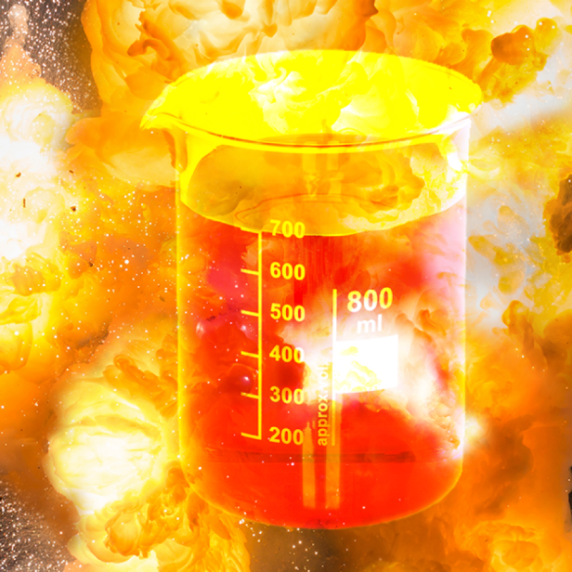
Tar Heel Safety: Inorganic Azides
Chemical Hazards and Reactivity
Azides can be shock and heat sensitive. Handle with care!
Exposure to water and strong acids leads to the formation of hydrazoic acid (HN₃), which is highly toxic, volatile and explosive.
The reaction of inorganic azides (e.g. sodium azide) with dichloromethane produces chloroazidomethane and diazidomethane, which are highly explosive!
”Masked” azides such as trimethylsilylazide may be prone to the same reactivity risks as inorganic azides, particularly under conditions where the TMS group can hydrolyze (e.g. base, fluoride, acid).
Tips and Precautions for using Inorganic Azides
Do not mix inorganic (e.g. alkali) azides and halogenated solvents!
Do not mix azides and strong acids!
Avoid distillation/concentration of azides.
Separate waste stream required (See EHS Website link below)
Do not use a metal spatula for weighing and transferring. Plastic spatulas are alternatives.
Friction around ground glass joints may cause explosions upon contact with azides
Azides should be stored below room temperature and away from light, heat, pressure and shock risks.
Perform a careful risk assessment before using azides!
For more information, read:
Sodium azide-halogenated solvent explosion: https://pubsapp.acs.org/cen/safety/19930419.html; https://cen.acs.org/articles/88/i24/Sodium-Azide.html; https://pubsapp.acs.org/cen/safety/19940314.html; https://pubs.acs.org/doi/full/10.1021/op8000977
UNC EHS Sodium Azide SOP (including waste disposal): https://policies.unc.edu/TDClient/2833/Portal/KB/ArticleDet?ID=132075

