Slide 1
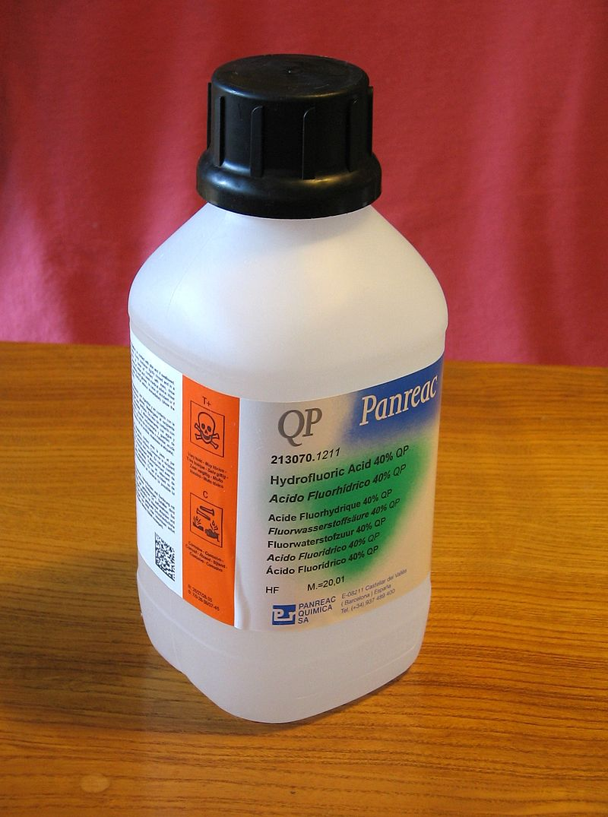
Tar Heel Safety: Hydrofluoric Acid
Uses:
Hydrofluoric acid (HF) is a clear, colorless, fuming liquid used in the electronics industry and in synthetic chemistry.
It is a glass etchant, a protecting group removal agent, a fluorinating agent, and is used for biological staining.
HF is also the byproduct of hydrolysis of various compounds such as fluoride salts and alkylating agents, like [Me₃NO][BF₄].
Precautions:
Hydrofluoric acid is highly corrosive and involves production of lipophilic fluoride ions that cause the breakdown of bone and deep tissue. Symptoms of HF exposure may not be immediate, but HF burns should be treated right after exposure.
Necessary personal protective equipment (PPE) includes a chemical splash goggles, face shield, lab coat, rubber apron, and two layers of nitrile gloves (inner) and thick butyl nitrile or neoprene gloves (outer).
HF should be handled exclusively in a designated fume hood. A safety shower and eye wash should be nearby.
Due to HF’s etching properties, care should be taken to avoid manipulations involving glassware. Storage and manipulation of HF should be undertaken with materials made with polyethylene, Teflon, or plastic.
In the event of exposure, immediate flushing of affected area with water should be undertaken for 5 minutes followed by generous application of calcium gluconate gel. CALL 911.
Gluconate gels typically have a shelf life of ~2 years. Restock regularly!
Does your lab use hydrofluoric acid? What are your lab specific protocols?
For More Information: https://chemistry.harvard.edu/files/chemistry/files/safe_use_of_hf_0.pdf
https://ehs.unc.edu/topics/hazardous-chemicals/hydrofluoric-acid/ SOP available at Safety Net: https://safetynet.web.unc.edu/home/sops/sop-collection/

