Slide 1
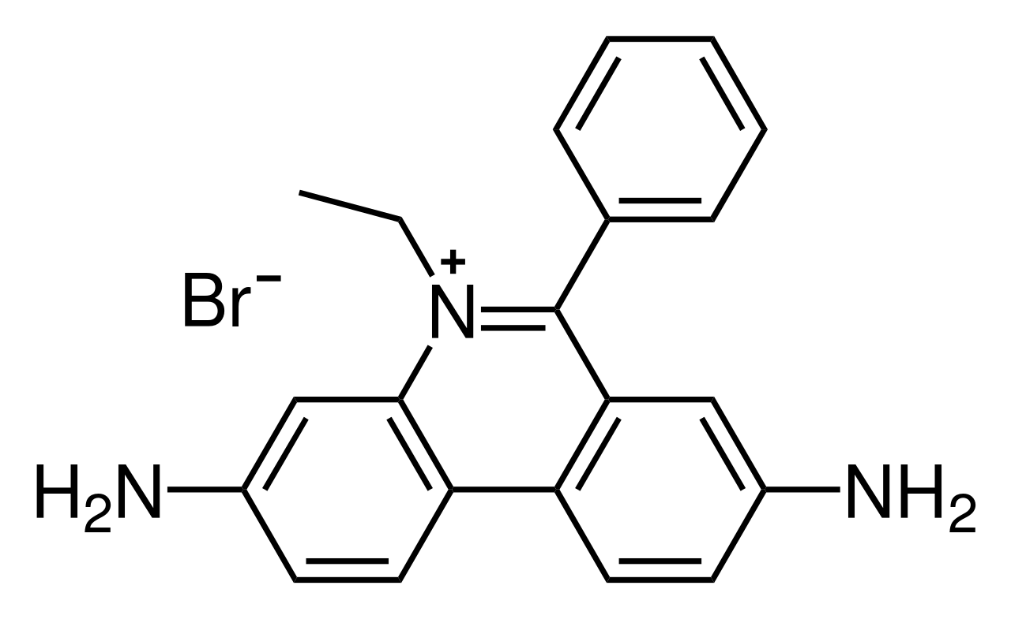
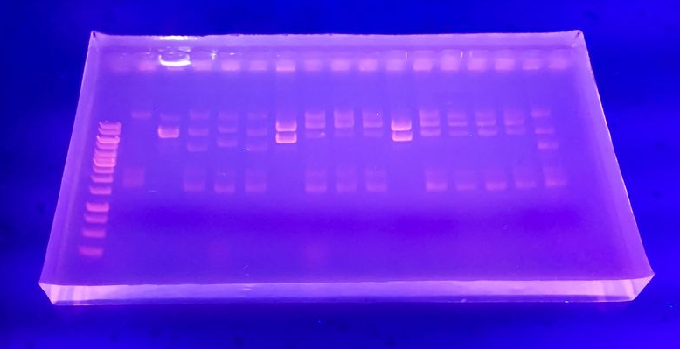
Tar Heel Safety: Gel Electrophoresis
General Hazards
Electrical
Inspect power cords and leads for cracks or frays. Ensure plugs are not corroded.
Turn power off before connecting leads. Connect one lead at a time.
Keep apparatus in a dry environment
Inhalation
Work with solids in ventilated hood to avoid inhaling aerosols and volatiles.
Polyacrylamide/agarose
When casting gels, avoid heating for too long, as there is risk of melting gel/boiling over.
Safer alternatives for staining
Ethidium Bromide and other common stains are carcinogenic. Replace with safer alternatives such as SYBR green, Accuris SmartGlow or Apex Safe, whenever possible.
Fluorescently labelled analytes can be visualized without stains.
Disposal
Acrylamide liquid and dye solutions are disposed as chemical waste.
Ethidium bromide (top), DNA gel (bottom)
For more information:
https://www.labmanager.com/lab-health-and-safety/electrophoresis-safety-tips-19688
https://ehs.stanford.edu/reference/electrophoresis-safety

