Slide 1
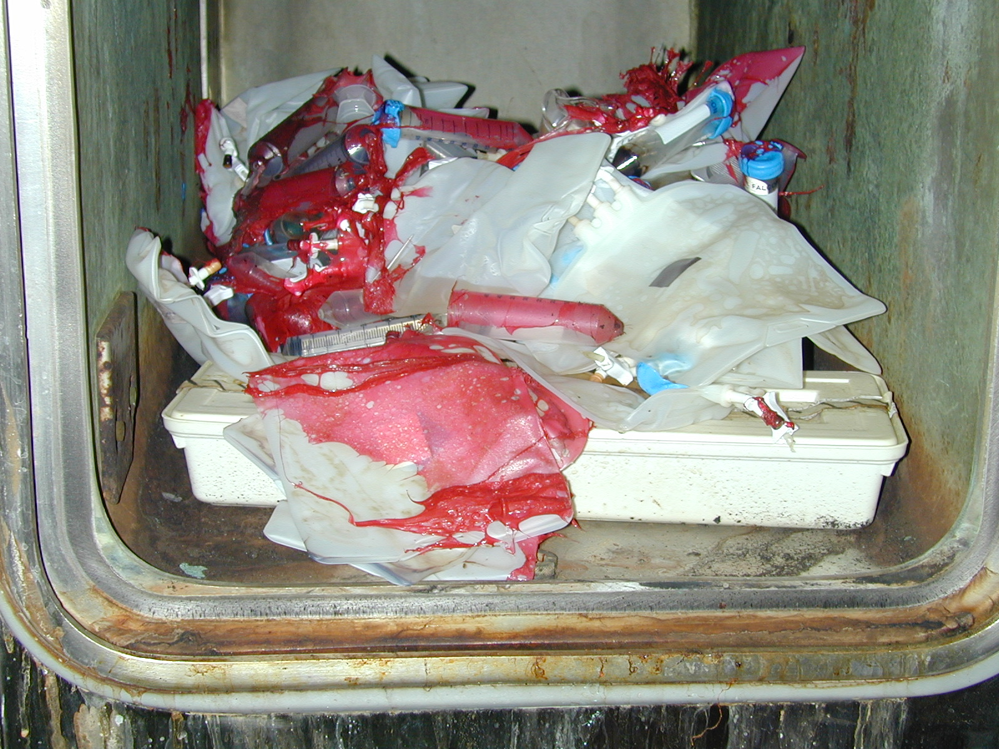
Tar Heel Safety: Autoclaves
DO…
Have a cart to transport items.
Use a secondary container for all items.
Inspect seals. Seals should be smooth and pliable.
Use autoclave safe plastics.
Use autoclave tape on items.
Open door slowly after ensuring pressure and temperatures have dropped.
Let items cool before handling (~10 min).
DO Not…
Seal containers air-tight.
Leave biohazardous waste unattended in autoclave room.
Change autoclave temperature to >250ºF.
Shut off the autoclave at the end of your cycle.
Autoclave bleach, formalin, or glutaraldehyde.
Autoclave flammable or volatile liquids.
Autoclave radioactive materials.
Autoclave corrosives.
How many things can you find wrong with this autoclave disaster?
Additional resources - https://ehs.stanford.edu/reference/autoclave-safety

