Slide 1
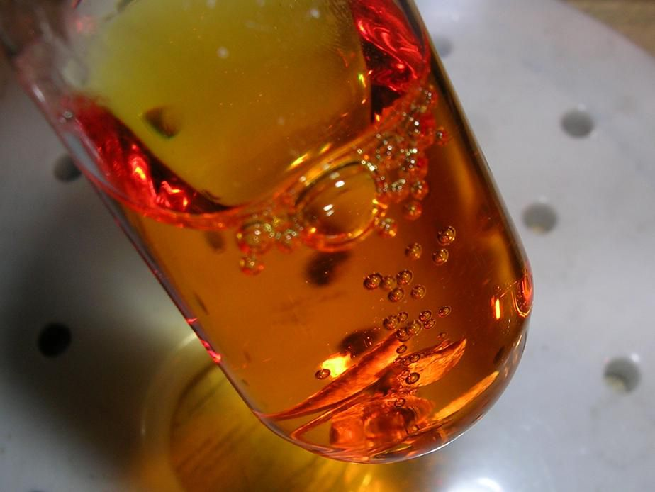
Tar Heel Safety: Aqua Regia
Uses
Aqua regia is fuming acidic mixture, containing typically a 1:3 ratio of nitric acid to hydrochloric acid, respectively.
Freshly prepared aqua regia is colorless but quickly turns yellow, orange or red.
It is commonly used for cleaning glassware by dissolving trace metal contaminants.
3HCl + HNO₃ → NOCl + 2H₂O + Cl₂
Precautions
Work in a fume hood. Toxic gases are evolved.
Always add the nitric acid to the hydrochloric acid slowly. The reaction is exothermic.
Aqua regia is extremely corrosive and can cause skin burns.
Glassware should be thoroughly rinsed with water before adding aqua regia.
Keep aqua regia and associated waste away from organic material.
Aqua regia can react violently and exothermically with organic materials!!
Aqua regia should be thoroughly diluted with water, not bubbling, and colorless when placed in a waste container.
Aqua regia evolves gases and may pressurize a waste container if it is still reactive!
Never store aqua regia in a closed container! Mix only what you need.
Does your lab use aqua regia? What are your lab specific protocols? Do you maintain a specific aqua regia waste stream?
SOP available at Safety Net: https://safetynet.web.unc.edu/home/sops/sop-collection/

