Slide 1
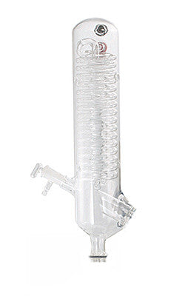
Tar Heel Safety: Vapor Cooling
Water condensers provide cooling for a variety of applications:
Refluxing reactions
Up-and-over distillate condensation
Rotovap distillate condensation
Sublimation
Using house water taps for these applications poses a great risk for flooding during long, unattended periods!
Alternatives to house water for vapor cooling include:
Dry ice/acetone or dry ice/isopropanol baths
Recirculating water baths (fish pump – cheap!)
Ethylene glycol chillers (can be expensive, but DIY options may be possible)
Ideally, connection points are secured with worm clamps or copper wire
For more information, read:
Discussion about cooling line substances: https://rotovaps.net/blogs/blog/118856707-cooling-liquids-for-rotary-evaporator-condensers

