Slide 1
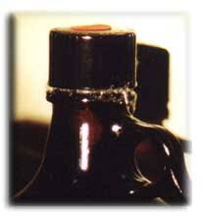
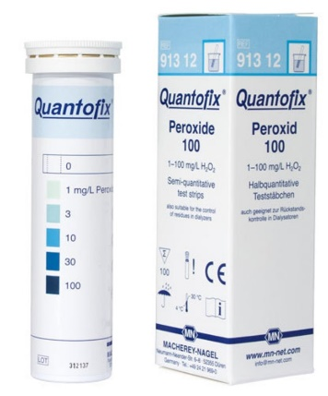
Tar Heel Safety: Peroxide-Forming Chemicals
Explosion risk
Peroxides are capable of exploding when subjected to thermal or mechanical shock
Common peroxide-forming chemicals include:
Diethyl ether, THF, dioxane, aldehydes, and vinyl halides
When possible, consider purchasing peroxide-forming chemicals that contain inhibitors or stabilizers to inhibit peroxide generation.
Distillation and Evaporation Precautions
Do not distill peroxide-forming chemicals to dryness, as you may precipitate peroxides unintentionally.
How do you know if peroxides are formed?
Peroxide crystals are sometimes observed, typically around the bottle cap
Colorometric peroxide testing strips can indicate dissolved peroxides
Appropriate response if unwanted peroxides are generated:
Do not open or handle the chemical. It poses a shock hazard!
Submit to EHS for disposal, alert lab members, and label “Do Not Touch” to remind others of the danger associated with the observed peroxides.
Peroxide crystals
Peroxide testing strips
Discussion Questions: What peroxide-forming chemicals do you have in your lab? When should you test a chemical for peroxides? When should you dispose of a peroxide-forming chemical? What should you do if a chemical forms peroxides within your lab?
Resources: UNC Policy – Safe Handling of Peroxidable Compounds – https://policies.unc.edu/TDClient/2833/Portal/KB/ArticleDet?ID=132025

Slide 2
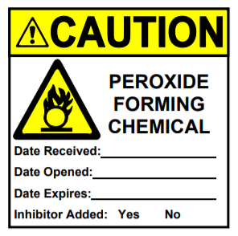
Tar Heel Safety: Peroxide-Forming Chemicals
UNC EHS classifies peroxide-forming chemicals into three categories or “lists”
List A: Compounds that form peroxides that may explode even without concentration.
List B: Chemicals that are dangerous when concentrated by distillation or evaporation.
List C: Substances for which peroxide formation can initiate explosive polymerization of monomeric forms.
UNC EHS Lists: https://policies.unc.edu/TDClient/2833/Portal/KB/ArticleDet?ID=132025
Labelling Peroxide-Forming Chemicals
Label peroxidizeable materials with the date received, date opened and expiration date.
Labels are available at: https://ehs.unc.edu/lab/labels/
Testing, Storage, and Disposing of Peroxide-Forming Chemicals
Evaluate and test List A materials every 3 months. If peroxides are detected, call EHS for assistance and submit a disposal request through EHS.
Evaluate and test List B and List C materials every 12 months. If peroxides are detected, call EHS for assistance and submit a disposal request through EHS.
Uninhibited List C materials should only be stored for 24 hours
The suggested safe storage period if unopened from a manufacturer is up to 18 months from receipt or stamped expiration date, whichever comes first
All peroxide forming chemicals should be labelled with the appropriate tag (see above).
Discussion Questions: What peroxide-forming chemicals do you have in your lab? When should you test a chemical for peroxides? When should you dispose of a peroxide-forming chemical? What should you do if a chemical forms peroxides within your lab?
Resources: UNC Policy – Safe Handling of Peroxidable Compounds – https://policies.unc.edu/TDClient/2833/Portal/KB/ArticleDet?ID=132025

