Slide 1
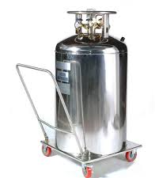
Tar Heel Safety: Liquid Nitrogen
Asphyxiation
Displaces oxygen in confined spaces
Ensure good ventilation during use and transport
Cold burns/frostbite
Use cryogenic gloves, in addition to traditional PPE to prevent cold burns
Fill containers slowly to prevent splashing
Condensing Liquid N₂, O₂, or Ar is possible
N₂ boiling point: -196 ⁰C
O₂ boiling point: -183 ⁰C
Ar boiling point: -186 ⁰C
Condensed gases can create a potentially flammable or explosive condition and is possible when using glovebox traps, Schlenk lines, etc.
If present, alert lab members/safety officers/PI, replace traps, turn vacuum back on, set up blast shield, evacuate lab
Prevent Pressure Build-up
Only store in approved vessels, like dewars. Never store in closed vessels.
Discussion Questions: How does your lab use liquid nitrogen? What safety concerns should you consider when using liquid nitrogen?
Resources: https://www.monash.edu/ohs/info-docs/chemical-management/handling-and-storage-of-liquid-nitrogen

