Slide 1
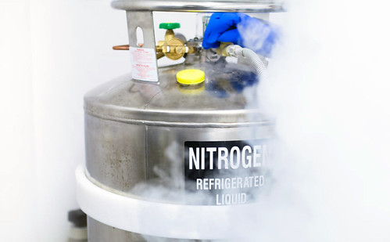
Tar Heel Safety: Elevators and Off-Gassing Substances
Riding in an elevator with a cylinder of liquid nitrogen (or dry ice, or any other off-gassing substance) poses an asphyxiation risk!
If the off-gassing substance must be transported with an elevator, take the following actions:
Move the off-gassing substance into the elevator.
Press the cylinder destination floor button.
Exit the elevator before the doors close!!
Take the stairs to the destination floor!
It may be helpful to have a buddy waiting on the destination floor for the off-gassing substance to avoid the exertion of quickly ascending (or descending) a staircase!
For more information, read:
University of Nebraska-Lincoln announcement: https://newsroom.unl.edu/announce/procurement/6806/38400
University of British Columbia Safe Work Practice Protocol (start of Section 3): http://chem.ubc.ca/sites/default/files/users/programassistant/ln2_handling_2018-09-10.pdf

