Slide 1
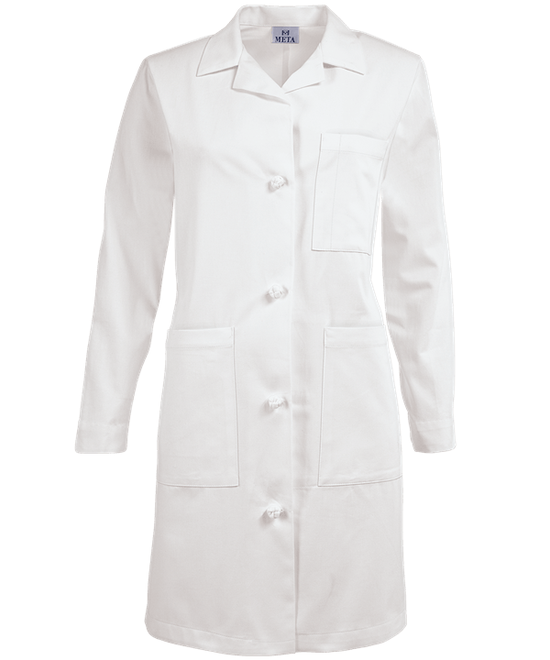
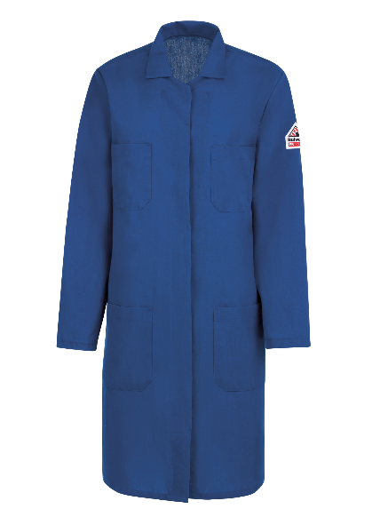
Tar Heel Safety: Lab Coats
General Practices
Wear your lab coat at all times to prevent incidental & unexpected chemical exposures. Even if you are doing something that is low risk; others around you may not be.
Keep lab coat buttoned & sleeves rolled down.
Choosing lab coats with “knots” and “snaps buttons”, instead of traditional buttons can provide easy removal
Keep lab coat in your workspace. This prevents contamination of other areas.
Lab coat laundering is available
Cotton Lab Coats:
Appropriate for general use, where risk of fire is low
Better than synthetic blends, which can dissolve and/or melt to your skin & adhere to the wearer
Nomex Lab Coats:
Excellent heat resistance and recommended when using pyrophoric chemicals
Does not melt or ignite at normal levels of oxygen
Cotton Lab Coat
Nomex Lab Coat
Discussion Questions: When should you wear a lab coat? Does your lab use different types of lab coats? Resource: Watch it Burn – Demonstration of Nomex Lab Coats – https://www.youtube.com/watch?v=VUptxukY8_k

